Slide 1
Sparse Convolution
Kiefer Selmon

Slide 2
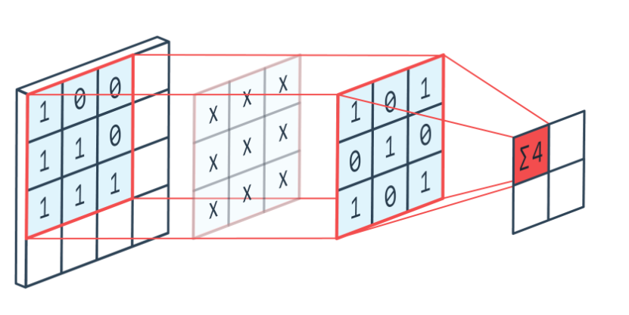
Goals
Create a convolution implementation that exploits sparsity
Analyze the sparse implementations interactions with the underlying hardware
Visualize the sparsity patterns in the weights
Use visualizations to guide future implementations
Source: https://peltarion.com/knowledge-center/documentation/modeling-view/build-an-ai-model/blocks/2d-convolution

Slide 3
Selecting the Workload
Need a convolution operation to use as a case study
Selected the 4th convolution layer from Alexnet
2nd longest execution time using GPU
Largest memory footprint

Slide 4
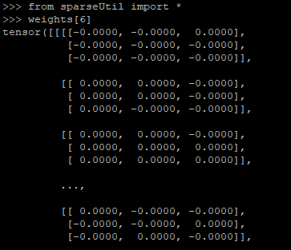
Workload
Trained on CIFAR10 dataset
Pruned and re-trained using a tool called condensa
Resulting layer is ~99% sparse
Weights are a 4D matrix of shape (256, 384, 3, 3)

Slide 5
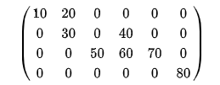
Sparse representation
Using Compressed Sparse Row (CSR) format to store the weights
CSC stores only the nonzero elements of the array
This allows the implementation to stream over only non-zero elements
V = [ 10 20 30 40 50 60 70 80 ]
COL_INDEX = [ 0 1 1 3 2 3 4 5 ]
ROW_INDEX = [ 0 2 4 7 8 ]
Source: https://en.wikipedia.org/wiki/Sparse_matrix

Slide 6
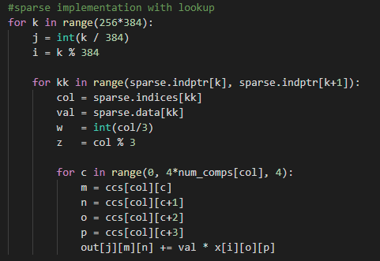
Implementation
Prototype implementation in python
Soon to be C++
Uses CSC format to compute only the non-zero elements

Slide 7
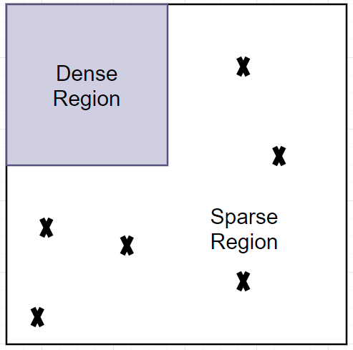
Next Steps: Visualization for heterogeneous execution
Identify opportunities to offload dense regions to GPU
GPU is really good at handling highly parallel computationally dense workload
Compute sparse region using CSC format on the CPU

Slide 8
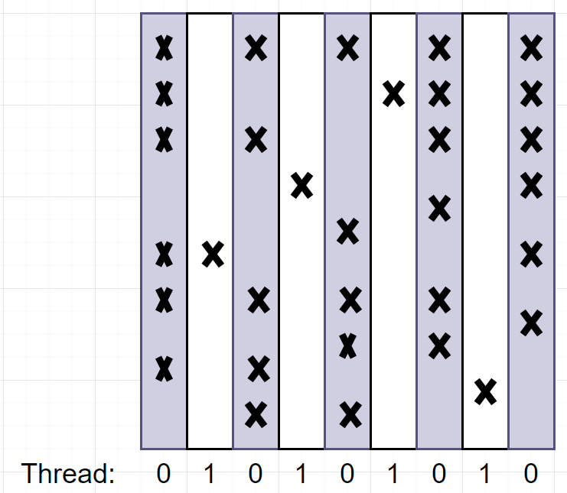
Next Steps: Visualization for load balancing in a homogenous architecture
Identify how load can be properly distributed in a multicore environment
Example:
Parallelized about the columns
2 threads assigned work in a round robin style
Thread 0 ends up with all the work

Slide 9
The End
Questions?

