Slide 1
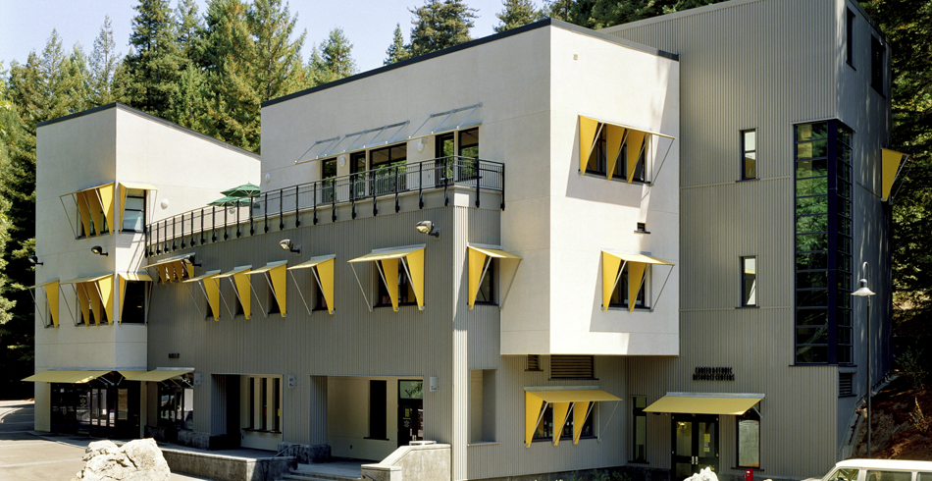
Career Center Services
Bay Tree Building
careers.ucsc.edu
(831) 459-4420
M-F 8:00-5:00

Slide 2
Our Services
Career Coaching
Career Assessments
Part-Time Job
Internship/Job Search
Career Fairs (every quarter)
SlugQuest (job database)
Resume & Letter Critiques
Mock Interviews
Workshops (every quarter)

Slide 3
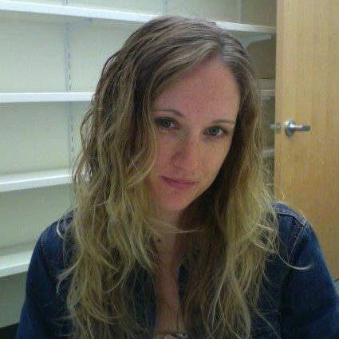
Drop-In Coaching
Resumes, CV and Cover Letter Reviews
On and Off Campus Jobs Opportunities
How to use Career Center Online Resources
Fridays, 9am-1pm
Graduate Student Commons
(but not this Friday!)

Slide 4
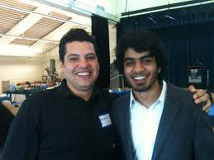
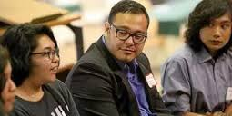
Multicultural Career Conference
Every Winter Quarter
A Day to Connect with UCSC Alumni of Color
Safe Space to Engage in Honest Dialogues
Network and develop career strategies
Meet alumni from diverse backgrounds to discuss careers, internships, and graduate school experience
Come enjoy a day that includes:
Panels • Career Information • Raffle Prizes • Great Food

Slide 5
Ways to Connect with Employers
On-Campus Interviews
(apply through SlugQuest for positions)
Information Sessions
(check CC calendar online)
Career Fairs
CECI Fall Fair
November 01, 2016
Computing/Engineering Career & Internship (CECI) & Gaming Fair
February 1, 2017

Slide 6
Are you a Computer Science or Engineering student looking to work for in the technology field? This is your chance to meet with representatives from tech firms and government entities to find out about career opportunities. Bring multiple copies of your resume, dress professionally and be prepared to interview. Student ID is required for entrance. Another CECI Fair will be hosted in Winter!
Tips to Get the Most Out of Job Fairs
Companies Scheduled to Attend:
(List will be updated frequently)
Arista Networks
Cisco Meraki
Commvault
DataCare
Google
eBay
HP-HPE Storage Division
iD Tech
Riverbed Technology
Tata Consultancy Services
The Wine Group
Veritas Technologies, LLC.
organizations to harness the power
Xilinx
What Employers will attend?
8x8, Inc
Amazon
Arista Networks
Cisco- Meraki
Commvault
DataCare
Dell EMC
eBay
Google
HP-HPE Storage Division
iD Tech
Jolokia Corporation
Microsoft
Mimosa Networks
Prysm, Inc.
RBC Bearings
Riverbed Technology
Tata Consultancy Services
The Wine Group
United States Air Force
Veritas Technologies, LLC.
Xilinx

Slide 7
PUTTING CAREER FAIR MYTHS TO REST
Myth #1: All I need to do is “show up” the day of the event.
MYTH # 2 It’s ok to show up in my jeans and UCSC sweatshirt.
MYTH # 3 I should go to the Career Fair only if I’m looking for a full-time job.

Slide 8
But what if I’m not ready to look for a job or internship? Should I still attend?
YES!
To eavesdrop
To practice for when it DOES matter
To learn about what opportunities are out there
Your time will come!

Slide 9
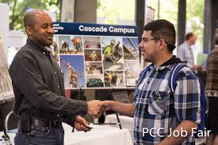
EMPLOYER EXPECTATIONS
What do Employers Expect of You?
Have some knowledge of the company/organization
Have an idea of the type of industry/position you might be seeking in the future
Dress professionally
Prepared to answer questions
Prepared to ask thoughtful questions
Follow-up after the fair

Slide 10
BEFORE THE FAIR
5 THINGS TO DO:
Get resume critiqued
Draft and rehearse your 15-second commercial
Prepare your attire & gather important items
Conduct company research and prepare questions
Clarify your career goals

Slide 11
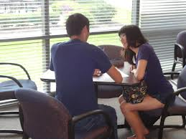
1. GET RESUME CRITIQUED
Have your resume critiqued through: Drop-In Coaching
Monday-Friday 8-5 at the Career Center

Slide 12
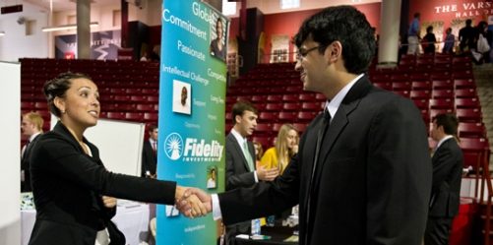
2. CRAFT YOUR 15-SECOND COMMERCIAL
Basic Formula:
Name/Major
Something about yourself (present or past experience)
Something about them
What position you’re looking for
Question
Practice until it sounds natural to both you and the other party!!

Slide 13
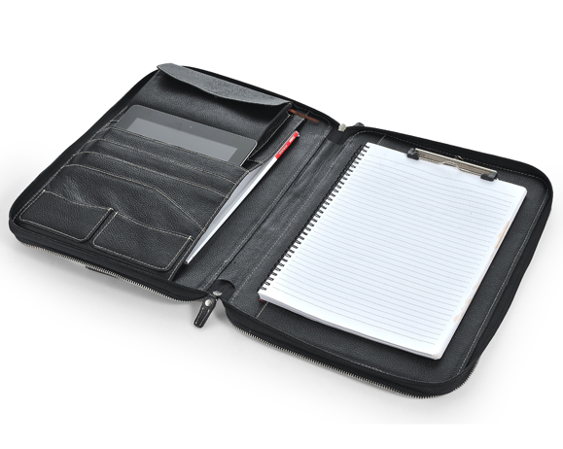
3. GATHER THESE ITEMS
Several copies of your resume
A portfolio to keep your resumes, employer’s business cards, notepad, etc. (a plain folder is okay too)
Pen
*There will be a backpack check
A wise and useful
investment you will
use your whole life!

Slide 14
3. PREPARE YOUR ATTIRE

Slide 15
Dress
as if
you were
going
to a
job
interview
Wear comfortable shoes – you will be on your feet and waiting in line

Slide 16
4. CONDUCT COMPANY RESEARCH
Mission statement
Product line, industry, service, clients, potential markets
Size
Location
Past, current, and potential growth
Competition
Recent news items, trends, problems
Positions available – apply online ahead!
Websites to Conduct Research
www.glassdoor.com
www.linkedin.com
Google News
Their social media

Slide 17
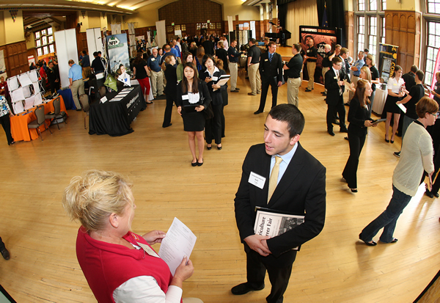
PREPARE QUESTIONS FOR RECRUITERS
What kind of skills/characteristics are you looking for when you recruit?
What can I do now to prepare for a career in your organization or industry?
What career paths are available?
What challenges/trends are you seeing?
What role does the career fair play in recruiting for your company?
“I read that…..” “Can you tell me more about…….?”

Slide 18
5. CLARIFY YOUR CAREER GOALS
Recruiters are not interested in an unfocused student who will take “any job,” or is “open to anything.”

Slide 19
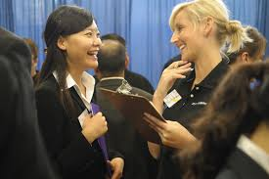
DURING THE FAIR
General Tips:
Be polite and courteous (thank you, please, excuse me).
Pay attention. Listen to what employers are telling you.
Don’t interrupt.
Speak clearly and loudly enough to be heard through the noise.
Be patient while waiting in line. Make small talk with others.

Slide 20
DURING THE FAIR
TIP: WARM UP
Start with the companies in which you're the least interested to practice your approach & commercial.

Slide 21
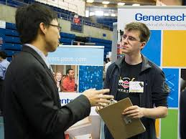
PRESENTATION SKILLS
Be mindful of your verbal communication
Speak clearly and concisely
Provide brief, targeted answers to questions
Provide complete and articulate responses
Show interest, energy, enthusiasm
Be confident and self-assured
Demonstrate your preparedness through your questions/answers

Slide 22
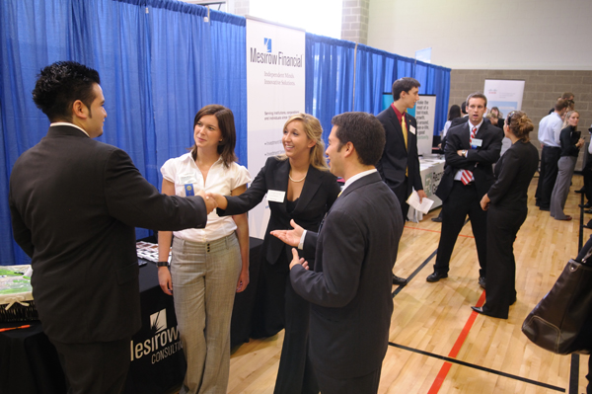
PRESENTATION SKILLS
Be mindful of your non-verbal communication
Eye contact
Firm handshake
Demonstrate poise and composure
Avoid distracting mannerisms
Smile
Exude confidence!

Slide 23
AFTER YOU MEET
Jot down some notes
Use back of business card if possible.
What did you discuss?
How will they remember you?

Slide 24
AFTER THE FAIR
Send a thank you email
Reflect upon your approach and interactions.
What went well?
What would you do differently?
Did you learn anything about yourself or a potential employer?

Slide 25
COMMON MISTAKES
Inappropriate attire
Failure to do research on participating companies
Running out of resumes
Not showing enthusiasm & confidence
Bringing food or drink to the recruiting tables
Taking the “freebies” and walking away
Forgetting to follow-up with a thank you email
Attending with a group of friends and not leaving their side
Monopolizing the recruiter’s time
Leaving your resume without talking to someone

Slide 26
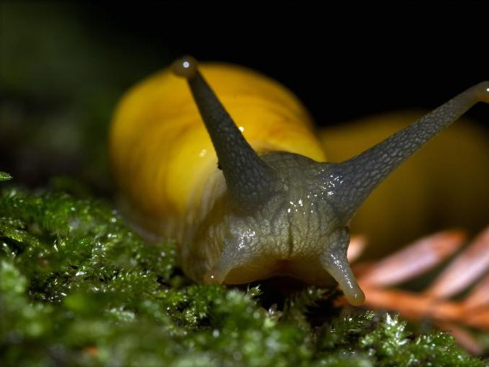
QUESTIONS?

