Slide 1
Current and Future Projects
For the UCSC Genome Informatics Group
aka Browser Staff

Slide 2
Our Goals
Encourage understanding of basic biology
Help develop of new medical therapies
Promote cooperation and collaboration in research
Enjoy our work

Slide 3
Projects in the works
Basic Bio
Genome Browser and associated web works + database
Data Coordinating Center for scientific consortia
Gene sets
Comparative genomics
Regulatory elements
1000 Genome Project (Normal human variation)
10000 Vertebrate Genomes
Medical
Cancer browsers
Copy number variation in pediatric patients
FACE-base
Linking variations in genotype to variations in phenotype
Games to promote physical activity

Slide 4
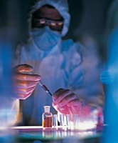
Basic bio

Slide 5
Genome Browser etc.
Will be subject to it’s very own meeting in a few weeks.
Likely will need 40%-60% of staff time for the next few years anyway.
Changes to further improve handling of distributed data
Continued integration of high quality data sets
Web services development to make it easier for third party tools to integrate our data
Work to make it easier to set up “modified mirrors” and to make it possible for UCSC to easily import data from them.

Slide 6
Data Coordinating Center Work
Almost every new large scale research effort now includes a data coordinating center (DCC).
Our grant to be the DCC for ENCODE runs 2 more years
Do we want to do more work like this?
The grants are relatively easy to get for us
Gets interesting data into our web works
Puts us in a bureacratic/enforcement role
Maybe wait and see how the new wranglers enjoy it
Funding – currently ~6 FTE ENCODE?

Slide 7
Gene Sets
At ENSEMBL the gene build is considered ~50% of their work, here it’s Hiram and me maybe 20% time.
Worth investing more?
High value, relatively easy to make our own RNA gene set.
High value, difficult to expand set to new organisms. (Would need new techniques.)
High value, difficult to integrate RNA-seq data into gene set.
Moderate value, moderate difficulty to update UCSC genes more often. We have automated about as much as it can go, would need to train and devote an engineer or two half time to it.
Funding? 1 FTE browser + 1 FTE various?

Slide 8
Comparative Genomics
Current lastz/multiz approach invaluable to research but will only scale to 50 or so.
David H. has group working on newer approaches with the hopes that they will scale and also yield more info.
Should browser staff get more involved?
Will Brian want to leap back in after ENCODE?
Do we want to build and publically release browsers on reconstructed ancestors?
Have we already reached point of diminishing returns on vertebrates?
Really do need 100’s if not 1000’s to do good protein level conservation plots on just vertebrates.
Funding? 1 FTE to maintain 50 genome lastz/multiz on browser.

Slide 9
Regulatory Elements
Predicting regulatory elements (REs) today much like predicting exon/introns was 10 year ago:
Enough experimental data available (from ENCODE, elsewhere) to paint >50% of elements
Data is scattered all over the place, needs synthesis
Reasonable to think that could develop methods that would predict 80-90% of true REs with 80-90% specificity.
ENSEMBL has done this, but it is pretty weak.
Strong personal research interest for Jim
Funding – ENCODE + Browser. ~1 FTE

Slide 10
Cataloging human variation
We’re just playing a peripheral role in the 1000 genomes project.
In general though having a catalog of normal human variation is critical to most medical genomics projects.
What mutations are tolerated in one copy of a gene
What mutations are tolerated in both copies
What genes can function with just a single working copy
What genes can function with extra copies
Likely our role will be mostly integrating in work from outside, but some new browser displays and some diploid displays may be helpful.
Funding? Browser grant mostly. ~1 FTE

Slide 11
10000 Vertebrate Genome Project
Another of David H’s grand ideas
Lots of enthusiasm for it in the sequencing community, the wildlife conservation groups, and the organismal biologists
Mark D has done some preliminary work, useful in keeping track of samples
Would need to design alignment, gene prediction, visualization systems from scratch to handle the scale.
Funding? HHMI 0.5 FTE?

Slide 12
Medically Oriented Projects

Slide 13
Cancer Genome Browser
Prototypes are very well received
Very productive group of grad students and post docs working on it.
Would be good to start having more regular engineering staff and quality assurance involvement
Have funding now to turn into products. 5 FTE on top of existing team??

Slide 14
Face Base
Image database for purposes of pediatric genetic diagnosis.
Images need to be kept very confidential – parents do *not* want to see their kid’s face on the internet.
Might be good for Galt in that involves security and likely to share code with VisiGene.
Good to keep Chris in cancer group in the loop as he has also been making an image browser that leverages the VisiGene source.
Funding - Bob K is PI, ~1 FTE UCSC

Slide 15
Copy # Variation in Pediatrics
Collaborative grant with David Ledbetter from Emory and various clinical genetic testing facilities.
Organize and display copy number variation genotype data from pediatric patients with developmental problems.
Ideal outcome would include a haplosufficiency map of human genome.
Confidentiality of data map is built on must be maintained.
Thorgier Thorgierson has scientific interest in this.
Funding: Bob K is PI, ~1 FTE UCSC

Slide 16
Genotype/Phenotype Associations
Another place we hope we can work with Thorgeir.
We can no longer put up most medical genome association studies in detail.
With so many studies these days though, a summary track of just the biggest significant peaks of peer reviewed studies might be of more interest to more people.
Non-disease genotype/phenotype associations are interesting too, and are produced by many research groups including thouse at 23andme.
Funding? Probably could justify at least 2 fte on browser grant.

Slide 17
Games to promote physical activity
Perhaps a potent way to battle childhood obesity
May be helpful to many adults as well – cardiovascular problems bigger killer than cancer!
“Pocket” games put an acceleration sensor in the pocket. Game-play requires ongoing motion of the thighs (and hopefully other major muscles).
I-phone pocket apps that link music to motion
Wii pocket apps put main controller in pocket, navigate with nunchuk
Hula hips propel boats
Side to side sway propels fish
Jump to jump….
Walk in place to climb
Work with video game development class here at UCSC?
Funding – Jim 1 month concept development at this stage.
Apply for NIH grants once have storyboards?

Slide 18
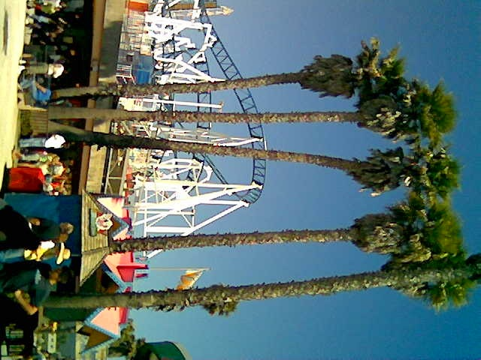
Or give it all up for a nice job at the boardwalk?

Slide 19
Concluding thoughts
Have successfully diversified funding
Work will become likely more closely linked to medicine over time.
More data will be private
May increasingly have semi-specialized sub-teams
I’ll put up a doodle poll shortly to get an idea what projects people are most interested in working on.

