Slide 1
Geospatial Graphical Models of Human Response to Emergencies
Adrian Dobra
Nathalie Williams
Michelle O’Brian

Slide 2
Big Data for Demography and
Public Health
Migration (more permanent move patterns)
Mobility (movement over short or long distances over short or long periods of time)
Likely factor in understanding:
  Social behaviors
  Macro-level social change
  Associated key issues in society
    Spread of infectious diseases
    Health behavior and outcomes
    Economic, social and political wellbeing

Slide 3
Sources of Human Geolocated Data
Geolocated residential histories
Geolocated social media data
Individual GPS traces
  Obtained from GPS devices worn by study participants for a predetermined period (e.g., 1 year).
Individual call detail records (CDRs)
  Obtained from phone companies based on consent from study participants (known cell phone numbers used by each individual)
Collective call detail records
  Possibly millions of individuals

Slide 4
Our Event Detection System
Cell phone data from a major telecom provider in Rwanda (Jan 2005 - May 2009)
  Call detail records (CDRs): unique identifier of the caller and the callee; identifiers for the initial and final cellular antennae (towers) that handled the call; the date and time the call was placed, as well as the duration of the call.
  The locations (latitude and longitude) of cellular towers.
  One CDR + the location of the tower that handled the call = the approximate location of the caller when placing the call.

Slide 5
Dynamics of CDRs
Number of callers
Active towers and sites
Active Sites October 2005

Slide 6
Mobility Measures:
Most/Least Mobile Individuals
Number of towers used
Maximum distance between towers
Radius of gyration
Area of the convex hull
Perimeter of the convex hull
Area per tower used

Slide 7
Mobility Measures
Based on Road Network

Slide 8
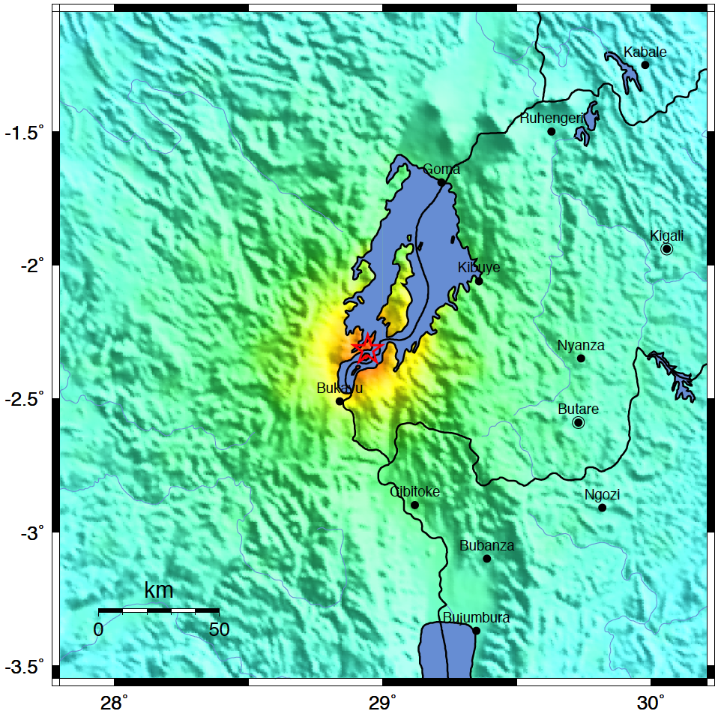
Outlier Event: Earthquake, Lake Kivu Region
Background information
  Magnitude: 5.9
  Date: February 3, 2008
  Time: 09:34:12 AM at epicenter
  Location: LAT=-2.302, LONG=28.9475
  Depth: 10 km (6.2 miles)
  Location uncertainty: 5.7km (3.5 miles)
  Location of Site 361

Slide 9
Call Volume for Site 361
Calling behavior of the people who made at least one call from at least one cellular tower located in site 361 between January 24, 2008 (10 days before the Lake Kivu earthquakes) and February 13, 2008 (10 days after the Lake Kivu earthquakes). The side-by-side boxplots represent the distribution of the number of calls made by these people in each of the 21 days. The squares indicate the total number of calls made in site 361 in each of the 21 days.

Slide 10
Movement Frequency for Site 361
Mobility behavior of the people who made at least one call from at least one cellular towers located in site 361 between January 24, 2008 (10 days before the Lake Kivu earthquakes) and February 13, 2008 (10 days after the Lake Kivu earthquakes). The side-by-side boxplots represent the distribution of the movement frequency of these people on each of the 21 days.

Slide 11
Our Approach to Identifying Behavioral Anomalies
It involves two steps:
Identifying days with anomalous human behavior at one site
Identifying days with anomalous human behavior at multiple sites

Slide 12
Daily Call Volume Time Series
for Site 361
The means of the estimated probabilities of making more calls are shown in blue. The gray band gives the intervals between the 2.5% and the 97.5% quantiles of the estimated probabilities. The dots indicate which days in this time series are extreme positive outliers (red) and extreme negative outliers (green). The red (green) squares indicate the confidence probabilities that a day is a positive (negative) extreme outlier. The confidence probabilities are shown only for the days that have been classified as an
outlier at least once.

Slide 13
Daily Movement Frequency Time Series for Site 361
The means of the estimated probabilities of being more mobile are shown in blue. The gray band gives the intervals between the 2.5% and the 97.5% quantiles of the estimated probabilities. The dots indicate which days in this time series are extreme positive outliers (red) and extreme negative outliers (green). The red (green) squares indicate the confidence probabilities that a day is a positive (negative) extreme outlier. The confidence probabilities are shown only for the days that have been classified as an outlier at least once.

Slide 14
Sites with Unusually High Behavior on February 3, 2008

Slide 15
Sites with Unusually Low Behavior on February 3, 2008

Slide 16
Matching Events with Human Behavioral Anomalies

Slide 17
Sites with Unusually Low
Behavior on April 7,8 2007,2008
Matched Event: Commemoration of the genocide against the Tutsi (April 7)

Slide 18
Sites with Unusually High
Behavior on December 31, January 1
Matched Event: New Year's Eve and New Year's Day

Slide 19
Sites with Unusually High
Behavior on December 24
Matched Event: Christmas Eve

Slide 20
Sites with Unusually Low
Behavior on November 19, 2008
Matched Event: Protests in Kigali
On the that day reports indicate
that tens of thousands of Rwandans participated in a series of protests over the arrest in
Germany of Rose Kabuye, a prominent Rwandan military and political figure, on alleged involvement in the plane crash that led to the 1994 genocide against the Tutsi.

Slide 21
Sites with Unusually Low
Behavior on April 24 and 25, 2008

Slide 22
Papers
Dobra A, Williams NE, Eagle N (2015). Spatiotemporal Detection of Unusual Human Population Behavior Using Mobile Phone Data. PLoS ONE 10(3): e0120449.
Williams NE, Thomas TA, Dunbar M, Eagle N, Dobra A (2015). Measures of Human Mobility Using Mobile Phone Records Enhanced with GIS Data. PLoS ONE 10(7): e0133630.

Slide 23
Research Goals of Our Current Project
Build a corpus of geolocated emergency and non-emergency events that occurred in sub-Saharan Africa and Nepal.
Develop state of the art machine learning models that detect geospatial clusters of locations with anomalous human behavior, and produce advanced GIS visualizations.
Create a catalogue of behavioral signatures characterizing emergency and nonemergency events.

Slide 24
Data for Our Current Project
Geolocated Twitter Data
South Africa
Number of geotweets: 46,210,370
Number of Twitter users: 501,346
GNIP data start/end dates: 2011/09 – 2016/09
Twitter REST API start/end dates: 2016/01 - 2016/12
Number of unique hashtags: 2,375,694
Nepal
Number of geotweets: 3,378,637
Number of Twitter users: 22,148
GNIP data start/end dates: 2015/01 – 2015/10
Twitter REST API start/end dates: 2016/01 - 2016/12
Number of unique hashtags: 317,377

Slide 25
Data for Our Current Project
Events Data
Sources:
Global Database of Events, Location and Tone (GDELT) project (acleddata.com)
Armed Conflict Location and Event Data (ACLED) project (data.gdeltproject.org/events)
Integrated Crisis Early Warning System (ICEWS) (dataverse.harvard.edu)
ReliefWeb - a service of the UN Office for the Coordination of Humanitarian Affairs (http://reliefweb.int)

Slide 26
Data for Our Current Project
Events Data
South Africa
Major disasters: floods in January 2011 and March 2014
35,442 geolocated violent events/unrests
Nepal
Major disasters: the Gorkha earthquake on April 25, 2015 killed 9,000 people and injured 22,000.
12,291 geolocated violent events/unrests

