Slide 1
Nonlinear Hyperspectral Clustering,
Anomaly Detection, and Active Learning
James M. Murphy, Department of Mathematics
Mauro Maggioni, Department of Mathematics,
Department of Applied Mathematics and Statistics,
and Institute of Data Intensive Engineering and Science

Slide 2
Hyperspectral Images (HSI)
High dimensional images:
The spectral bands are localized at certain electromagnetic frequencies, allowing for precise differentiation of materials in scene.
Learning Problems: clustering, anomaly detection, active learning, classification, segmentation, compression…
Spatial Spectral
Subset of Pavia dataset, sum of all bands (sum across )
Ground Truth
http://www.ehu.eus/ccwintco/index.php?title=Hyperspectral_Remote_Sensing_Scenes

Slide 3
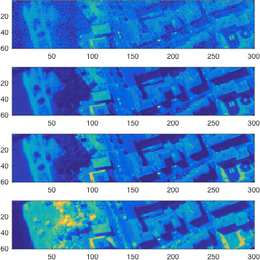
Individual Spectral Bands
Band 2
Band 20
Band 40
Band 102

Slide 4
Three HSI Learning Problems
Clustering: Label points in the HSI without access to any training labels. Uses inherent structure in the spectral signatures and potential spatial regularity of classes of homogenous materials. (Unsupervised)
Anomaly Detection: Segment a particular class of interest. Special case of clustering.(Unsupervised).
Active Learning: The algorithm is allowed to ask for a certain (very small!) number of points to be labeled. These are chosen with care. (Semisupervised)

Slide 5
Obstructions to Learning HSI
High ambient dimension: Pavia dataset has 102 spectral bands—others over 200!
Nonlinear spectral structure: Bands capture different material properties, and do not correlate with each other linearly.
Large numbers of pixels: Images can easily exceed in spatial size. Combined with the spectral dimension, this data is quite big.
Noise: HSI are prone to noise from a variety of settings, which may affect some dimensions differently than others.
High-dimensional, big data regime

Slide 6
Redeeming Properties
Intrinsically low-dimensional: while the number of spectral bands is high ( ), a lower dimensional ( ) representation may be feasible.
Manifold structure: though nonlinear, the spectra may lie near a
(low-dimensional) manifold characterized by the intrinsic properties of the materials in the scene.
High-dimensional noise: the noise may be understood as additive in the bands, and thus is amenable to robust methods.
Joint spatial-spectral information: the arrangement of pixels for each band is consistent, which introduces spatial regularity that can be exploited.
Robust, nonlinear statistical learning

Slide 7
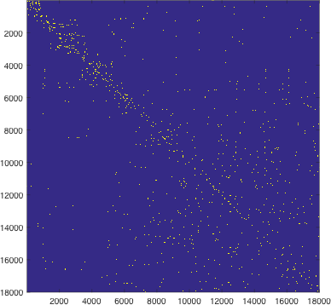
Capturing Intrinsic Geometry of Data
Weight matrix
Construct a weighted graph on the HSI data
Use the graph to generate a Markov process:
Create a distance function based on diffusion with respect to :
Coifman R.R., S. Lafon, A.B. Lee, M. Maggioni, B. Nadler, F. Warner and S.W. Zucker. ”Geometric diffusions as a tool for harmonic analysis and structure
definition of data: Diffusion maps." PNAS 102.21 (2005): 7426-7431.

Slide 8
Exploiting Nonlinear Structure: Diffusion Maps
Compute spectral decomposition
of :
This gives a low-dimensional
representation of a pixel :
Moreover, one can compute:

Slide 9
Approach: Density Estimate+Diffusion Geometry
1.) Mode Estimation: Learn modes of classes by finding high density points that
are -far from other high density points.
2.) Spectral labeling: Label points by finding -nearest neighbor of higher density.
3.) Spatial labeling: Incorporate spatial information for points far from class modes—use spatial regularity to resolve spectral ambiguity.
Learn the centers of the distributions,
which we can label confidently.
Allow these high confidence labels to
spread their labels to (spectrally) nearby points.
Intervene near the class boundaries.

Slide 10
Low Computational Complexity
1.) Mode Estimation: Learn modes of classes by finding high density points that
are -far from other high density points.
2.) Spectral labeling: Label points by finding -nearest neighbor of higher density.
3.) Spatial labeling: Incorporate spatial information for points far from class modes—use spatial regularity to resolve spectral ambiguity.
Overall complexity:

Slide 11
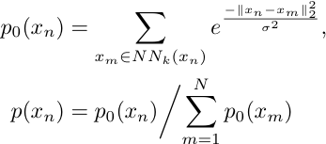
Mode Estimation
1.) Compute empirical density:
2.) Find points that are -far from higher density points:
3.) Estimate modes as maximizers of:

Slide 12
Maximizers of shown in red.

Slide 13
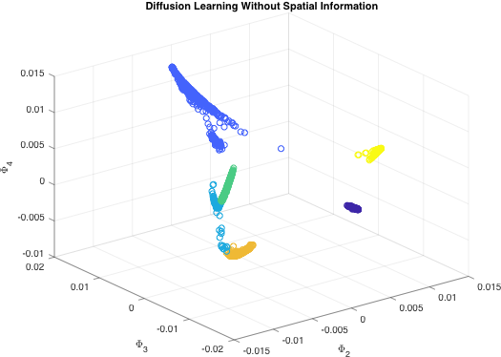
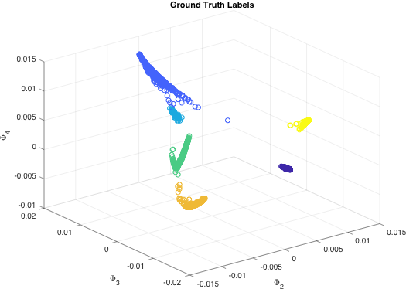
Spectral Diffusion
Spectral information alone makes some errors…brown, green, and sky blue classes are mixed up somewhat.

Slide 14
The value of spatial information
Spectral information only…some problems near class boundaries.
Spectral-only labels

Slide 15
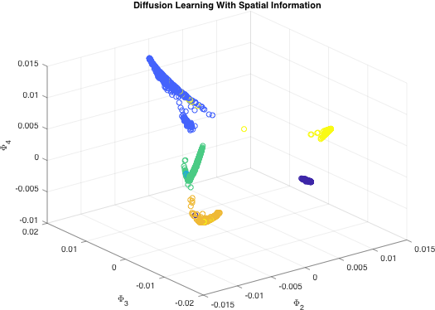
Two Stage Labeling
Stage 1: Only label points that can confidently be labeled with spectral information.
Stage 2: Then, use spatial information to help fill in the remaining, spectral ambiguous points.

Slide 16
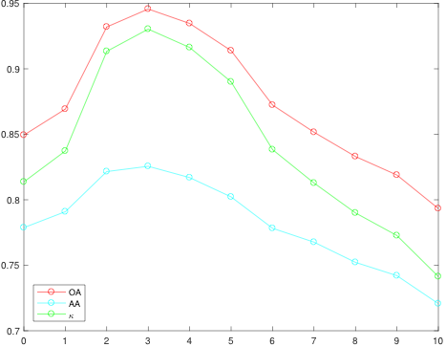
Spatial Regularization: Too Much of a Good Thing?
Empirical Performance with Respect to Spatial Regularization Parameter
Accuracy
Measure
Radius of spatial regularization neighborhood

Slide 17
Empirical results are good…
Spectral-Only
Overall Accuracy:
Spatial-Spectral
Overall Accuracy:
Ground Truth

Slide 18
…and theoretical performance
is guaranteed.
Theorem: If the classes are suitably coherent and separated, then the proposed method correctly determines a unique mode for each class. Moreover, labeling according to nearest -neighbor labels most points correctly.
Diffusion (or at least non-linear) distances are key!

Slide 19
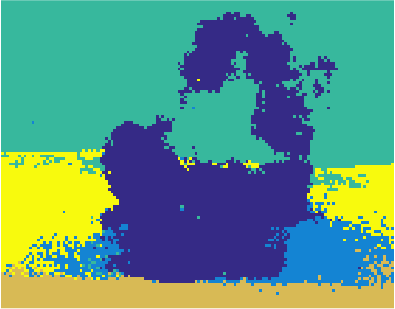
Anomaly Detection: Diffusion Modes + PLSR
In the anomaly detection setting, we wish to identify a special class.
Diffusion mode
estimation
PLSR
Four bands of chemical plume HSI data, courtesy of JHU APL
Segmentation Result
Our method learns modes of a class. These can be used in partial least square regression (PLSR) to perform (linear) dimension reduction in a way that forces these classes apart.

Slide 20
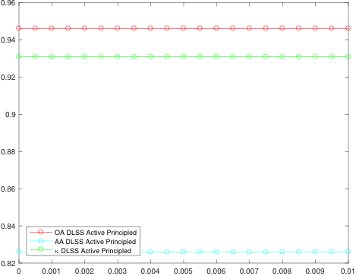
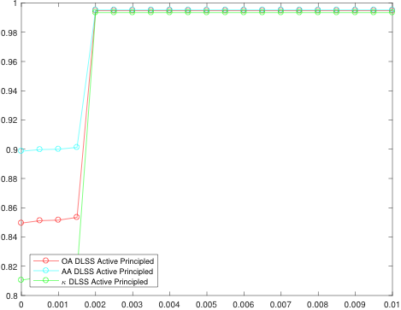
Active Learning: Which Pixels to Query?
Active Learning for Pavia
User is allowed to sample a small number of points. How to choose labels intelligently, so as to maximize their value for the overall learning problem?
Let be the two class modes -closest to a point .
The minimizers of the following should be labeled with ground truth:
Such points are ambiguous with respect to their nearest mode.
Active Learning for Salinas A

Slide 21
Try for yourself!
Algorithms and experiments: Murphy, J. and M. Maggioni. Nonlinear Unsupervised Clustering of Hyperspectral Images with Applications to Anomaly Detection and Active Learning. ArXiv preprint. 2017.
Theoretical results: Maggioni, M. and J. Murphy. and Clustering by Unsupervised Geometric Learning of Modes. In preparation. 2017.
Software and data: http://www.math.jhu.edu/~jmurphy/Code
Thanks for your attention!

