Slide 1
Studying the (in)effectiveness of graph embeddings
C. Seshadhri
(UC Santa Cruz)
Thanks to NSF CCF-1740850, CCF-1813165, CCF-1909790, CCF-2023495, and ARO Award W911NF1910294

Slide 2
Thanks to my teachers
Manindra Agrawal
Bernard Chazelle
Mike Saks
Tamara Kolda
Ali Pinar

Slide 3

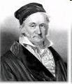






On the importance of networks
The web
Computer networks
Social networks
Cursory slide on why graphs/networks are important
  But you already knew that…

Slide 4
ML on graphs
Community detection
G
Link prediction
Content recommendation
Attribute prediction
Data
Tasks

Slide 5
The ML pipeline
G
Result!
Complex ML machine
How to incorporate “graph structure” in ML task?
Is there a convenient “representation” of vertices?

Slide 6
Graph embeddings
G
Graph embedding
Proximity
≈
Proximity
Edge
Closeness

Slide 7
Graph embeddings
G
Graph embedding
Proximity
≈
Proximity
Convert topology into geometry
Dimension d << n
  n is number of vertices

Slide 8
The promise of graph embeddings
I am not a person,
I am d numbers!
Result!
G
Complex ML machine
Convenient ”task independent” representation
  Can be directly fed as features in any ML pipeline
d << n, so efficient to add in (d = 128, n = 1M)

Slide 9
Very popular area of research
SVD
Laplacian Eigenmaps
GraRep
LINE
HOPE
DeepWalk
node2vec
NetMF
GraphSage
[Hamilton-Ying-Leskovec 18] Survey of methods
G

Slide 10
Low rank factorization
G
Pick your
poison
M
≈
V^{T}
V
Massive history in low-rank factorizations
  Graph ML can piggyback on advances in that area
Embedding becomes optimization problem

Slide 11
Do graph embeddings actually “work”?
G
Result!
Link prediction
Evaluate downstream task (link prediction, community labeling)
Most experiments: embedding methods compared with each other
Anecdotally, adding the vectors to pipeline helps
  Sure, more information is useful. But do you need the embeddings?
[Gurukar et al 19] You can beat embeddings using hand tuned features

Slide 12
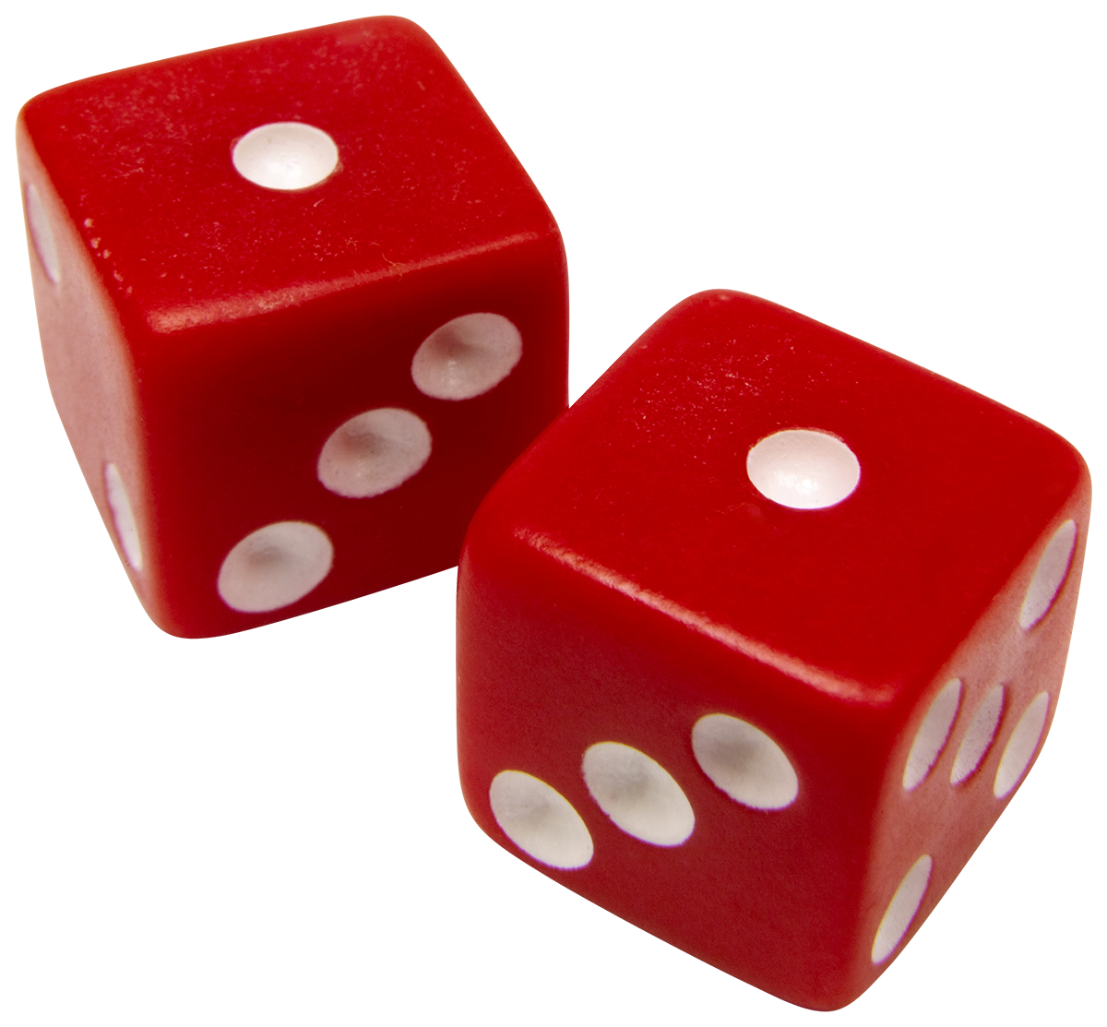
The hidden assumption
Statistical Model
Outcome/observations of model
G
Finding graph
embedding
Buried inside, some assumption on the structure of social network
People are vectors in R^{d}, connect based on geometric proximity, this yields social network
  Finding graph embedding = Finding model parameters

Slide 13
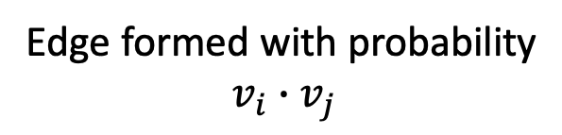
For example
Edge formed with probability
$$v_{i}∙v_{j}$$
G
Geometry represents space of a few “interests”
Edges created by “homophily” (similar interests)
  Often measured as dot product
Can we validate this assumption?

Slide 14
The hidden assumption
Are these assumptions true?
Statistical Model
Outcome/observations of model
G
Finding graph
embedding
Buried inside, some assumption on the structure of social network
People are vectors in R^{d}, connect based on geometric proximity, this yields social network
  Finding graph embedding = Finding model parameters

Slide 15
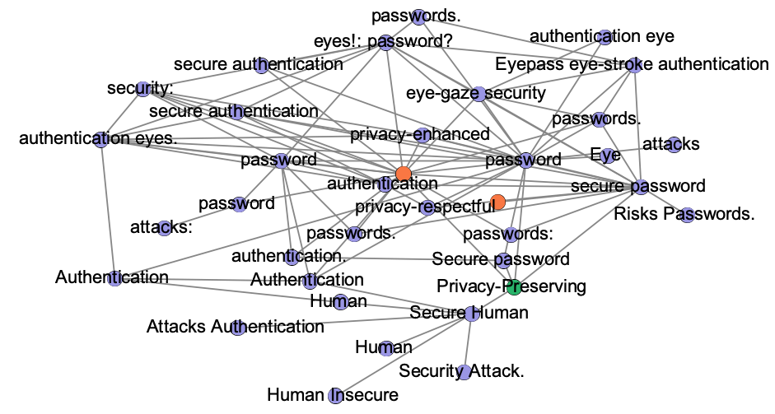
An anecdote
DBLP citation network
  3M vertices (paper), 8M edges (citations)
Get PersonalizedPageRank (PPR) cluster from a paper “On Privacy Preserving HCI Issues”
  Put keyword in title for “related” vertices/papers in cluster
  Green = source, Blue = relevant, Red = not relevant

Slide 16
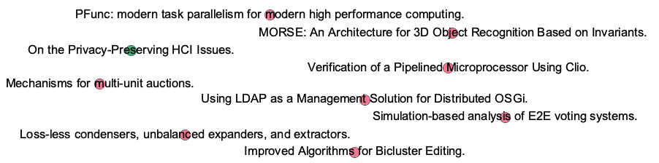
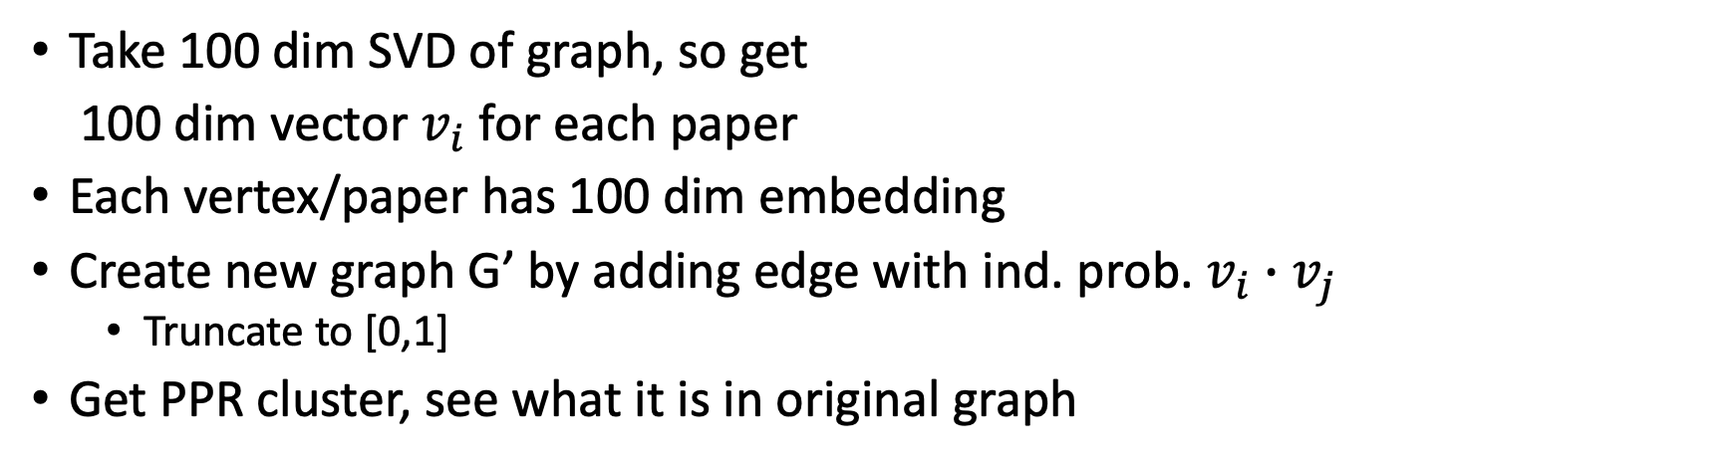
An anecdote
G
M
SVD
G’
Take 100 dim SVD of graph, so get
100 dim vector $v_{i}$for each paper
Each vertex/paper has 100 dim embedding
Create new graph G’ by adding edge with ind. prob. $v_{i}∙v_{j}$
  Truncate to [0,1]
Get PPR cluster, see what it is in original graph

Slide 17
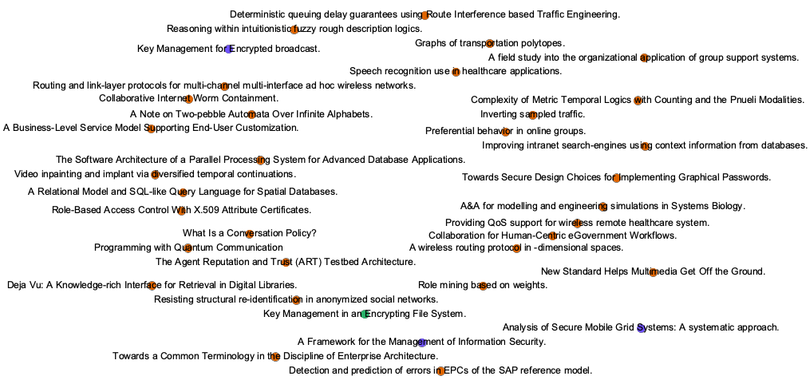
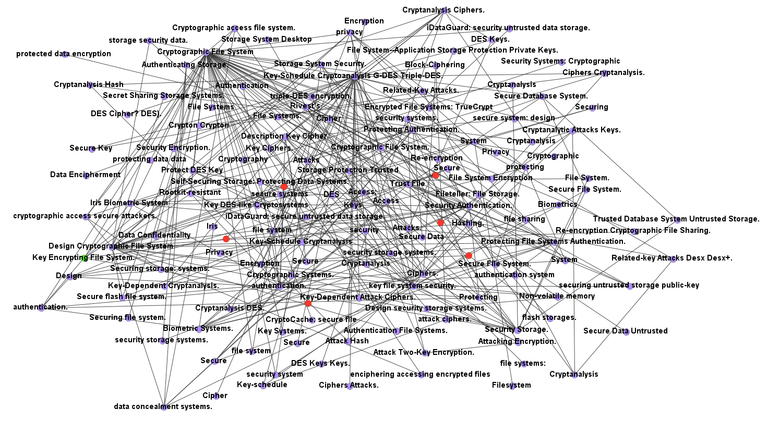
Another anecdote
Again for “Key Management in an Encrypting File System”

Slide 18
How is the embedding missing so much?

Slide 19
The Sandia Connection: circa 2012
How to design good graph benchmarks that “look like” social networks?
Tried to design low dimensional “factor/dot product models” that match social network characteristics
  [S-Pinar-Kolda 11] After having realized that Kronecker models fail

Slide 20
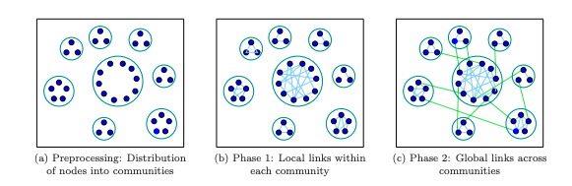
We had our hunches
[S-Kolda-Pinar 13] BTER model for social networks
Came out of inability to design low rank models for such networks
[Ashish Goel-Aneesh Sharma, circa 2017]
“SVD doesn’t work well for recommendations at Twitter,
but everyone wants to use it. Can we prove something?”

Slide 21
The results
Many popular low-dimensional embedding methods fail to capture important structure of real-world networks.
Theoretical and empirical justification
[S-Sharma-Stolman-Goel PNAS 20] Dot product low-rank models cannot produce triangle structure of real-world networks
[Stolman-Levy-S-Sharma, Manuscript 21] Popular factorization-based methods cannot produce communities. They perform poorly on community labeling tasks

Slide 22

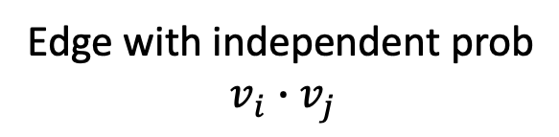
A specific model
n
Edge with independent prob
$$v_{i}∙v_{j}$$
G
$$max⁡(0,\min\left(v_{i}∙v_{j}, 1\right))$$
Prob
Dot product
d
Can also have logistic function with constant parameters
Model used by GraRep, HOPE, LINE (sort of)
Related to SVD, V^{T}V is (low rank) eigendecomposition of probability matrix
If d << n, can this model generate (approximations of) real-world networks?

Slide 23

The significance of triangles
Dense blocks
Clustering coefficient
How often
is edge
present?
What is density
of neighborhood?
Overall sparse graph
Density = edges/$\left({vert \atop 2}\right)$
Well established that real-world networks have many triangles incident to low-degree vertices
High clustering coefficients proxy for community structure (“social structure”)

Slide 24
See for yourself
Graph | n | m | T | cc
ca-AstroPh | 18K | 200K | 1.3M | 0.63
web-Google | 880K | 4.3M | 13M | 0.51
as-skitter | 1.7M | 11M | 29M | 0.26
soc-LiveJ | 4.9M | 86M | 286M | 0.27
com-Orkut | 3.1M | 234M | 628M | 0.17
Clustering coefficient
How often
is edge
present?
Many triangles incident to low-degree vertices
  Ω(n) triangles incident to vertices of degree O(1)
The tension: overall sparse, but neighborhoods are dense
  Overall density < 0.0001, but cc > 0.1
  Need high rank to resolve this tension, a separate dimension for each dense cluster

Slide 25
A convenient metric
Vertices
of deg ≤ c
Δ(c) = (# triangles contained among vertices of degree c)/n
Typically, Δ(10) > 0.1
  For c = O(1), Δ = Ω(1)
  Linear number of triangles among constant degree vertices

Slide 26
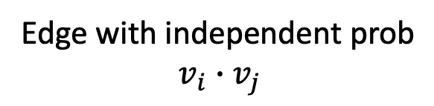
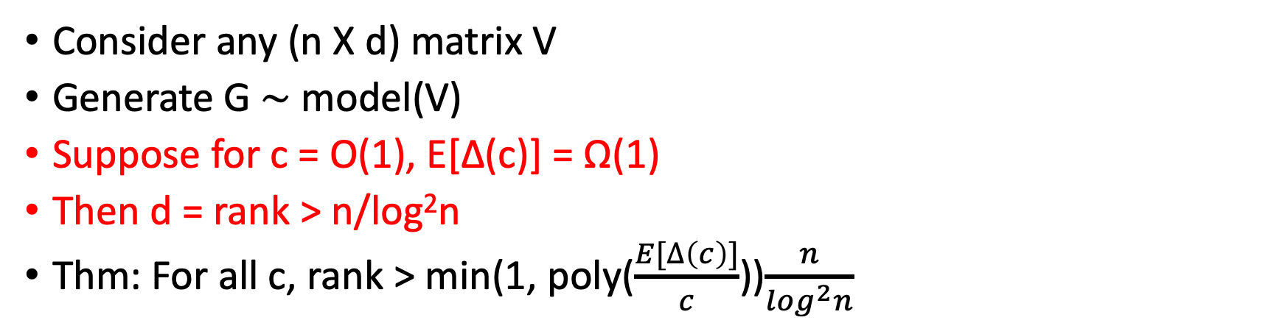

The main lower bound
G
Edge with independent prob
$$v_{i}∙v_{j}$$
$$max⁡(0,\min\left(v_{i}∙v_{j}, 1\right))$$
Consider any (n X d) matrix V
Generate G ∼ model(V)
Suppose for c = O(1), E[Δ(c)] = Ω(1)
Then d = rank > n/log²n
Thm: For all c, rank > min(1, poly($\frac{E[∆\left(c\right)]}{c}$))$\frac{n}{\log^{2}n}$
Vertices
of deg ≤ c

Slide 27
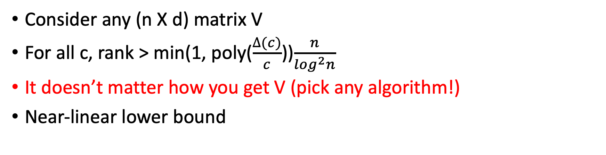
The main lower bound: please note
G
Edge with independent prob
$$v_{i}∙v_{j}$$
$$max⁡(0,\min\left(v_{i}∙v_{j}, 1\right))$$
Consider any (n X d) matrix V
For all c, rank > min(1, poly($\frac{∆(c)}{c}$))$\frac{n}{\log^{2}n}$
It doesn’t matter how you get V (pick any algorithm!)
Near-linear lower bound

Slide 28
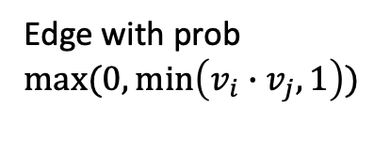
Empirical evaluations
G
Embedding
algorithm
G’
Graph model/distribution
Edge with prob
$$max⁡(0,\min\left(v_{i}∙v_{j}, 1\right))$$
Train model to predict
edges using dot product
Plot c vs Δ(c) for (many) G’
Compare with plot for G

Slide 29
In practice
We took max Δ over 100 samples
Vectors: SVD = 100 dim SVD, n2v = output of node2vec
Models: TDP = basic, LRDP = log. reg. on dot product, LRHP = LR on Hadamard product, softmax = popular normalization

Slide 30
Things to notice
Large gap at small (“constant”) c
Match for total triangle count
Important to consider degree and triangles together

Slide 31
Degree distributions match
“First order” matches, “higher order” fails
Consistent across datasets

Slide 32
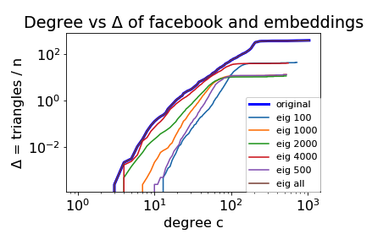
Really need high rank
Even rank 2000 isn’t enough
  n = 4K

Slide 33

Time for some math
Theorem: For all c, rank > min(1, poly($\frac{E[∆\left(c\right)]}{c}$))$\frac{n}{\log^{2}n}$
  Δ(c) = (# triangles contained among vertices of degree c)/n
Consider special case: all $v_{i}$ have same length L
c = O(1), E[Δ(c)] > 1 (triangle-rich)
Graph has at most cn edges (sparse)
V is (d X n) matrix
V

Slide 34
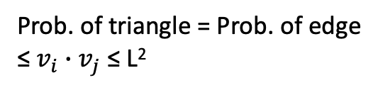
Triangles ⇒ L is large
Expected degree c
Prob. of triangle = Prob. of edge
≤ $v_{i}∙v_{j}$ ≤ L²
Cauchy-Schwartz
E[#triangles this vertex is in] ≤ c²L²
  Linearity of expectation over all potential triangles
E[Δ(c)] = Ω(1), so E[#triangles all c degree vertices are in] > n
c²L²n > n, so L > 1/c

Slide 35


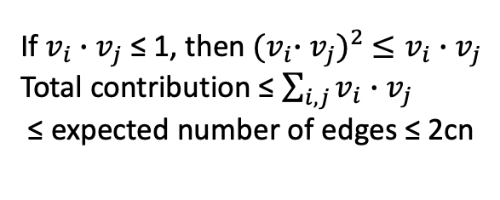
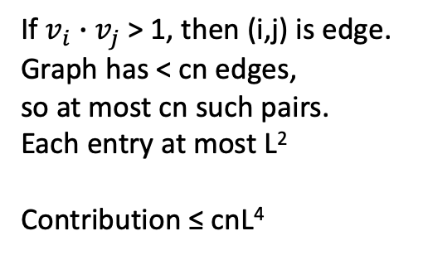
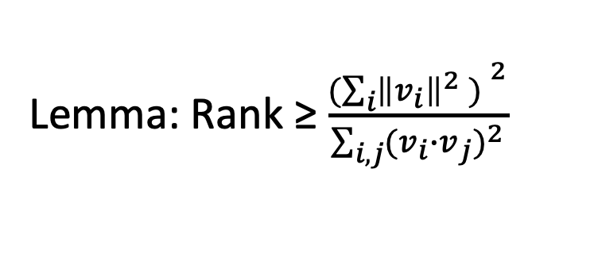
Sparsity + L is large ⇒ Rank is high
Lemma: Rank ≥ $\frac{{(\sum_{i}{{\left\|v_{i}\right\|}^{2} ) }}^{2}}{\sum_{i,j}{{{(v}_{i}∙v_{j})}^{2}}}$
$v_{i}∙v_{j}$
Prob. of edge
(i,j)
V
${\left\|v_{i}\right\|}^{2}$ = L²
If $v_{i}∙v_{j}$ > 1, then (i,j) is edge.
Graph has < cn edges,
so at most cn such pairs.
Each entry at most L²
Contribution ≤ cnL⁴
If $v_{i}∙v_{j}$ ≤ 1, then${ {(v}_{i}∙v_{j})}^{2} ≤v_{i}∙v_{j}$
Total contribution ≤ $\sum_{i,j}{v_{i}∙v_{j}}$
≤ expected number of edges ≤ 2cn
V^{T}V
(nL²)²
n
Rank ≥
=
≥ n/2c⁵
cnL⁴ + 2cn
c(1 + 2/L⁴)
L⁴ > 1/c⁴

Slide 36
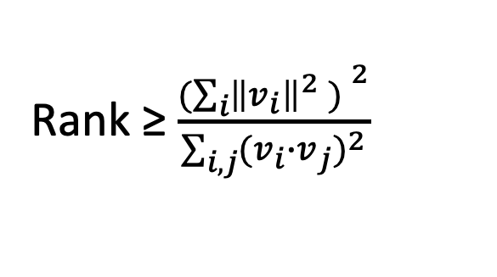
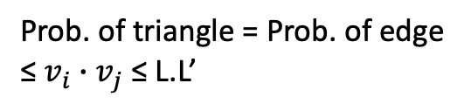
The problem of long vectors
Rank ≥ $\frac{{(\sum_{i}{{\left\|v_{i}\right\|}^{2} ) }}^{2}}{\sum_{i,j}{{{(v}_{i}∙v_{j})}^{2}}}$
Prob. of triangle = Prob. of edge
≤ $v_{i}∙v_{j}$ ≤ L.L’
Long vector
interaction
Cauchy-Schwartz
Too weak!
V^{T}V
Long vectors skew the dot product
What if each orthant had a long vector, with all mutual small dot products? (So their degrees are small)
  2^{d} long vectors creating triangles, leading to rank bound of only (log n)

Slide 37
Packing and cleaning
Spherical packing lemma: if there are more than 4d unit vectors, two of them have dot product > 1/4d
Too many long vectors ⇒ Interaction, creating too many edges
  Sparsity implies few long vectors. Can be removed without removing too many triangles

Slide 38
Binning by length
There exists one “annulus” containing enough “action”
Apply fixed length argument to annulus.
  Loss of (log n) factor because of choosing one of (log n) annuli

Slide 39
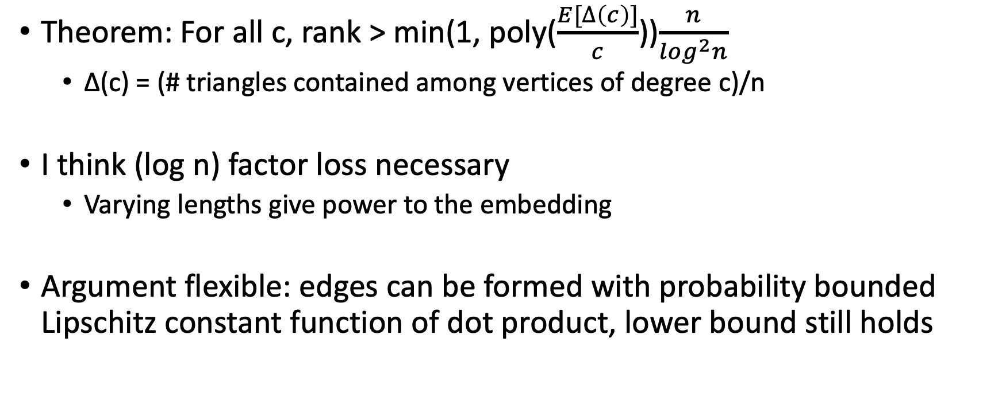
Overall…
Theorem: For all c, rank > min(1, poly($\frac{E[∆\left(c\right)]}{c}$))$\frac{n}{\log^{2}n}$
  Δ(c) = (# triangles contained among vertices of degree c)/n
I think (log n) factor loss necessary
  Varying lengths give power to the embedding
Argument flexible: edges can be formed with probability bounded Lipschitz constant function of dot product, lower bound still holds

Slide 40
Counterpoints

Slide 41

Argument #1: doesn’t capture other methods
Edge with independent prob
G
$$max⁡(0,\min\left(v_{i}∙v_{j}, 1\right))$$
Prob
Dot product
Softmax, steeper logistic function, neural net, etc.
DeepWalk, node2vec use different geometry/kernel, not direct dot product
[Chanupriya-Musco-Tsourakakis-Sotiropoulos NeurIPS 20] Design a new embedding, LPCA, avoiding lower bounds
  LPCA can embed triangle-rich sparse graphs in low dimension
  LPCA can embed any bounded-degree graph in low dimension

Slide 42

Response #1: dot product matters
n
Edge with independent prob
$$v_{i}∙v_{j}$$
G
Dot product is most common model. Need to understand its weakness
Premise that social networks formed by low-dimensional vectors with edges by dot product is questionable
SVD is bad idea for “task-independent” social network analysis
  Embeddings are not silver bullet

Slide 43
Argument #2: I care about downstream ML
Result!
G
Complex machine for ML task
Vectors used for link prediction, community labeling, etc.
  So what if the model doesn’t produce triangles?
Lower bound say nothing about impossibility of these tasks

Slide 44
Response #2: that’s not good science
Result!
G
Complex machine for ML task
Triangle structure fundamental hallmark of real-world graphs with relevance for downstream ML
If premise of the embeddings is wrong, maybe downstream ML works because of artifacts…?

Slide 45
A better response
Binary prediction task
Do i and j
belong to
same community?
G
Dot product or
softmax
Result!
[Stolman-Levy-S-Sharma, Manuscript 21] Popular factorization-based methods cannot produce community structure. They perform poorly on community labeling tasks
Impossibility for dot product and softmax kernels for recreating communities
  Most popular methods (GraRep, LINE, DeepWalk, node2vec)

Slide 46
An experiment
Given two vertices, are they in the same community?
Usually “score” is dot product $v_{i}∙v_{j}$or Hadamard product
4/n
0.2
Precision@10: what fraction of top 10
are in the community?
node2vec, DeepWalk, NetMF, GraRep
SBM: 10⁵ vertices, community size = 20
  Density within = 0.2, 0.4; degree outside = degree inside
How many of the ”geometric/model” neighbors are really neighbors?
  Plot distribution of Precision@10

Slide 47
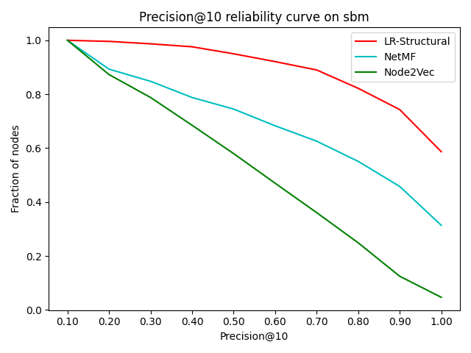
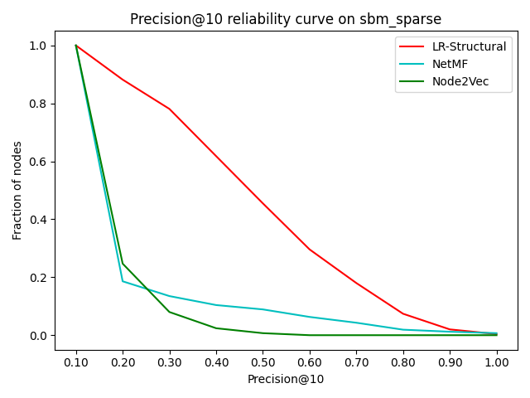
The results
Reliability curve: x vs fraction of vertices with Precision@10 > x
LR-struct: simple regression model using PersonalizedPageRank, cosine sim of neighborhoods
  Standard features

Slide 48
The results
30% of vertices have Precision < 0.6
50% of vertices have Precision < 0.6
Reliability curve: x vs fraction of vertices with Precision@10 > x
LR-struct: simple regression model using PersonalizedPageRank, cosine sim of neighborhoods
  Standard features
Embeddings methods fail to accurately get structure of simple SBM

Slide 49
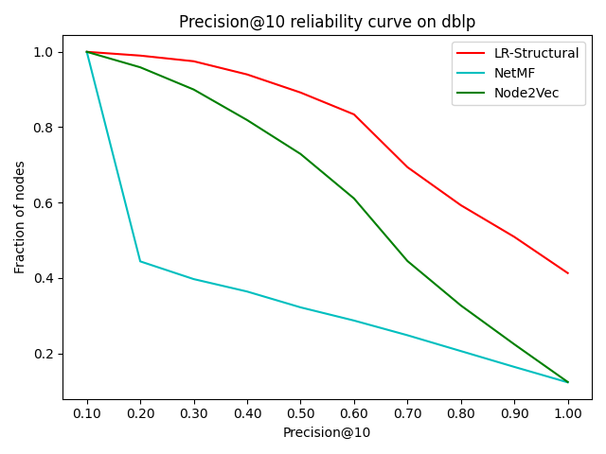
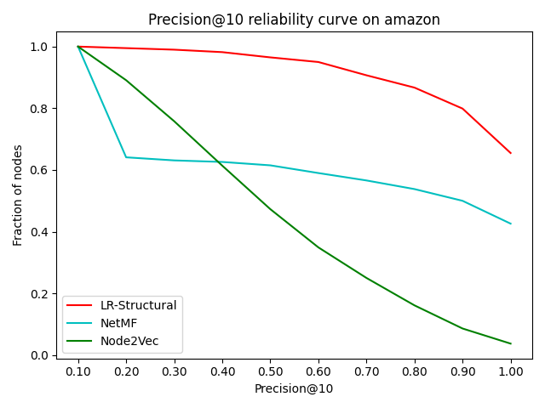
The results on real data
Amazon, DBLP networks with ground truth communities
Popular embeddings methods perform poorly vs a simple baseline
[Gurukar et al 19] Hand-tuned features competitive for many tasks

Slide 50
But others say embeddings work…?
Existing papers on graph embeddings use AUC scores to compare performance
  Might not be best measure since most pairs are not community pairs (sparse ground truth)
AUC scores above 0.9 for these examples

Slide 51
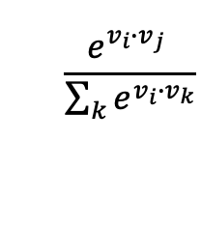
The math
$$\frac{e^{v_{i}∙v_{j}} }{\sum_{k}{e^{v_{i}∙v_{k}}}}$$
Dense blocks
≈
Sparse
matrix
Entrywise
softmax
V^{T}
V
Input matrix to embedding method
has block structure (communities)
Low-dimensional softmax factorizations can generate community structure
But fragile. Random perturbations to vectors destroy all communities

Slide 52
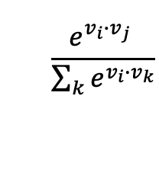
The effect of noise
Dense blocks
≈
Sparse
matrix
Entrywise
softmax
V^{T}
V
$$\frac{e^{v_{i}∙v_{j}} }{\sum_{k}{e^{v_{i}∙v_{k}}}}$$
≈
Entrywise
softmax
V’^{T}
V’
“Community factorizations” highly sensitive to noise
  Unlikely to be found, or at least, lots of inaccuracy in V

Slide 53
Miles to go…
G
We need more theory in the study on graph embeddings
The study of limitations, what is not possible
Different kinds of kernels/models (softmax, logistic fn, etc.) have significantly different power
  [Chanupriya et al 20]

Slide 54
Food for thought
G
What tasks can embeddings do (or not do)?
  Do they really give “task independent” information?
Which models/geometries can capture community structure?
How does noise affect embeddings?

Slide 55
Thank you

