Slide 1
Stencil Shadows
Garrett Weng

Slide 2
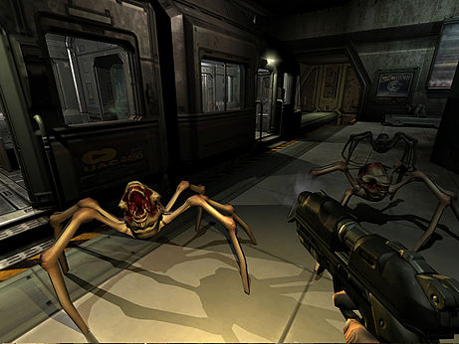
What are stencil shadows?
Also known as shadow volumes
Relies on use of the stencil buffer
Create volumes of the shadows
Shadows projected onto surfaces of objects
Different from shadow mapping

Slide 3
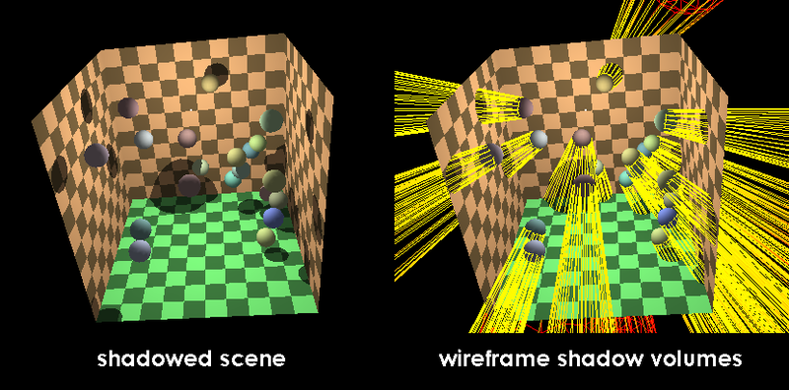
How do we get the shadow volumes?
Find the silhouette edge of the object
Project rays from the edges
Create polygons using these rays
Polygons form the volumes

Slide 4
How do we create the stencil?
Use the stencil buffer
Different techniques (Z-Pass, Z-Fail)
Assume Depth-Values are already set
Render front face of the volume
Increment the stencil value if depth test passes
Render back face of volume
Decrement the stencil value if depth test fails

Slide 5
How do we get shadows?
First, render the whole scene with ambient lighting
Create the volumes
Create the stencil
Render the rest of the scene with diffuse and specular lighting where stencil test fails

Slide 6
Where am I at?
Working on stencil buffer
Still working on creating the shadow volumes
Need to learn how to use depth test for creating the stencil

