Slide 1
Children Learning Computer Science Concepts via Alice Game-Programming
Linda Werner, UC Santa Cruz
Shannon Campe, ETR Associates
Jill Denner, ETR Associates
Funded by the NSF grant DRL-0909733

Slide 2
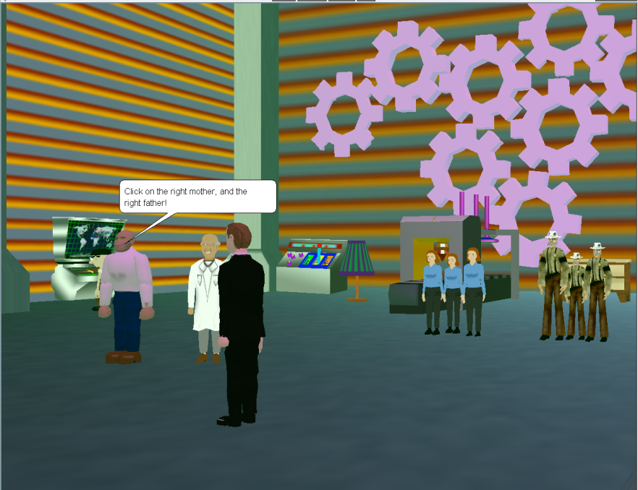
Project Overview
325 middle school students
Elective technology classes
Solo or programming pairs
Storytelling Alice/Alice 2.2
~20 hours
7-10 hours
programming games

Slide 3
Game Analysis Process
231 games
“Reachable” code
Executed with “no failure”
Most were successful!
Non-automated analysis
Analyzed twice

Slide 4
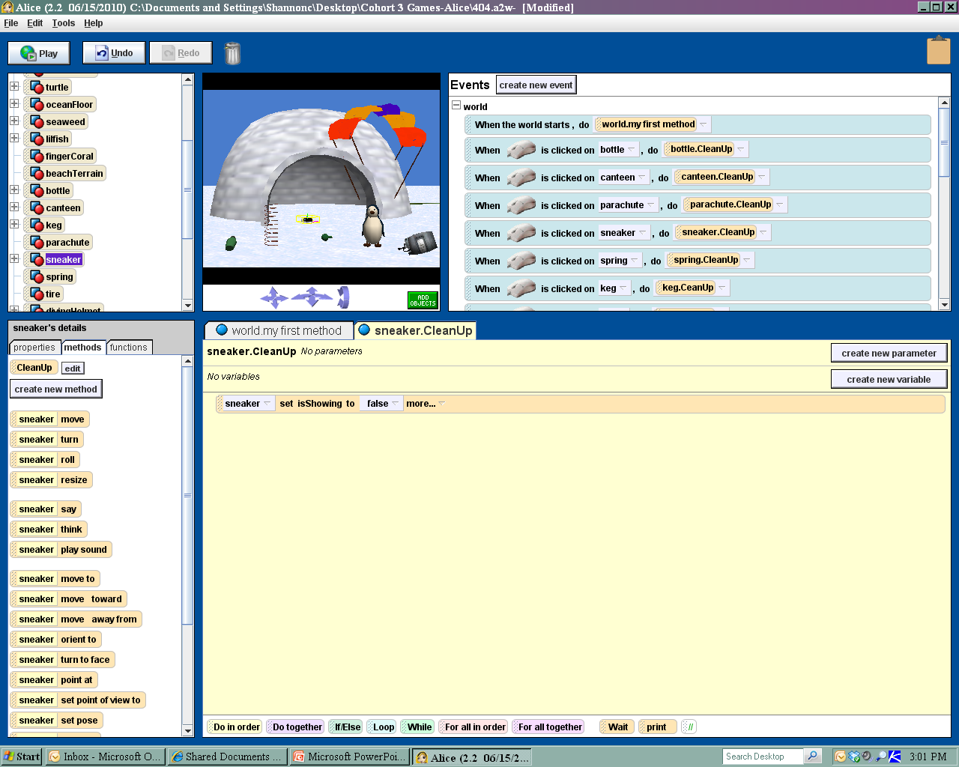
Reachable with no failure

Slide 5
Construct Categories
Methods
Parameters
Functions
Variables (list & non-list)
If/Else
Loops
Do in order; Do together
Event Handlers

Slide 6
Methods & Functions
All used built-in methods
71% created their own methods
46% used functions (mostly for collision detection)

Slide 7
Collision Detection “Bunny Run”

Slide 8
If/Else, Do together, Do in order

Slide 9
Events-driven game “Battle for Victory”

Slide 10
Why some constructs more than others?
Easier to learn and execute in Alice?
The curriculum focused more on certain types of games and constructs
It makes a “good game?”

Slide 11
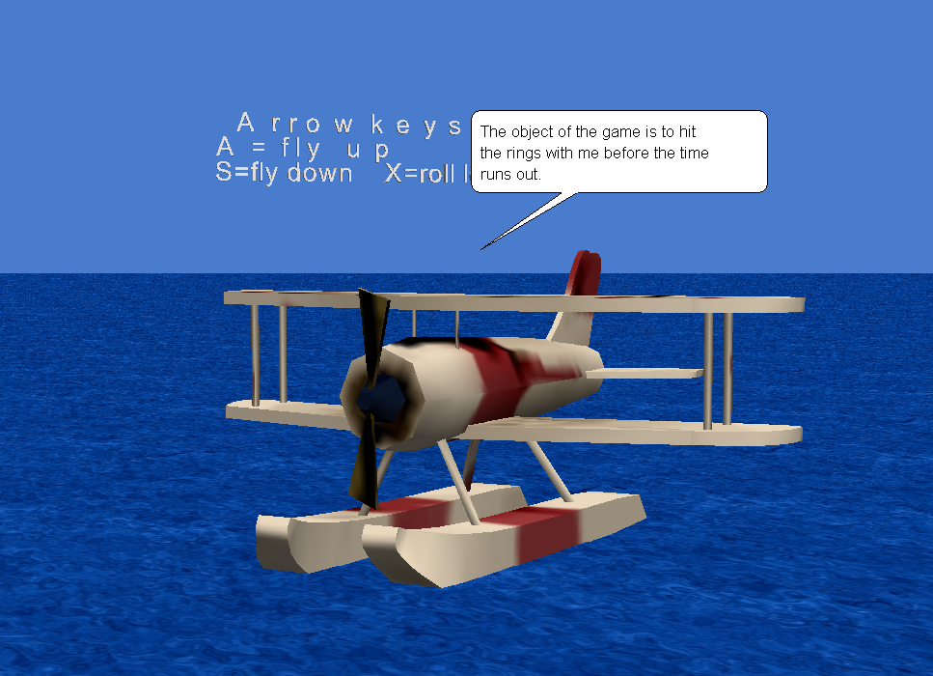
More Analysis
Patterns
Mechanics or “types” of games
Content
Curriculum

Slide 12
For more information
Shannon Campe: shannonc@etr.org
Linda Werner: linda@soe.ucsc.edu
Student games at:
psweb.etr.org/igame/demo/index.cfm
Project Advisors: Steve Cooper, Yasmin Kafai, Barbara Ericson, David Webb, Brigid Barron
Notes:
Many thanks to the guidance and support from our project advisors…

