Slide 1
Multi-platform analysis of 12 cancer types reveals molecular classification within and across tissues-of-origin
TCGA Symposium
May 12, 2014
Pan-Can Integrated Subtypes AWG
Leads:
Josh Stuart, UCSC
Chris Benz, Buck
Chuck Perou, UNC

Slide 2
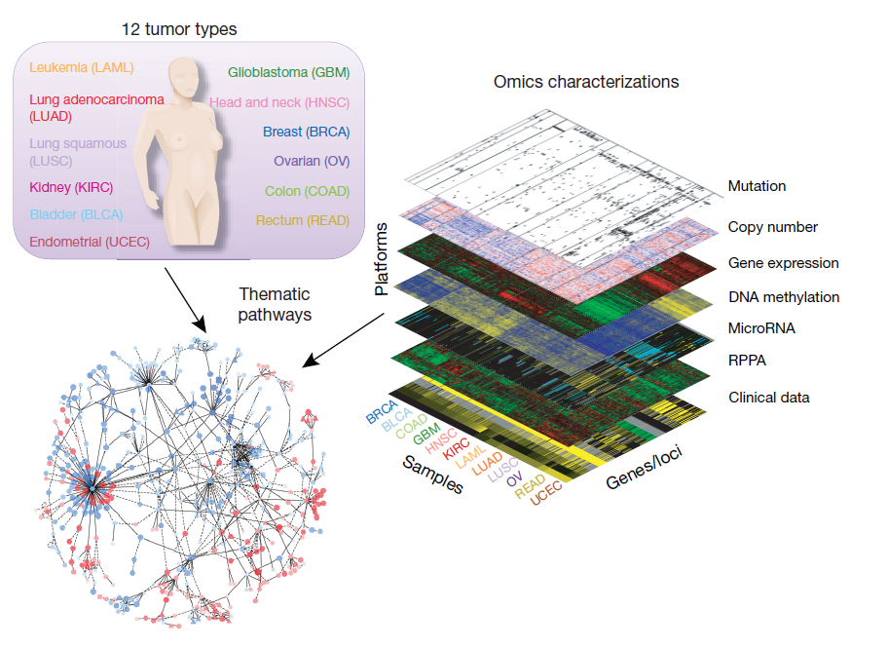
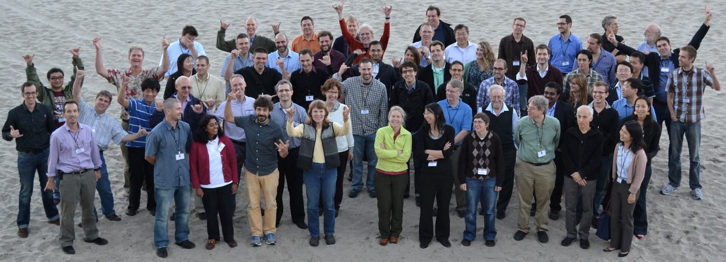
Pan-Cancer-12 Dataset
~3500 Samples
Tumor Type | # Samples
AML | 173
Bladder | 122
Breast | 845
Colon | 190
Endometrial | 370
GBM | 168
Head & Neck | 303
Kidney Clear Cell | 480
Lung Adeno | 355
Lung Squamous | 259
Ovarian Serous | 265
Rectum | 72
Defined by Pan-Cancer AWG

Slide 3
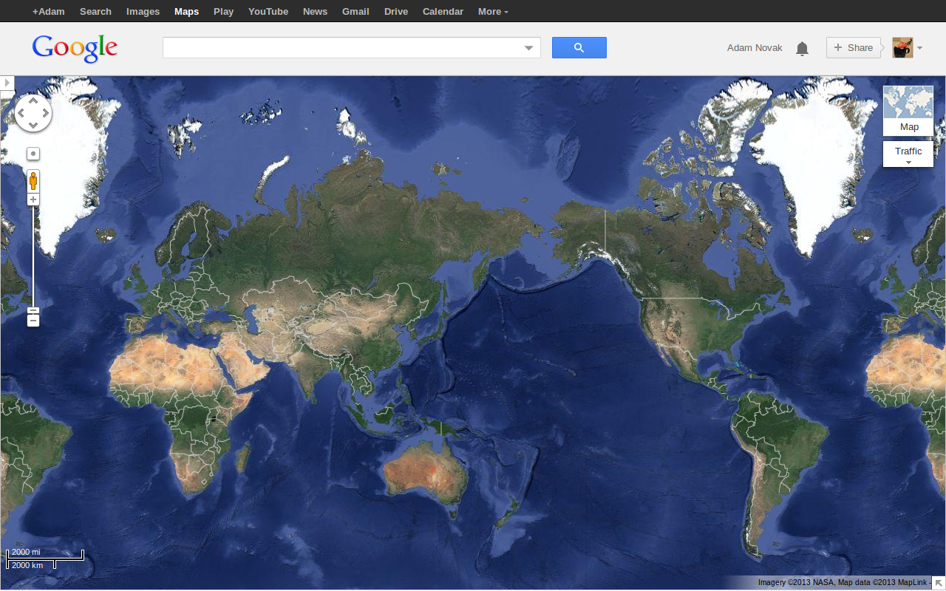
Need a Map to navigate so much info
Inspiration: Google Maps
Fixed, learnable coordinate system
Natural human intuition
Overlay stores, places, reviews, photos, video...
And… Its not a heatmap!

Slide 4


Each sample has its own Address
Each sample = hexagon (the address)
Hexagons good packing properties
Colors display attributes: outcomes, mutations, etc
1 Sample
(or signature)
Adam Novak, Sahil Chopra, Robert Baertsch

Slide 5
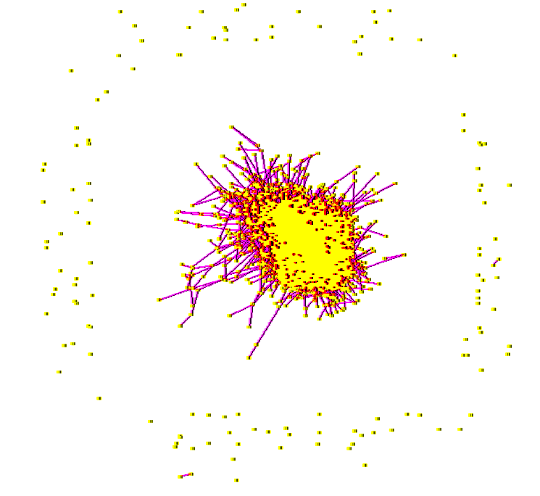
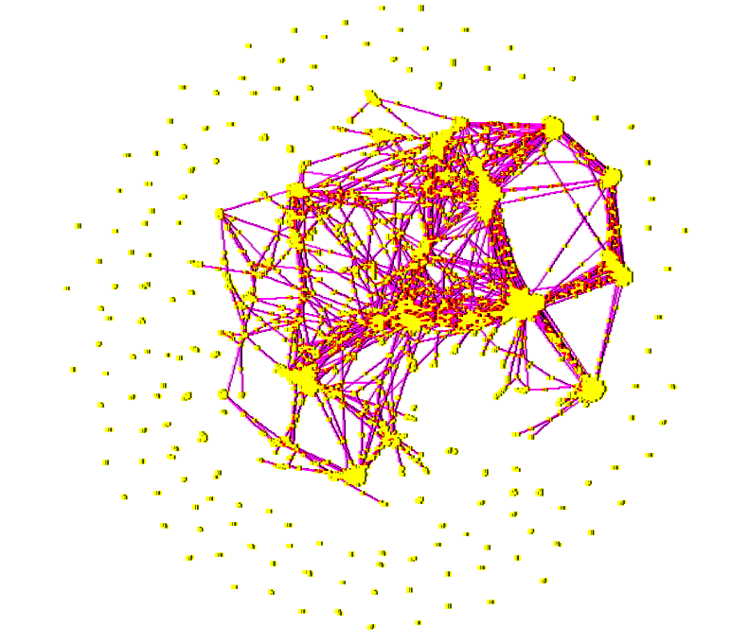
Connecting Signatures to Addresses
Snap to
Grid
Energy
Minimization
Spring Layout: Low energy configuration of competing springs
Snap to grid: Associate one point per hexagon.
Samples w/ similar signatures → same zip code.
Layout Engine: DrL. Sandia National Labs
Adam Novak, Sahil Chopra, Robert Baertsch
Notes:
Spring layout for dimensionality reduction.
Then snap to nearest empty hex.

Slide 6
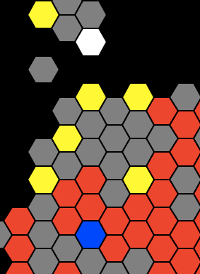
Identify similar samples in the same zip code
I’m not!
Map address reflects molecular similarity
“Zip codes” carry information
  like: Russian Hill, Berkeley, Silicon Valley, Bethesda, …
I am
I am
I am
who’s like
me?
I am
I am
Adam Novak, Sahil Chopra, Robert Baertsch
I am

Slide 7
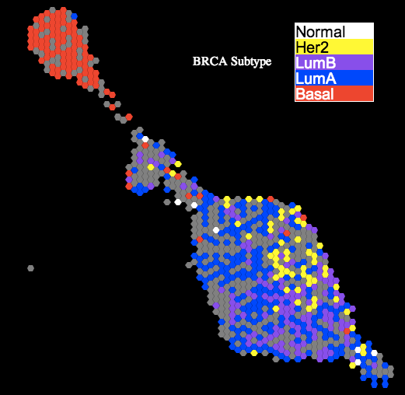
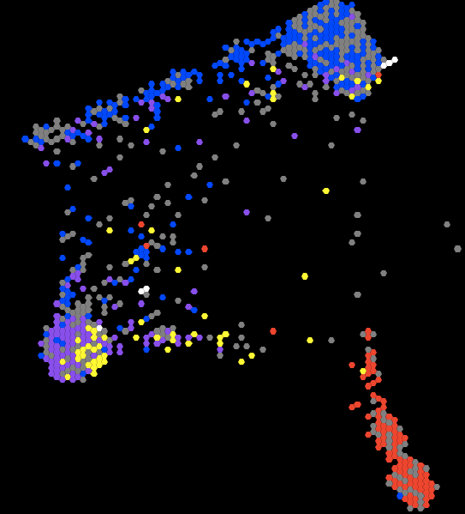
Are disease-specific AWG subtypes recapped in TumorMap?
mRNA Map
PARADIGM Map
lumB separation
BRCA subtypes resolve clearly on mRNA and PARADIGM maps.

Slide 8
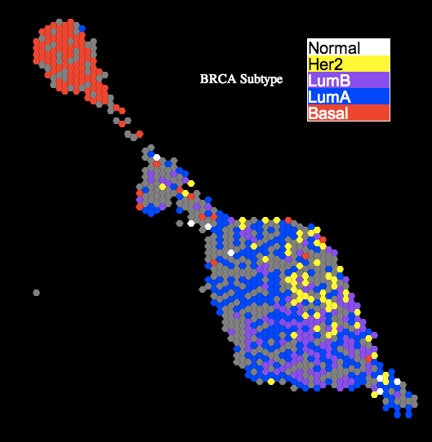
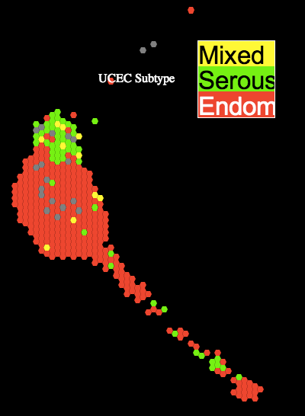
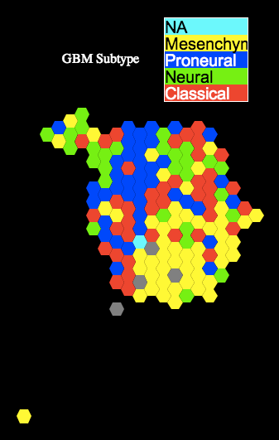
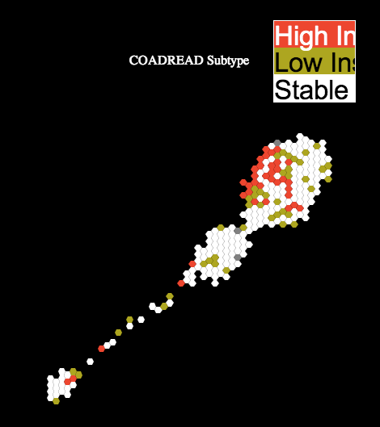
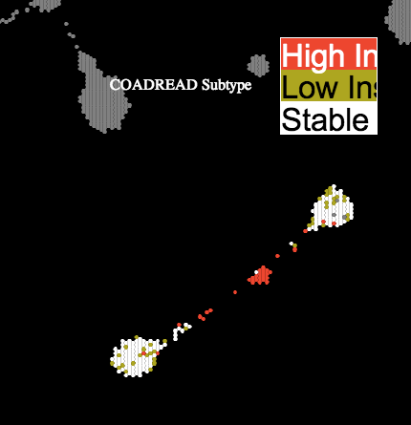
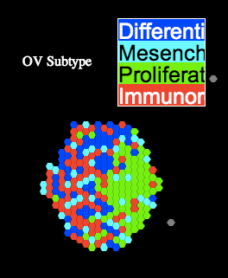
Are disease-specific AWG subtypes recapped in TumorMap?
BRCA
UCEC
GBM
COAD-READ
COAD-READ on
DNA Methylation Map
OV
Pattern on another
molecular map adds
insight.
Good agreement overall.
Newton, Baertsch, UCSC

Slide 9
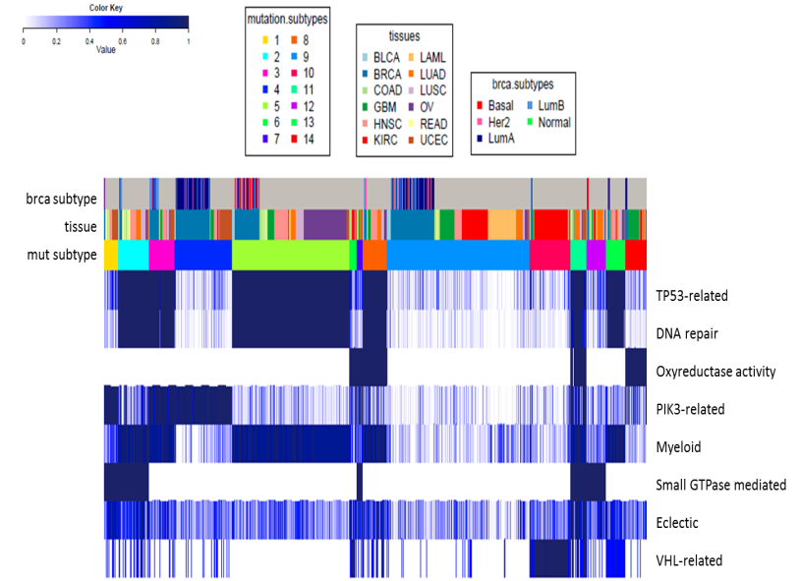
6 Data Platforms
mRNA
microRNA
Protein
(Hoadley, UNC)
(Hoadley, UNC)
(Akbani, MDACC)
Exome-Mutations
(not used)
DNA Copy Number
(Cherniack, Broad)
DNA Methylation
(Shen, USC)
(Uzunangelov, UCSC)

Slide 10
Single Platform Subtypes
6 platforms, each produced 8-19 different clusters.
  DNA Methylation had the most.
All subtypes show a strong correlation with tissue of origin.
Number of Clusters
Data Platform

Slide 11
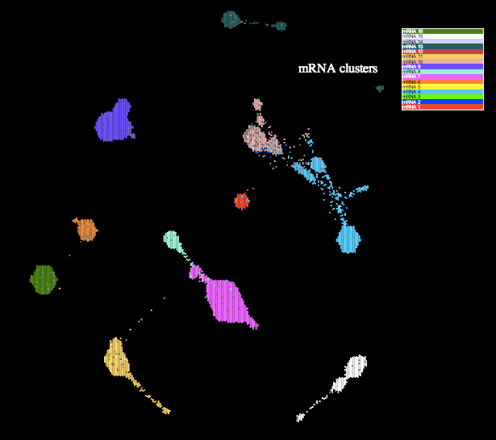
Single Platform Subtypes Recap on TumorMap
mRNA Map
Colors reflect
the subtypes
obtained using
mRNA
platform.
Newton, Baertsch, UCSC

Slide 12
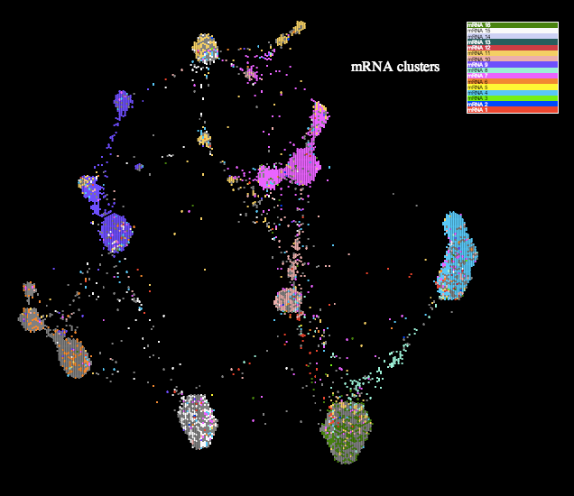
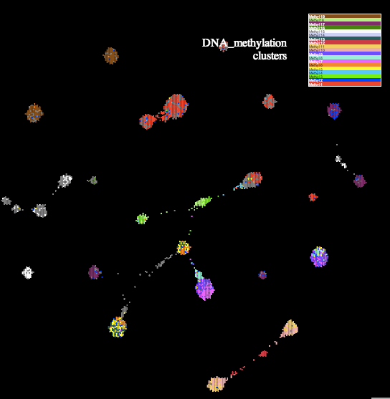
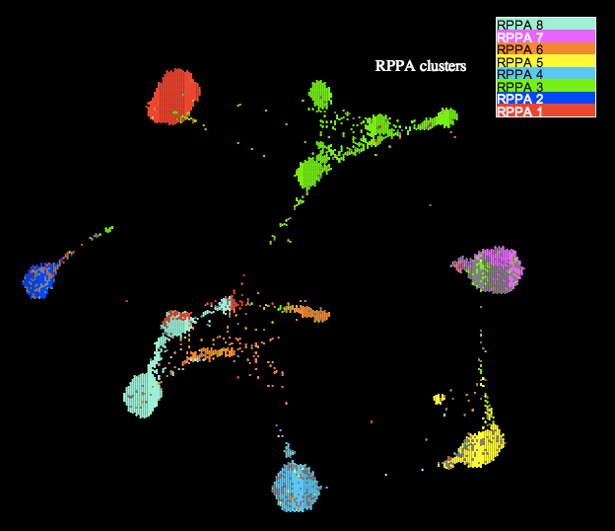
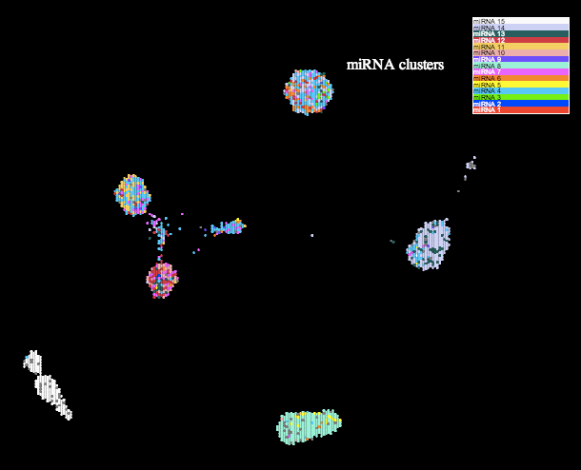
Single Platform Subtypes Recap on TumorMap
mRNA
SCNA
Colors reflect
the subtypes
obtained using
each different
platform.
DNA Methylation
RPPA
miRNA
Good agreement w/ most. miRNA still needs work…
Newton, Baertsch, UCSC

Slide 13
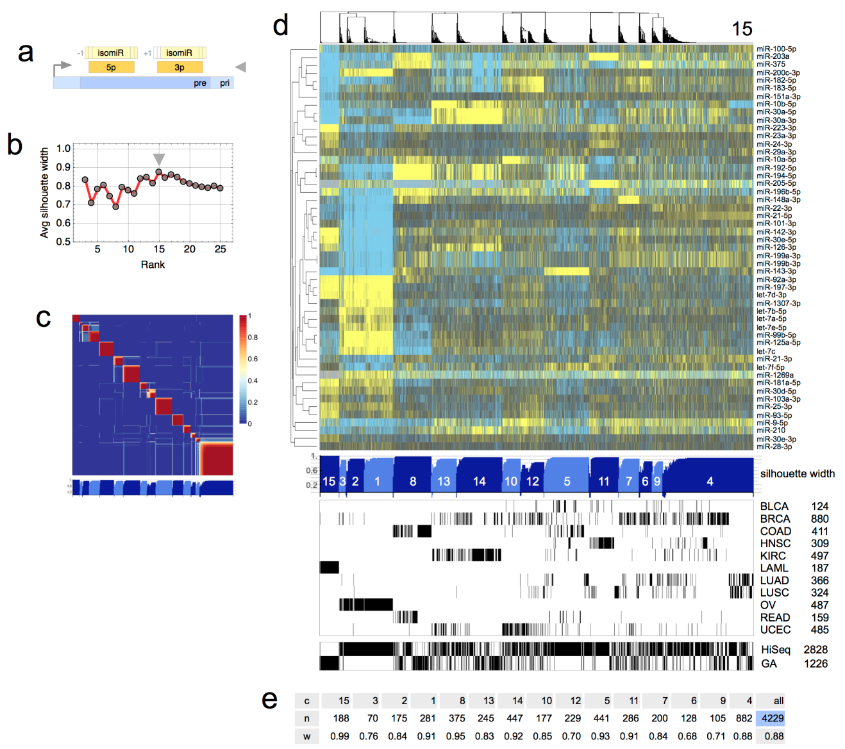
Single Platform Subtypes Correlated with Tissue of Origin
mRNA
SCNA
RPPA
DMeth
miRNA
Muts
Exome mutation clusters show least amount of tissue correlation, but still appreciable (~70%, Kandoth et al. Nature 2013).

Slide 14
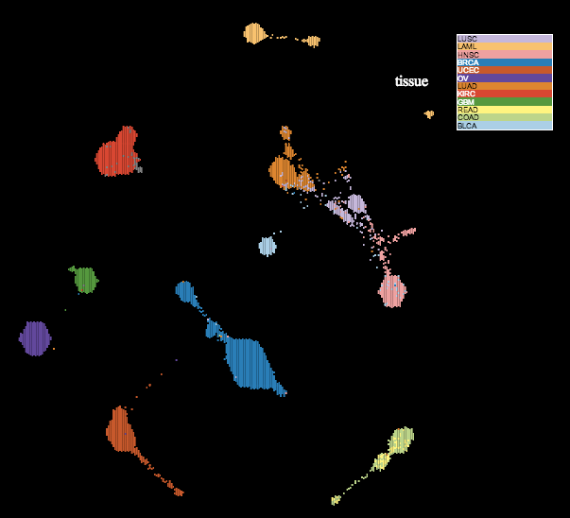
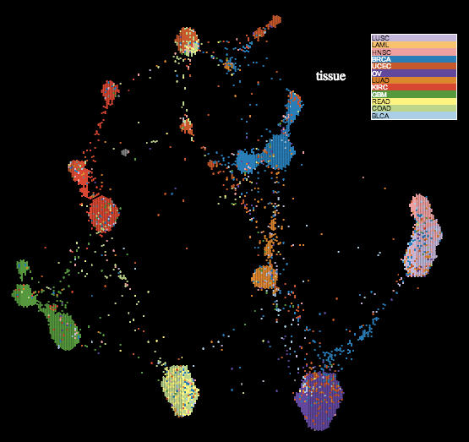

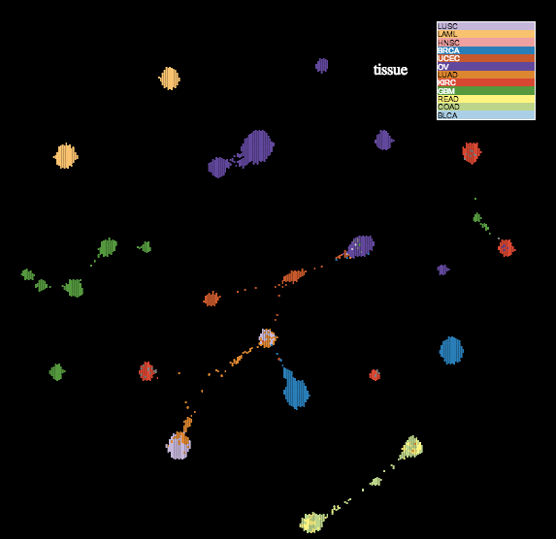
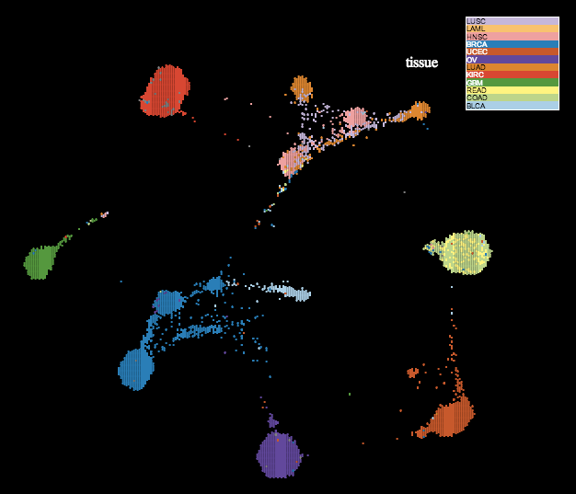
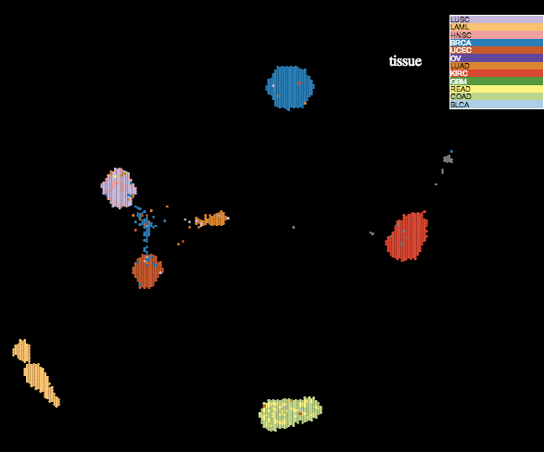
Single platform maps are tissue driven
mRNA
SCNA
DNA Methylation
RPPA
miRNA
Each layout driven by a different data platform.
Newton, Baertsch, UCSC

Slide 15
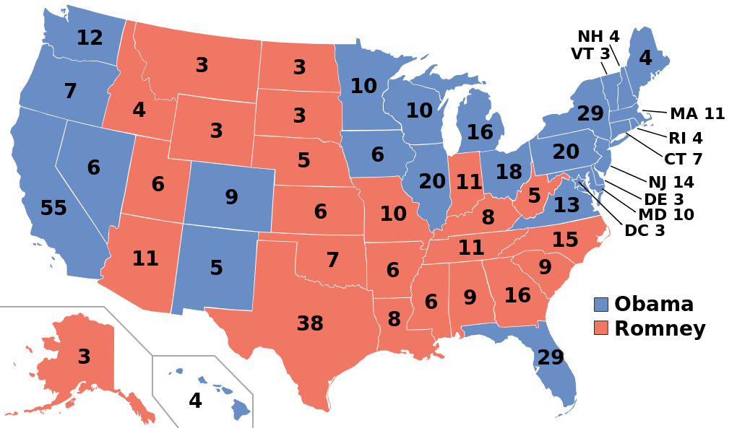
Cluster of Cluster Assignments - COCA
Question: How do get one cluster solution from many?
Answer: Democracy!
  But like the electoral college system:
  Every Platform Gets a Vote for Each of its Clusters
Katherine Hoadley, UNC

Slide 16
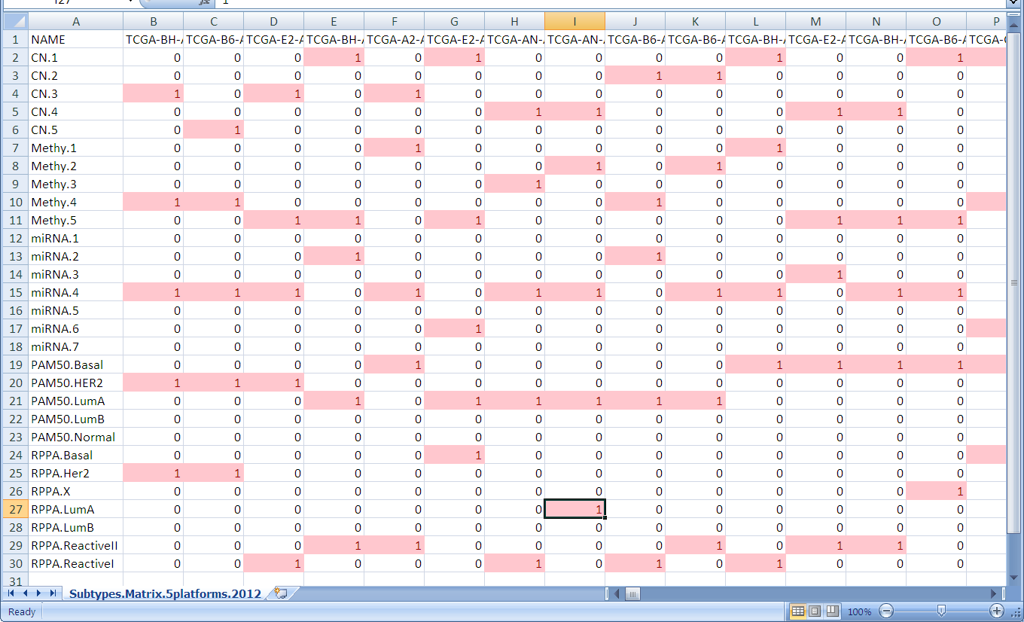
Cluster Of Cluster Assignments (COCA subtypes)
Katherine Hoadley, UNC

Slide 17
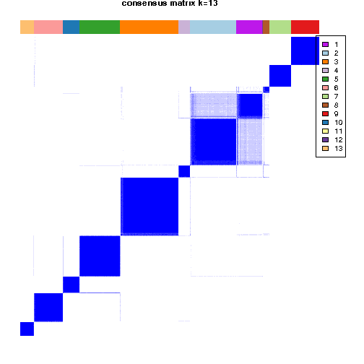
Consensus Clustering defines number of groups
At K=13, we have 11 main
Cluster of Cluster Assignment (COCA) subtypes
Katherine Hoadley, UNC

Slide 18
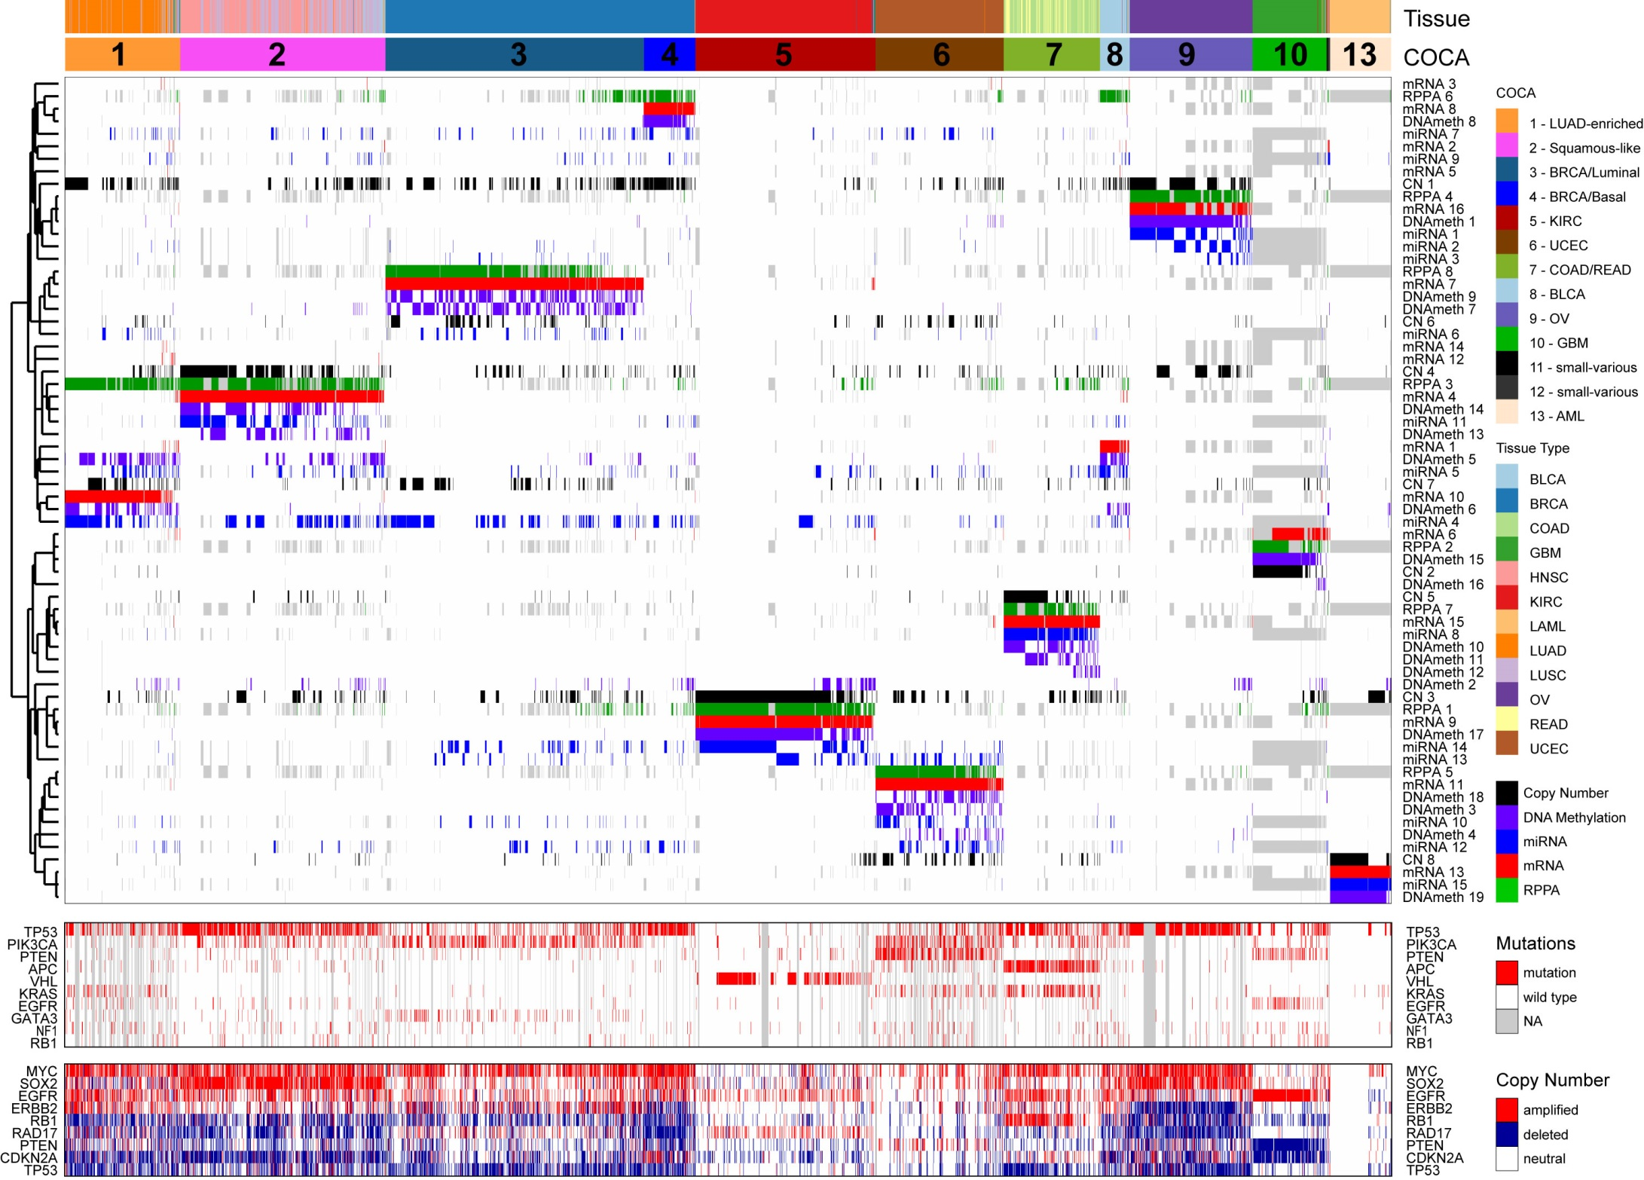
11 main subtypes found (plus 2 minor)
Katherine Hoadley, UNC

Slide 19
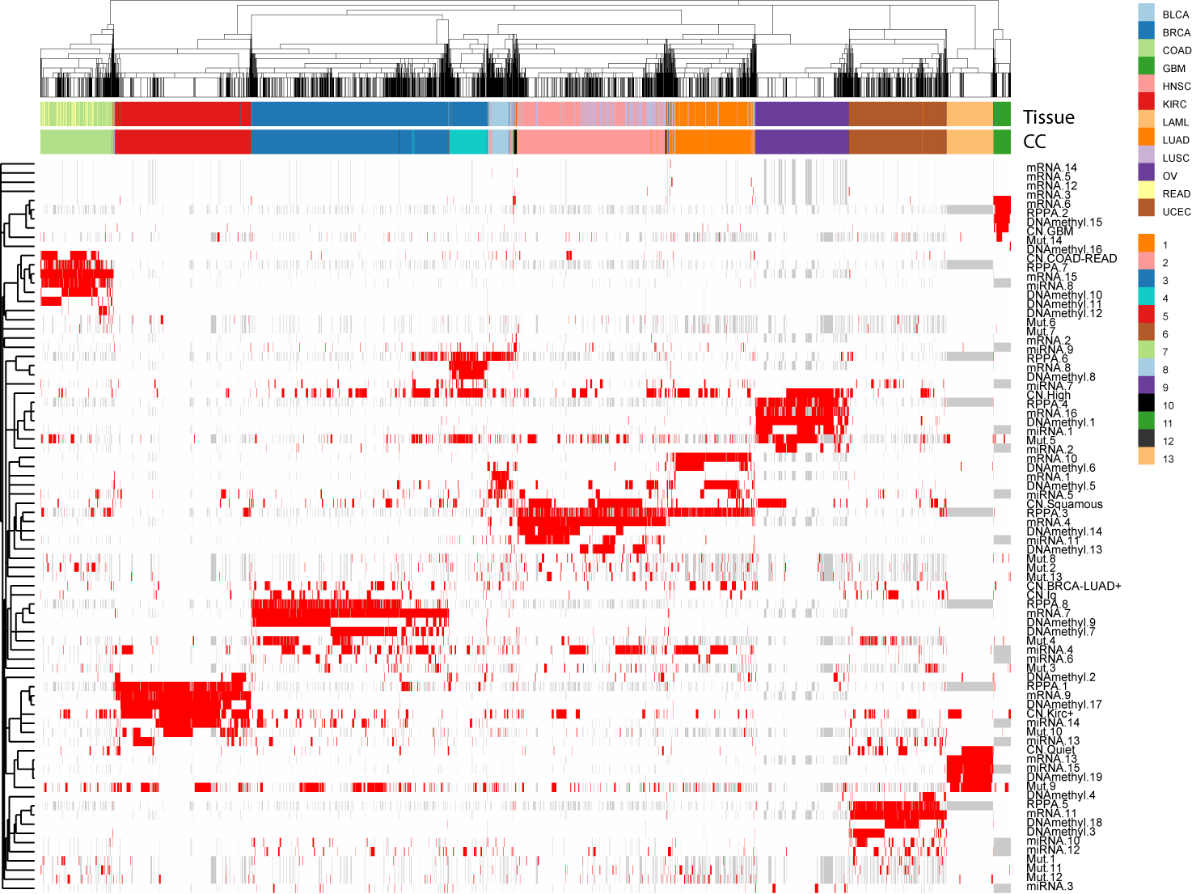
96% Agreement with Subtypes
that have no mutations classes

Slide 20
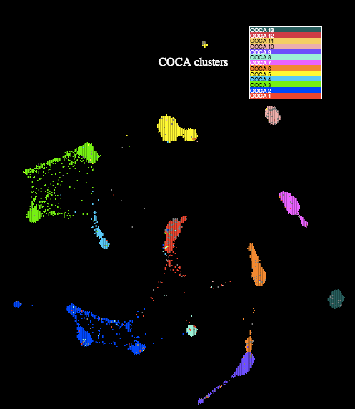
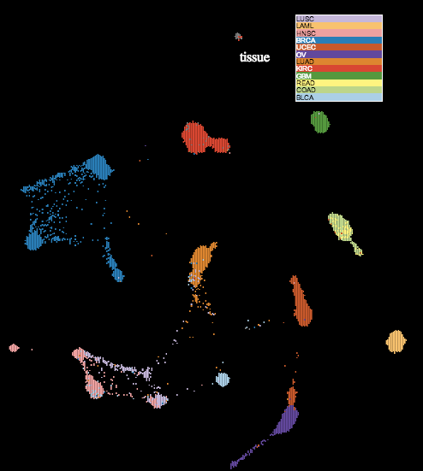
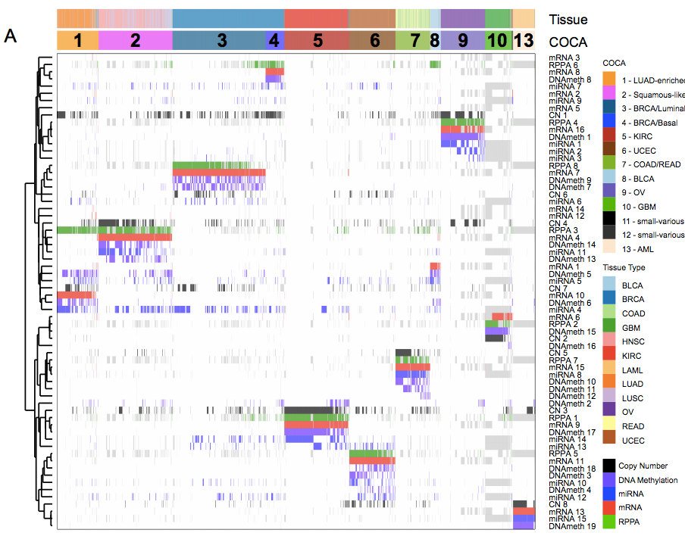
11 main COCA Subtypes
PARADIGM TumorMap
11 main subtypes found (plus 2 minor)
~90% of samples cluster with their tissue
PARADIGM TumorMap corresponds well to COCA

Slide 21
12 Tissue of Origin Sites Translate into 11 COCA Subtypes
Bladder
Head &
Neck
Rectum
Lung
Adeno
Lung
Squam
Breast
Kidney
Endometrial
Colon
Ovary
GBM
AML
LUAD-
enriched
Squamous
-like
Breast
Luminal
(includes
all HER2+)
Breast
Basal-
like
Kidney
Endo
Bladder
GBM
Rectum
&
Colon
Ovary
AML
131/139 Basal-like are in
this COCA group
Chuck Perou, UNC

Slide 22
Mutations according to COCA subtypes
Gene | 1- Adeno-enriched | 2- Squamous | 3- BRCA Luminal | 4- BRCA Basal | 5-KIRC | 6-UCEC | 7-COAD READ | 8- Bladder | 9-OV | 10-GBM | 13- AML | Total
TP53 | 52% | 72% | 24% | 80% | 2% | 28% | 58% | 51% | 94% | 30% | 9% | 41%
PIK3CA | 7% | 19% | 40% | 4% | 3% | 51% | 18% | 17% | 1% | 9% | 0% | 20%
PTEN | 3% | 4% | 4% | 3% | 4% | 63% | 1% | 3% | 0% | 32% | 0% | 10%
APC | 6% | 4% | 0% | 2% | 2% | 5% | 82% | 5% | 2% | 1% | 0% | 8%
MLL3 | 18% | 11% | 7% | 5% | 4% | 5% | 3% | 25% | 2% | 4% | 1% | 8%
VHL | 0% | 0% | 0% | 0% | 52% | 1% | 0% | 0% | 0% | 0% | 0% | 7%
KRAS | 24% | 0% | 1% | 0% | 0% | 20% | 46% | 2% | 1% | 1% | 4% | 7%
MLL2 | 10% | 20% | 2% | 1% | 3% | 9% | 2% | 19% | 1% | 3% | 1% | 7%
ARID1A | 8% | 5% | 2% | 2% | 3% | 30% | 6% | 30% | 0% | 2% | 1% | 7%
PBRM1 | 2% | 3% | 0% | 2% | 32% | 2% | 0% | 5% | 0% | 1% | 0% | 6%
NAV3 | 20% | 11% | 1% | 2% | 1% | 5% | 2% | 5% | 2% | 1% | 0% | 5%
PIK3R1 | 2% | 2% | 3% | 1% | 0% | 31% | 2% | 0% | 0% | 15% | 0% | 5%
NF1 | 12% | 5% | 2% | 3% | 2% | 4% | 1% | 11% | 3% | 8% | 1% | 5%
SETD2 | 7% | 3% | 1% | 1% | 12% | 3% | 3% | 8% | 2% | 2% | 1% | 5%
ATM | 7% | 4% | 2% | 2% | 3% | 6% | 6% | 8% | 1% | 2% | 0% | 4%
EGFR | 11% | 4% | 1% | 0% | 2% | 1% | 2% | 0% | 1% | 25% | 1% | 4%
FBXW7 | 1% | 6% | 0% | 2% | 0% | 12% | 12% | 6% | 1% | 1% | 0% | 4%
LRRK2 | 8% | 6% | 1% | 0% | 1% | 4% | 3% | 5% | 2% | 2% | 0% | 4%
MTOR | 7% | 3% | 2% | 1% | 6% | 5% | 4% | 2% | 2% | 1% | 0% | 4%
CDKN2A | 6% | 18% | 0% | 0% | 1% | 0% | 1% | 5% | 0% | 1% | 0% | 4%
GATA3 | 3% | 2% | 13% | 0% | 0% | 0% | 1% | 2% | 0% | 0% | 0% | 4%
CTNNB1 | 4% | 1% | 0% | 0% | 0% | 29% | 5% | 3% | 1% | 0% | 0% | 4%
ATRX | 7% | 5% | 1% | 0% | 2% | 3% | 1% | 8% | 0% | 6% | 0% | 4%
Only 3 Genes > 10% frequency
chromatin remodelers, as a class, account for many
Beifang Niu, Wash U

Slide 23
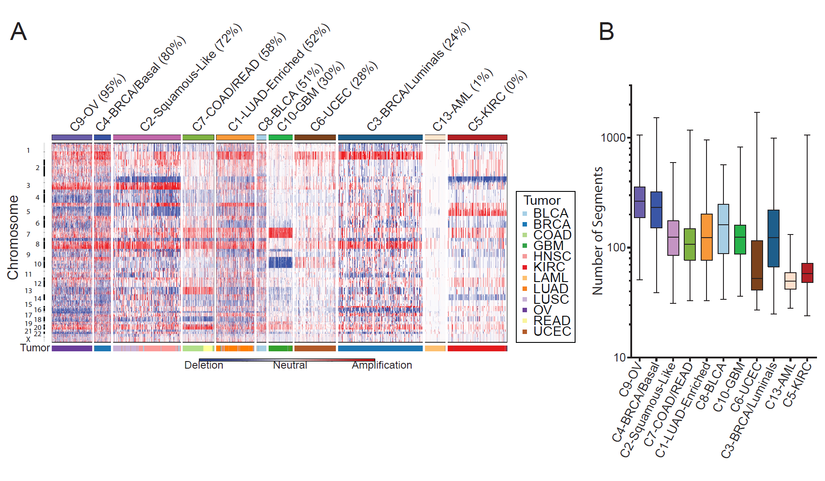
DNA Copy # according to
COCA subtypes
Andrew Cherniack, Broad

Slide 24
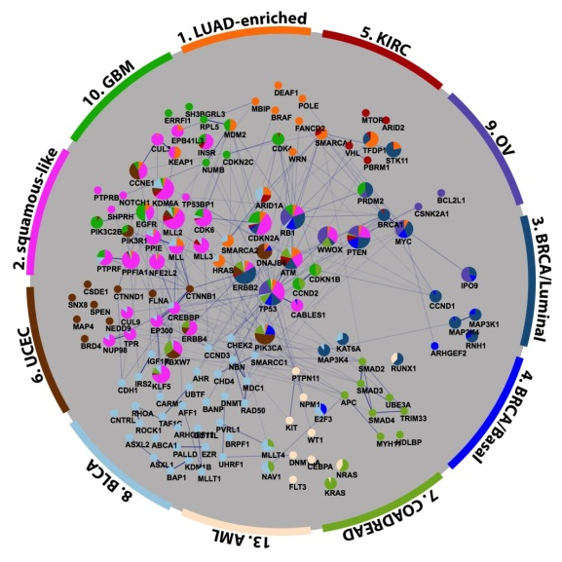
Interconnected mutated networks reveal subtype and tissue preferential
Core PanCan Mutated Genes
HotNet2 mutated subnetworks spanning all tumor types.
Max Leiserson, Brown

Slide 25
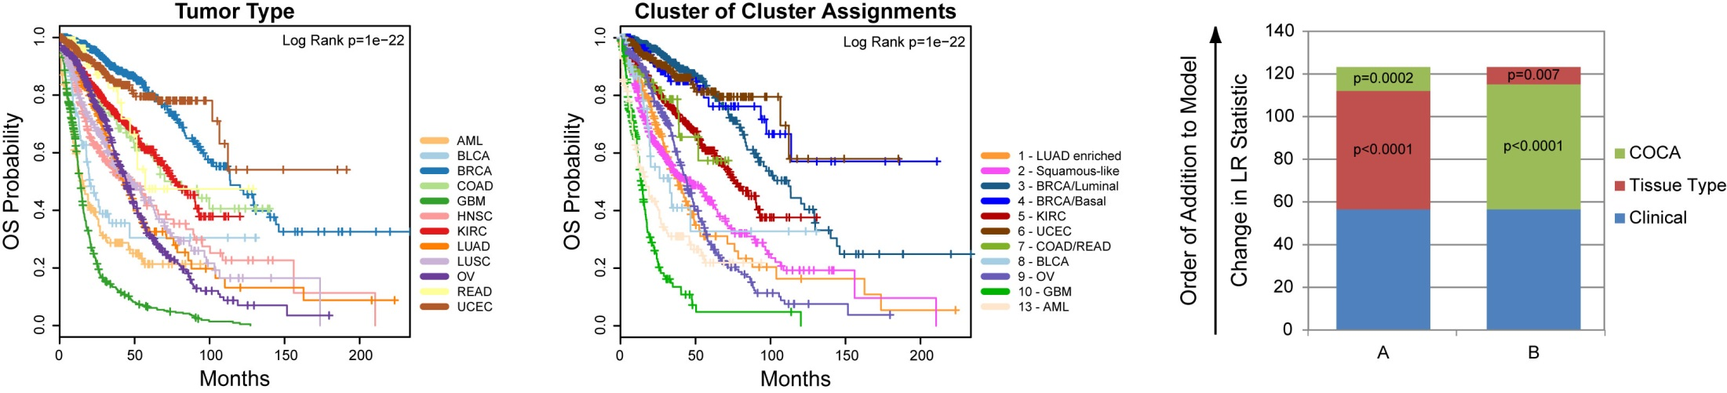
Do Integrated Subtypes Provide New Prognostic Information?
Tissue → Overall Survival
COCA → Overall Survival
Improvement w/
integrated subtypes
over clinical and tissue
Ability to Predict OS
Katherine Hoadley, UNC

Slide 26
12 Tissue of Origin Sites Translate into 11 COCA Subtypes
Bladder
Head &
Neck
Rectum
Lung
Adeno
Lung
Squam
Breast
Kidney
Endometrial
Colon
Ovary
GBM
AML
Breast
Luminal
(includes
all HER2+)
Breast
Basal-
like
131/139 Basal-like are in
this COCA group
Chuck Perou, UNC

Slide 27
BLCA samples diverge into 3 integrated subtypes
Bladder
Head &
Neck
Lung
Adeno
Lung
Squam
Chuck Perou, UNC

Slide 28
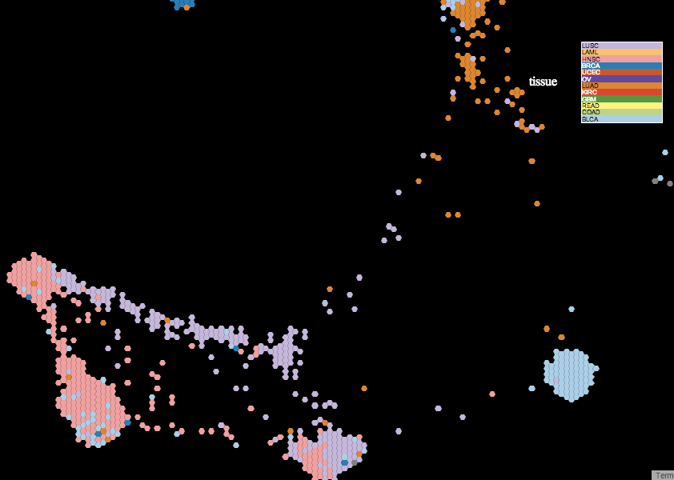
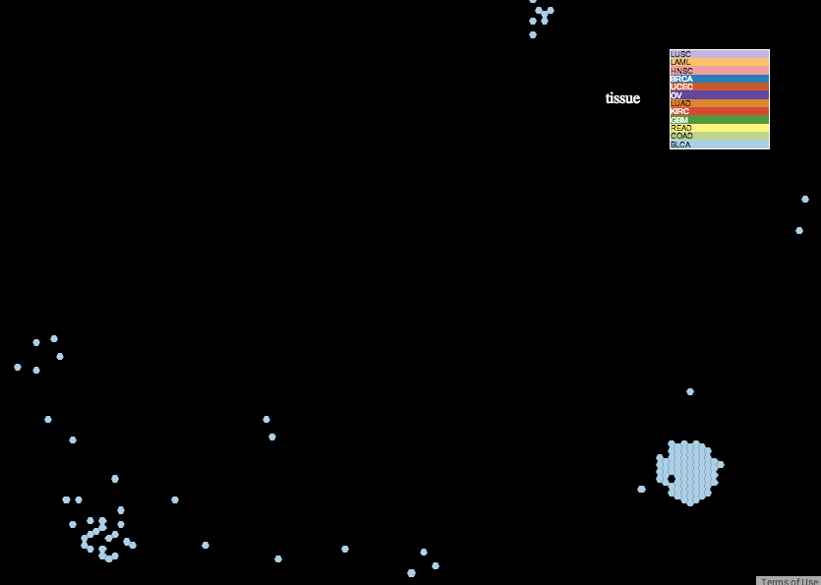
BLCA divergence in Pan-Can-12
LUAD-enriched
Map restricted to BLCA
BLCA
BLCA
BLCA-enriched
HNSC-enriched
BLCA diverge into bladder-enriched, squamous, and LUAD-enriched islands

Slide 29
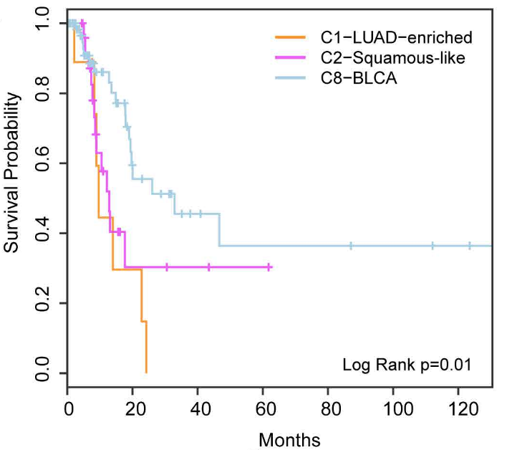
Integrated subtyping of BLCA distinguishes patient outcomes
COCA clusters distinguish different survival classes for BLCA

Slide 30
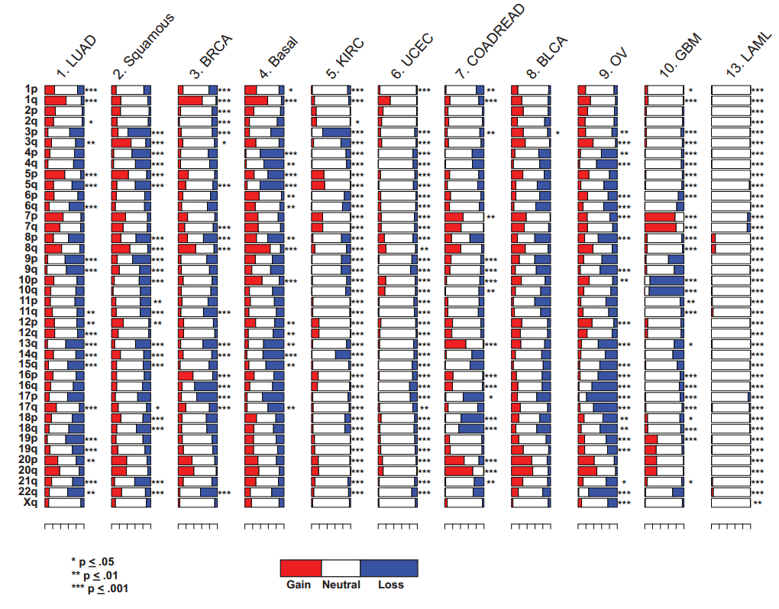
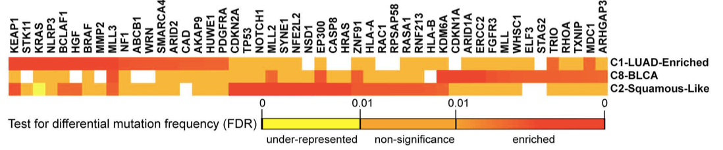
Expression determinants of BLCA divergence
Squamous-like BLCA show significant genomic differences
Squamous-like
BLCA-enriched
3p Loss
in Squamous
BLCA-squamous mutated chromatin
remodelers MLLs
KDM5A, EP300
Notes:
KDM5A – histone demethylase
EP300 – histone acetyltransferase (co-activator of HIF1A)
MLL2 – histone methyltransferase

Slide 31
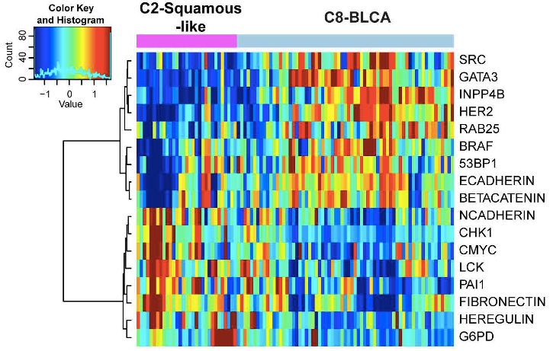
Expression determinants of BLCA divergence
See BLCA AWG
EMT and
proliferation
Higher HER2 and Rab25 in non-squamous BLCA – consistent w/ BLCA AWG
Markers of EMT expressed in squamous BLCA cases
Rehan Akbani, MDACC

Slide 32
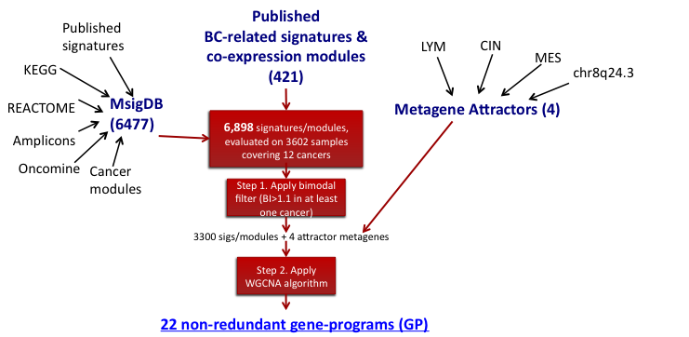
Gene Programs – functionally coupled genes coregulated across PanCan-12
Identified 22 sets of functionally-related genes coregulated in PanCan-12.
Gene Programs can recapitulate the integrated subtypes
Denise Wolf, UCSF

Slide 33
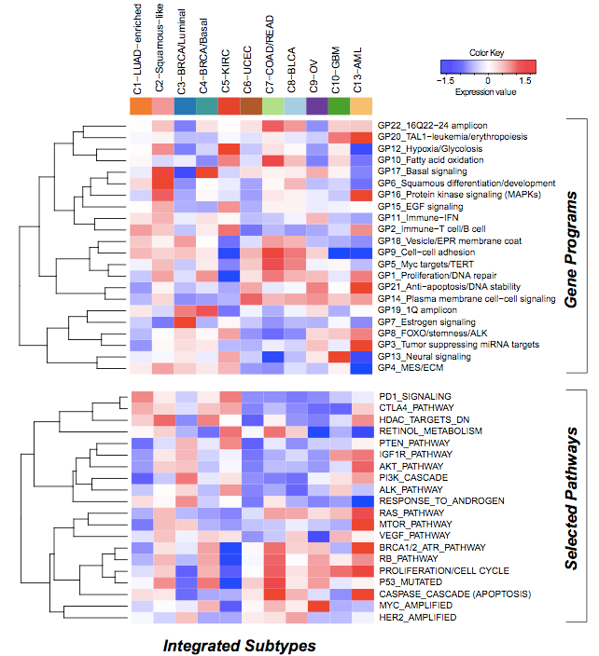
Gene Programs: Surrogates of Integrated Subtypes
COCA Subtypes
90% classification accuracy (LDA)
Denise Wolf, UCSF

Slide 34
Gene Programs: Surrogates of Integrated Subtypes
3-BRCA/Lums
Estrogen Signaling
90% classification accuracy (LDA)
Denise Wolf, UCSF

Slide 35
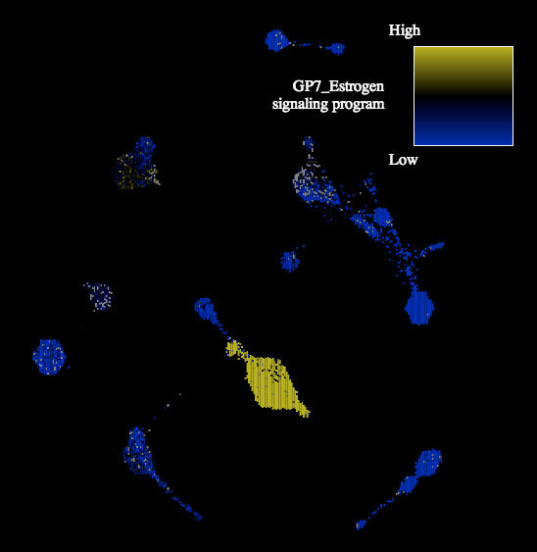
Viewing Gene Programs on the TumorMap
ER Signaling “Weather Map”
BRCA Luminals Show High ER signaling
Denise Wolf, UCSF

Slide 36
Gene Programs: Surrogates of Integrated Subtypes
5-KIRC
HIF1A
Fatty Acid
90% classification accuracy (LDA)
Denise Wolf, UCSF

Slide 37
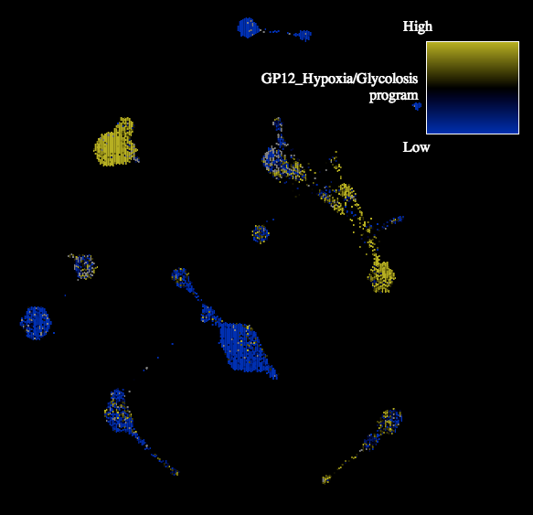
Viewing Gene Programs on the TumorMap
HIF1A “Weather Map”
KIRC w/ high hypoxia due to VHL mutations
Denise Wolf, UCSF

Slide 38
Gene Programs: Surrogates of Integrated Subtypes
2-Squamous-Like
Basal signaling
Squamous differentiation
MAPK signaling
90% classification accuracy (LDA)
Denise Wolf, UCSF

Slide 39
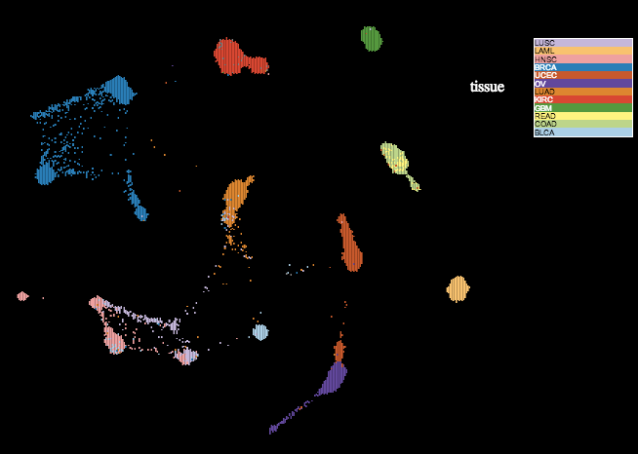
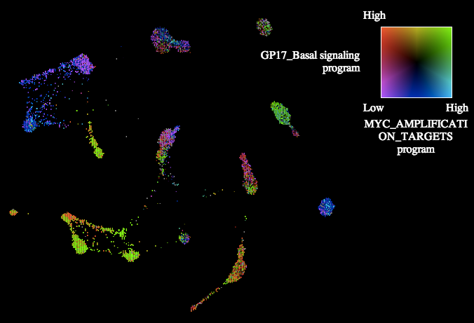
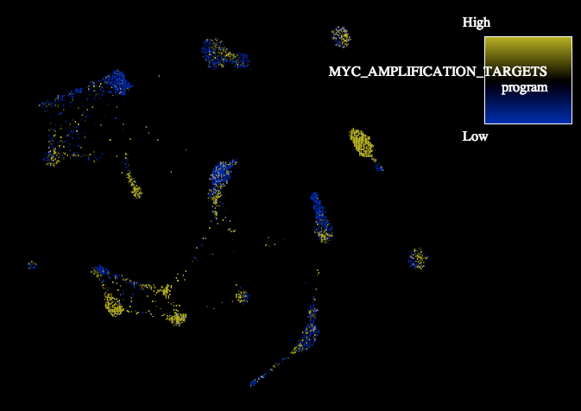

Viewing Gene Programs on the TumorMap
Tissue View
Merge
Subtypes w/ specific
gene programs patterns
MYC Amplification Targets
Basal Signaling
Denise Wolf, UCSF

Slide 40


Gene Program markers of BLCA divergence
Global Overview of GP17
Restricted to BLCA
“Bladder Island”
“Squamous island”
Squamous BLCA cases show higher GP17

Slide 41

Oncogenic Tp63 forms are more active in Squamous vs BRCA/Basal (or OV) TP53 mutants
= higher activity
in squamous
= higher activity
in basals
delta-Np63 hub:
Oncogenic Form
Most targets in network higher activity in Squmaous (more “squares in diagram”)
Christina Yau, Buck

Slide 42

Oncogenic Tp63 forms are more active in Squamous vs BRCA/Basal (or OV) TP53 mutants
higher mRNA
expression of
oncogenic isoform
in squamous
Wei Zhao, Katie Hoadley, Zhong Chen, Carter Van Waes

Slide 43

Published as a Resource
Datasets and subtypes provide pivot for further analyses
All datasets hosted on a Synapse project page
  Links to all relevant PanCan-12 datasets

Slide 44



To appear in Cell
Stacking cancers and genomic platforms
Zhong Chen
Hoadley and Zhang
Vote for your favorite cover image
Pancakes, Part II – Original Pancake House – 7703 Woodmont Ave.

Slide 45
Summary
Analysis of 12 tumor types w/ 6 platforms display tissue-of-origin as dominant
Integrated analysis reveals 11 major groups, with some tumor types merging together (HNSCC, Lung Squamous, some Bladder) and others separating (breast luminal vs. Basal-like)
1:10 re-classified cases based on the map.
  Rate similar to EGFR mutations in NSCLC cancers
  Convergences and Divergences of tissues
Intriguing subtype-specific differences in TP53 pathway activity between OV, BRCA-Basals, and the Squamous tumors
Classification adds prognostic information independent of tissue and stage.
  E.g. COCA clusters define clear prognostic groups for BLCA
Clearly more investigation will be beneficial; especially those that subtract away tissue-of-origin signals (see Verhaak paper)

Slide 46










TCGA Pan-Can AWG
MDACC
John Weinstein
Rehan Akbani
Lauren Byers
Han Liang
Roel Verhaak
Gordon Mills
UCSF/Buck Inst
Chris Benz
Eric Collisson
Christina Yau
Denise Wolf
USC
Peter Laird
Hui Shen
UNC
Katherine Hoadley
Chuck Perou
WashU
Li Ding
Cyriac Kandoth
Beifang Liu
Mike McLellan
UCSC
Vlado Uzunangelov
Sam Ng
Evan O. Paull
Kyle Ellrott
David Haussler
Jing Zhu
Broad
Andrew Cherniak
Matt Meyerson
Gaddy Getz
Rameen Beroukhim
Scott Carter
Travis Zack
Mike Lawrence
Angela Brooks
MSKCC
Chris Sander
Giovanni Ciriello
Anders Jacobsen
NCI / NHGRI
Julia Zhang
Zhong Chen
Carter Van Waes
Baylor
Mark Hamilton
David Wheeler
UPF Barcelona
Nuria Lopez-Bigas
David Tamborero
Abel Gonzalez-Perez
Sage Bionetworks
Adam Margolin
Larsson Ohmberg
Brown
Ben Raphael
Max Leiserson
Univ Toronto
Gary Bader
Juri Reimand
Harvard
Raju Kucherlapati
UBC
Gordon Robertson
Andy Chu
ISB
Ilya Shmulevich
Sheila Reynolds

Slide 47


















UCSC Integrative Genomics Group
Kyle Ellrott
Olena
Morozova
Sam Ng
Robert Baertsch
Evan Paull
Yulia Newton
Adrian Bivol
Vlado Uzunangelov
Kiley Graim
Marcos
Woehrmann
Artem Sokolov
Dan Carlin
Ted Goldstein
Chris Wong

Slide 48





Acknowledgments
David Haussler
Chris Benz,
Buck Institute for Aging
Christina Yau
Collaborators
Li Ding, WashU
Matthew Eills, WashU
Elaine Mardis, WashU
Rick Wilson, WashU
Cyriac Kandoth, WashU
Joe Gray, OHSU
Laura Heiser, OHSU
Nuria Lopez-Bigas, UPF
Abel Gonzalez, UPF
Adam Margolin, Sage
Larsson Omberg, Sage
UCSC Cancer Genomics
Adam Ewing
Chris Wilks
Sofie Salama
Steve Benz
UCSC Genome Browser Staff
Mark Diekins
Melissa Cline
Jorge Garcia
Erich Weiler
Jing Zhu
ORACLE
PCF
LINCS
NSF
Hitachi

