Slide 1
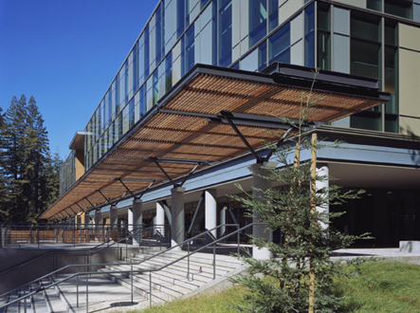
Pathway-based analysis of mutation impact
Beyond the Genome 2012
Informatics Workshop, Sep 27, 2012
Josh Stuart, UC Santa Cruz

Slide 2
“It is entirely in line with the accidental nature of mutations that … the vast majority [are] detrimental to the organism … Good ones are so rare that we can consider them all bad.”
-- H.J. Muller,
"How Radiation Changes the Genetic Constitution",
in Bulletin of Atomic Scientists, 11 (1955), p. 331

Slide 3
It is entirely in line with the accidental nature of mutations that … the vast majority [are] beneficial to the tumor … Bad ones are so frequent that we can consider them all good
(for the tumor).
-- Anonymous (circa 2012)
(default assumption in mutation analysis)

Slide 4
With Mutations, Context Matters
There are many recurrent, but low frequency mutations that are not well characterized.
Some patients with “right” mutation don’t respond. Why?
Many cancers have one of several “novel” mutations. Can these be targeted with current approaches?
The mode of action, loss-of-function or gain-of-function (LOF/GOF), of mutations can improve our understanding of disease mechanisms and treatment.
Pathway-based methods can complement prediction of LOF or GOF.
Complimentary to LoH, methylation, amplification, …

Slide 5
Two Themes
1) Predict Drivers
2) Predict Essential

Slide 6
Two Themes
1) Predict Drivers
2) Predict Essential

Slide 7
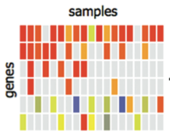
Predicting Drivers w/ Frequency Analysis
Which gene(s)
Are driving the cancer?
Recurrently mutated genes are more likely to be impactful
Correct background mutation rate?
Biased for “early” rather than “late” drivers?
Illustration from Nuria Bigas-Lopez, UPF

Slide 8
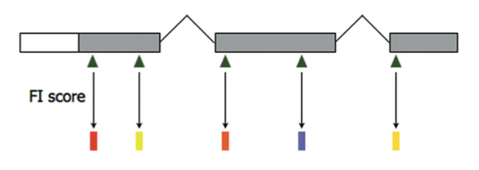
Predicting Drivers with Sequence Analysis
Protein domains
Disruptions in key domains (e..g DNA binding, kinase-interacting)
Conservation
Mutations in conserved residues or positions more important
Synonymous / non-synonymous ratio suggests selection
Non-random patterning across protein sequence/structure.
Functional
Impact

Slide 9
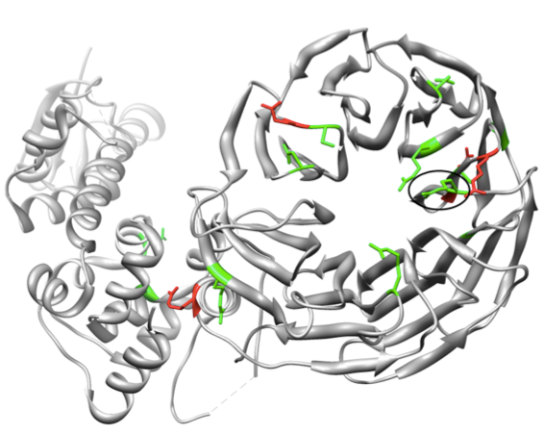
Methods to Gauge Mutation Impact
Most
frequent
Nonsense
Frameshift
FBXW7 mutations in colorectal cancer cluster in 3D space in beta propeller affecting its ability to ubiquinylate
Sander Group, MSKCC, TCGA Consortium

Slide 10
Predicting Drivers with a Combination of Frequency and Sequence Analysis
Predicted
Driving
Genes
Predicted functional impact can be accumulated across samples
Sensitive: Find more rare mutations w/ higher impact
Specific: Weed out frequent, spurious mutations (e.g. TITAN)
Illustration from Nuria Bigas-Lopez, UPF

Slide 11
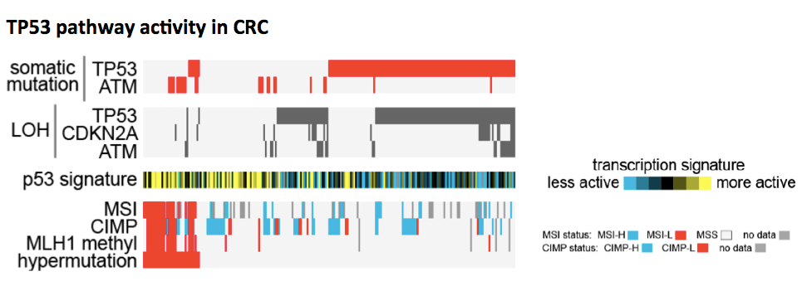
Gene Signatures of Mutations Shed Light on Impact
Gain of function events in TP53?
Gene expression signatures can predict presence/absence of mutations
Training predictors difficult if gene can have both GOF and LOF events
Chad Creighton, BCM

Slide 12
Are Pathway the Mutable Unit?
Genes in common pathway show Mutually Exclusive patterns
MEMo (Ciriello et al, MSKCC, 2011)
Mutations are clustered in protein-protein networks
HotNet (Vandin and Raphael, Brown, 2011)
Don’t think in terms of single genes in isolation…
X
Predicted
Driving
Genes
X
Illustration from Nuria Bigas-Lopez, UPF

Slide 13
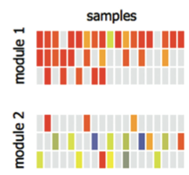
Pathway as the Mutable Unit
Genes in common pathway show Mut Ex patterns
MEMo (Ciriello et al, MSKCC, 2011)
Mutations are clustered in protein-protein networks
HotNet (Vandin and Raphael, Brown, 2011)
Pathways may reveal
significant patterns of
disruption
(Previous Talk!)
Illustration from Nuria Bigas-Lopez, UPF

Slide 14
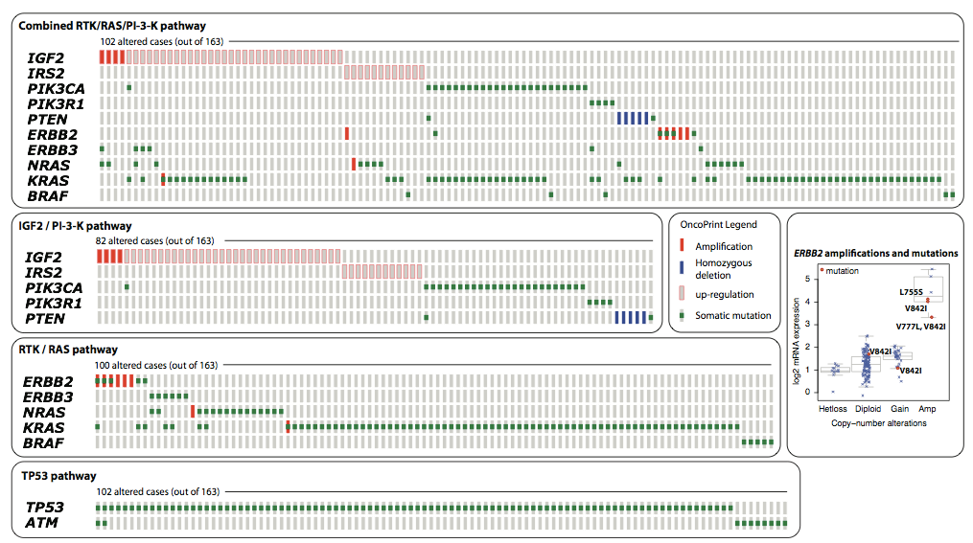
Mutual Exclusion among genes in key pathways in TCGA datasets
TCGA Colorectal MEMo result:
Giovanni Ciriello, MSKCC

Slide 15
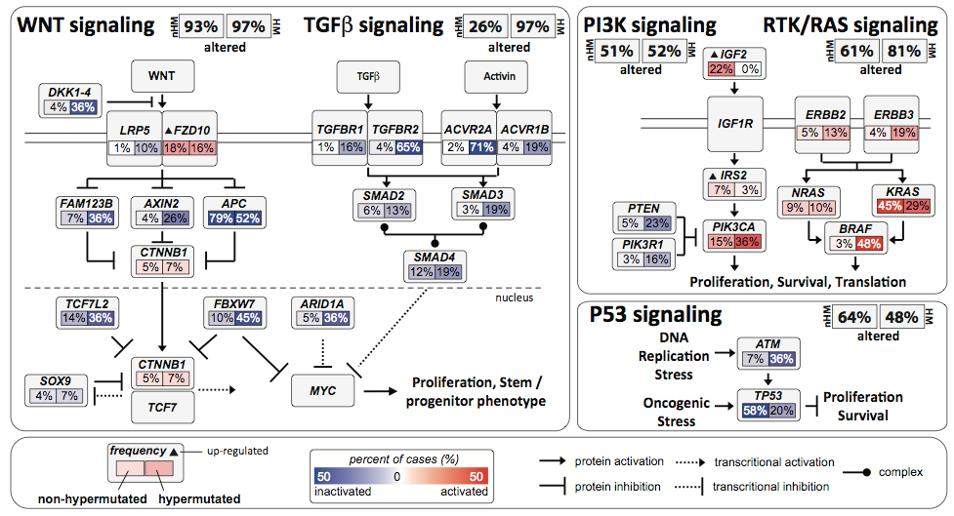
Mutual Exclusion among genes in key pathways in TCGA datasets
TCGA Colorectal Set:
Giovanni Ciriello, MSKCC

Slide 16
Overview of pathway-guided approach
Integrate many data sources to gain accurate view of how genes are functioning in pathways
Predict the functional consequences of mutations by quantifying the effect on the surrounding pathway

Slide 17
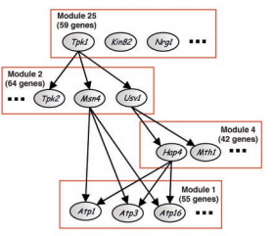
Probabilistic Graphical Models: A Language for Integrative Genomics
Nir Friedman, Science (2004) - Review
Generalize HMMs, Kalman Filters, Regression, Boolean Nets, etc.
Language of probability ties together multiple aspects of gene function & regulation
Enable data-driven discovery of biological mechanisms
Foundation: J. Pearl, D. Heckerman, E. Horvitz, G. Cooper, R. Schacter, D. Koller, N. Friedman, M. Jordan, …
Bioinformatics: D. Pe’er, A. Hartemink, E. Segal, E Schadt…

Slide 18
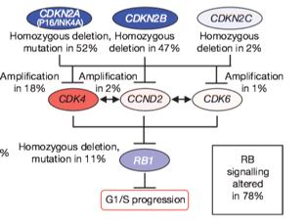
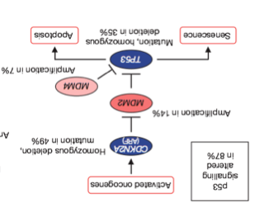
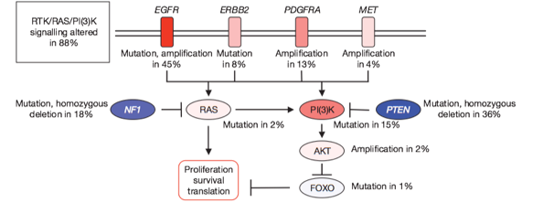
Integration Approach: Detailed models of gene expression and interaction
MDM2
TP53
Notes:
Encode mechanistic cause-event
Intuitive and suggestive of further experimentation
Data provide quantification to (someday) simulate

Slide 19
Integration Approach: Detailed models of expression and interaction
Two Parts:
MDM2
Gene Level Model
(central dogma)
2. Interaction Model
(regulation)
TP53
Notes:
Encode mechanistic cause-event
Intuitive and suggestive of further experimentation
Data provide quantification to (someday) simulate

Slide 20
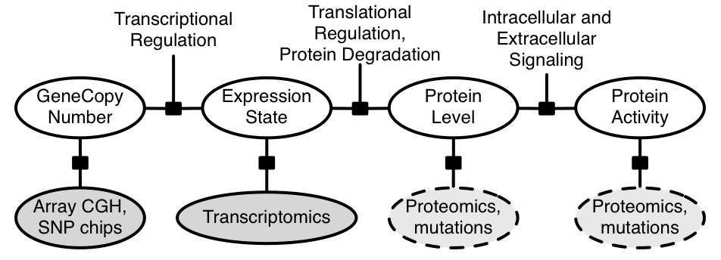
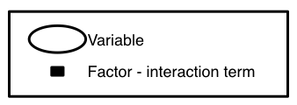
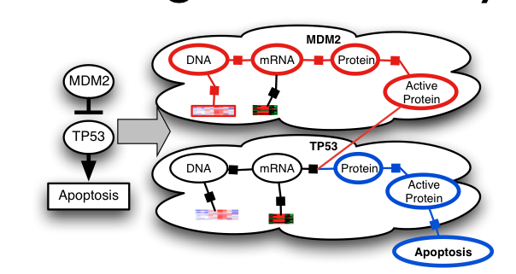
PARDIGM Gene Model to Integrate Data
1. Central Dogma-Like
Gene Model of Activity
2. Interactions that
connect to specific points
in gene regulation map
Charlie Vaske
Steve Benz
Vaske et al. 2010. Bioinformatics

Slide 21
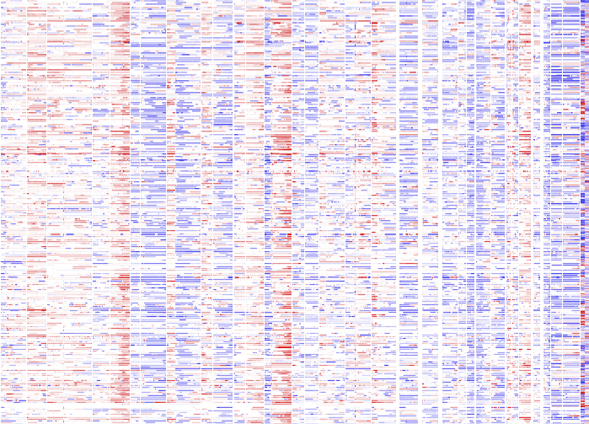
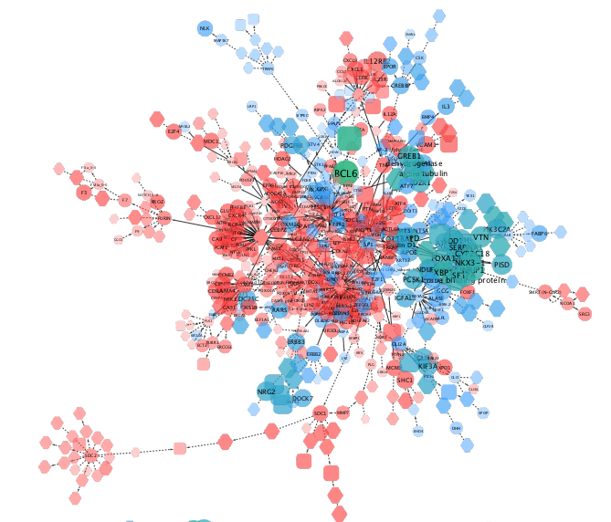
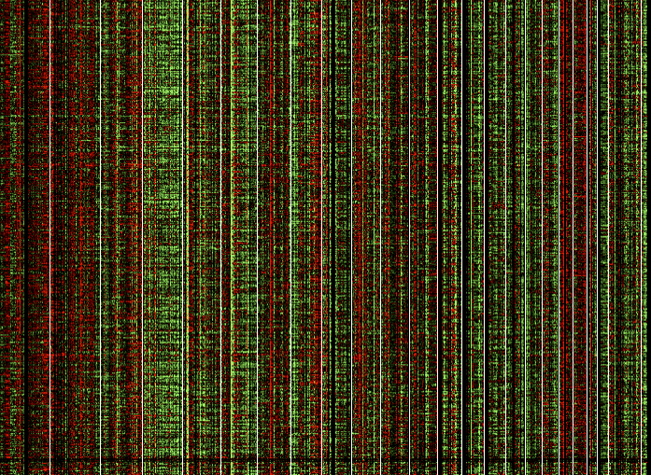
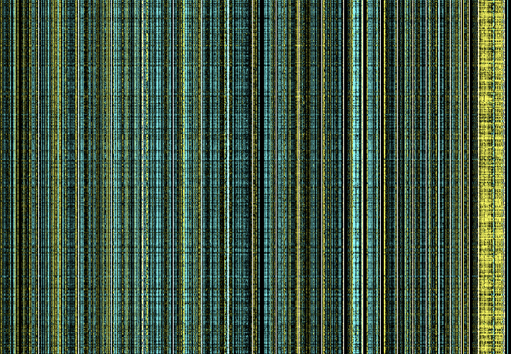
Integrated Pathway Analysis for Cancer
Inferred activities reflect neighborhood of influence around a gene.
Can boost signal for survival analysis and mutation impact
Multimodal Data
Inferred Activities of Genes
In Pathway Context
Cohort
CNV
mRNA
meth
…
Notes:
Pathway Inference in the Middle
Arrows pointing out to different uses:
differential marker ID for subtypes
cross-cancer analysis
assess mutations
simulate to infer drug targets

Slide 22
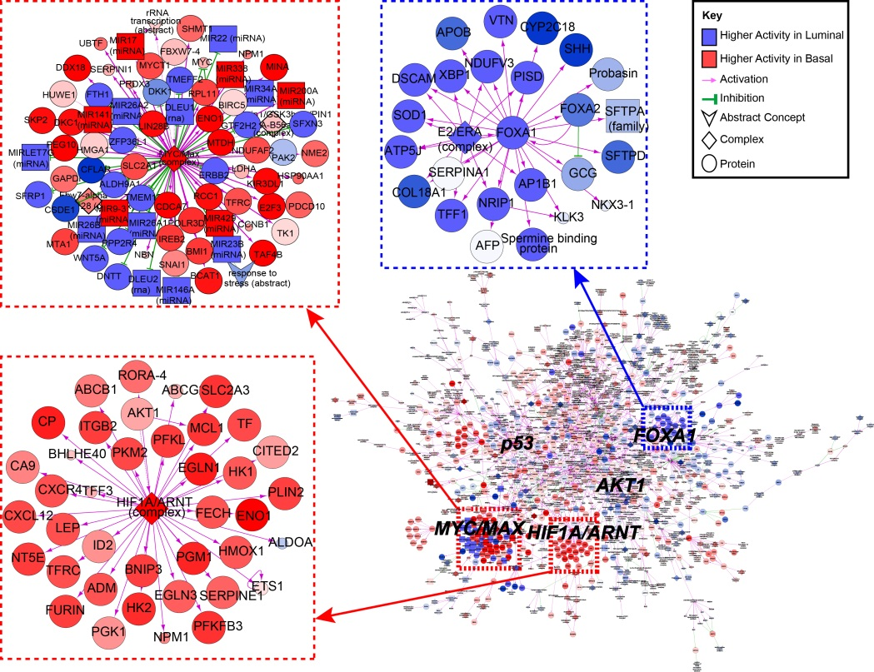
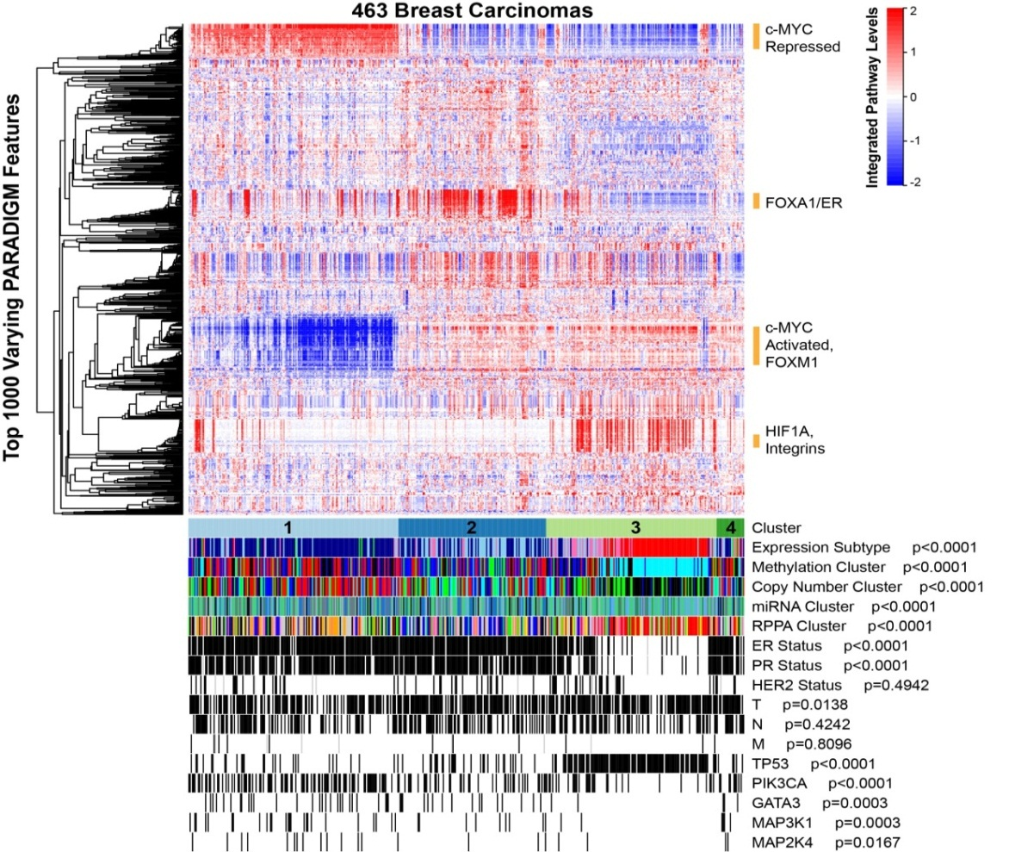
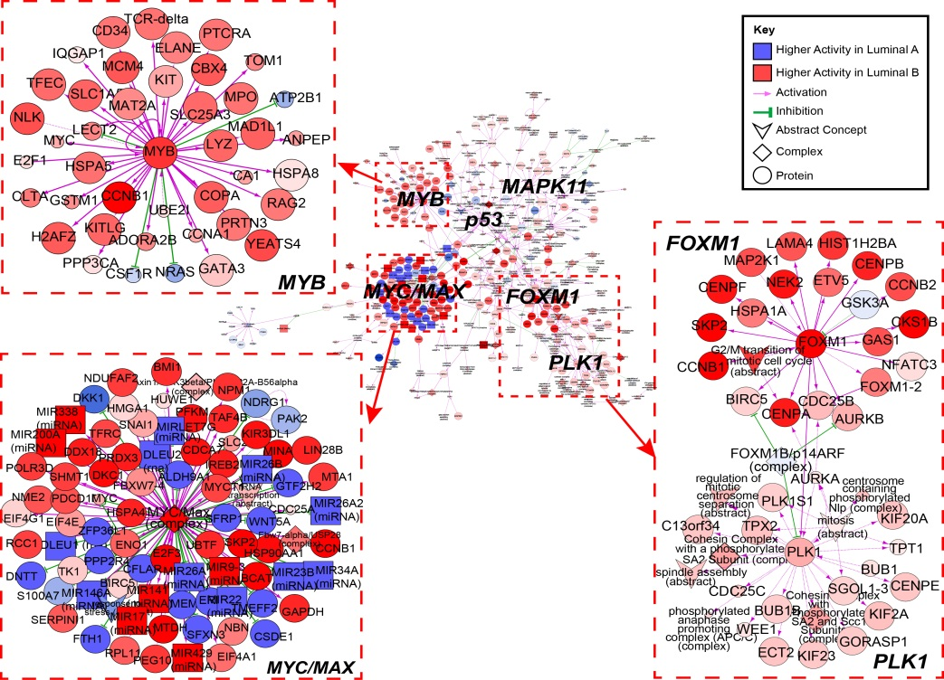
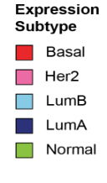
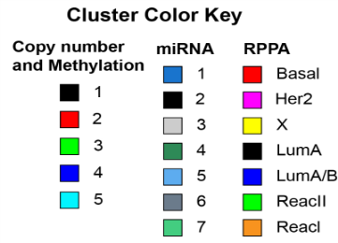
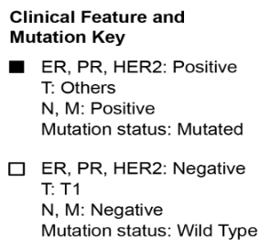
Perou & TCGA. Nature 2012.

Slide 23
How do you know its working?
It does what it should.

Slide 24
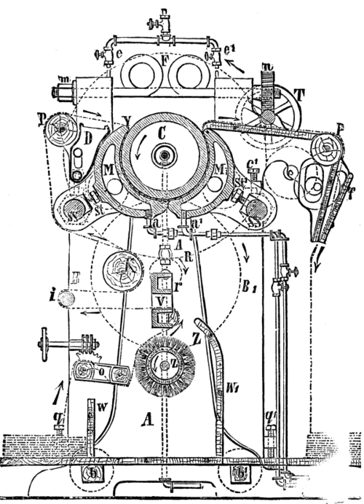
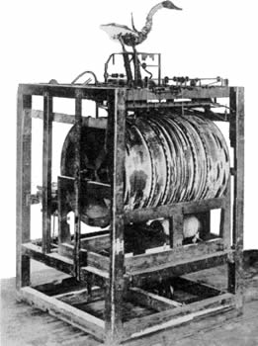
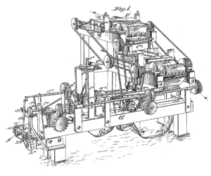
Machines
A
B
C
Notes:
Continuous cloth-pressing machine
Digesting duck, 1739. Automated digestion by Vaucanson.
Bonsack cigarette-rolling machine, 1880

Slide 25
PARADIGM-Shift Predicting the Impact of Mutations On Genetic Pathways
High Inferred Activity
Inference using downstream neighbors
Inference using upstream neighbors
Inference using all neighbors
mutated
gene
FG
FG
SHIFT
FG
Low Inferred Activity
Sam Ng, ECCB 2012

Slide 26
PARADIGM-Shift Overview
FG
Sam Ng, ECCB 2012

Slide 27
PARADIGM-Shift Overview
1.
Identify Local
Neighbor-
hood
FG
FG
Sam Ng, ECCB 2012

Slide 28
PARADIGM-Shift Overview
2a. Regulators
Run
1.
Identify Local
Neighbor-
hood
FG
FG
FG
2b. Targets
Run
FG
Sam Ng, ECCB 2012

Slide 29
PARADIGM-Shift Overview
2a. Regulators
Run
1.
Identify Local
Neighbor-
hood
FG
3. Calculate
Difference
-
P-Shift Score
FG
FG
FG
FG
2b. Targets
Run
FG
FG
(LOF)
Sam Ng, ECCB 2012

Slide 30
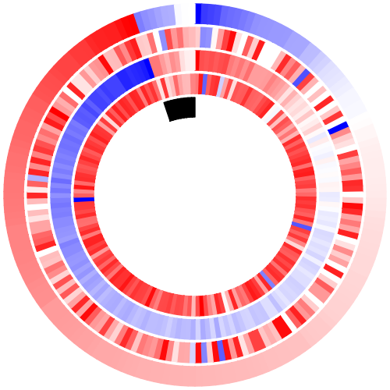
RB1 Loss-of-Function (GBM)
RB1 Mutation
RB1

Slide 31
RB1 Loss-of-Function (GBM)
Expression
RB1 Mutation
RB1

Slide 32
RB1 Loss-of-Function (GBM)
Inferred Upstream
Expression
RB1 Mutation
RB1

Slide 33
RB1 Loss-of-Function (GBM)
Inferred Downstream
Inferred Upstream
Expression
RB1 Mutation
RB1

Slide 34
RB1 Loss-of-Function (GBM)
Shift Score
Inferred Downstream
Inferred Upstream
Expression
RB1 Mutation
RB1

Slide 35
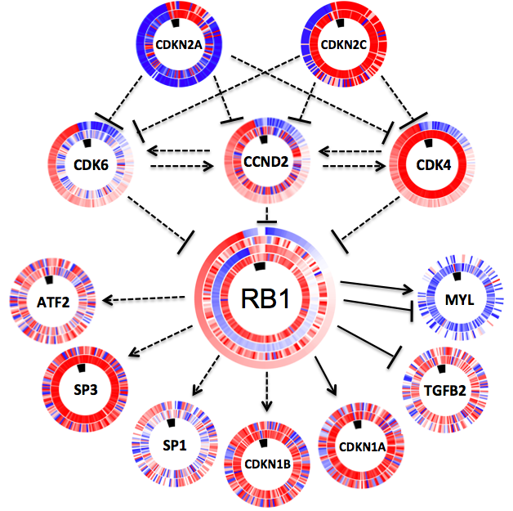
RB1 Loss-of-Function (GBM)
Upstream and Downstream Genes
PARADIGM
Expression
Mutation Status of focus gene (RB1)

Slide 36
RB1 Loss-of-Function (GBM)
High Activator Activity
Upstream and Downstream Genes
PARADIGM
Expression
Mutation Status of focus gene (RB1)

Slide 37
RB1 Loss-of-Function (GBM)
Low Inhibitor Activity
Upstream and Downstream Genes
PARADIGM
Expression
Mutation Status of focus gene (RB1)

Slide 38
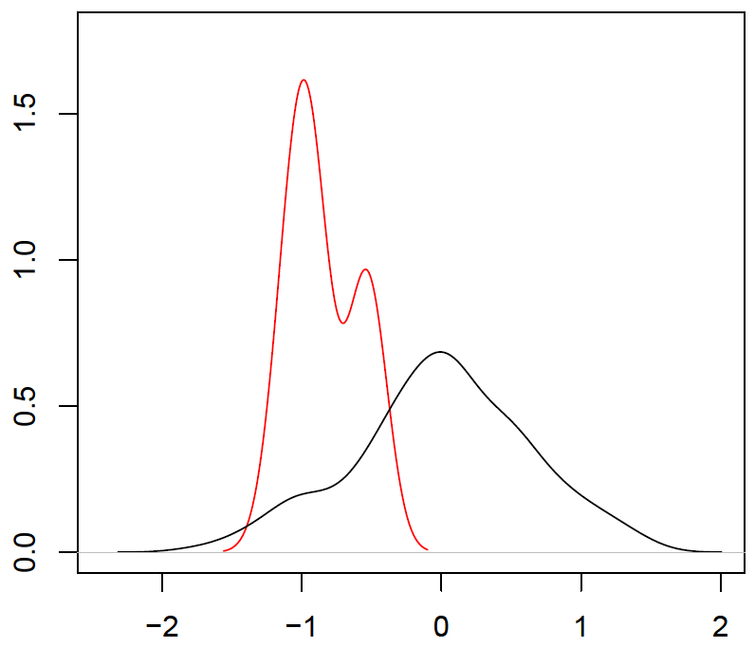
Shift Scores differ in mutated versus non-mutated samples
Mutant Separation (t-statistic) = –5.80
Shift Score

Slide 39
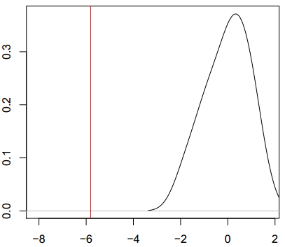
Significance Analysis
Given the same network topology, how likely would we call a gain/loss of function
Background model: permute gene labels in our dataset
Compare observed versus background mutant separation scores (M-sep)
Observed
Background
M-separation

Slide 40
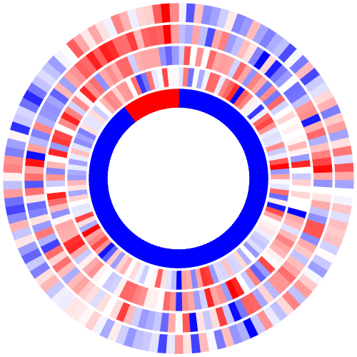
Gain-of-Function (LUSC)
P-Shift Score
PARADIGM downstream
PARADIGM upstream
Expression
Mutation
NFE2L2
Sam Ng

Slide 41
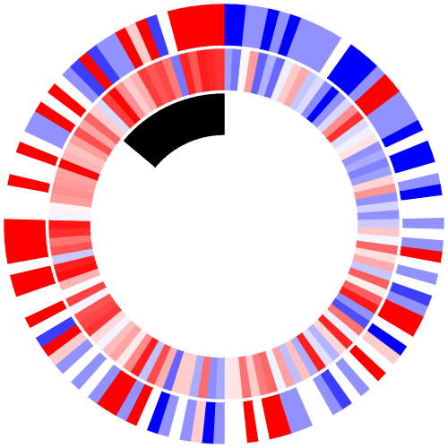
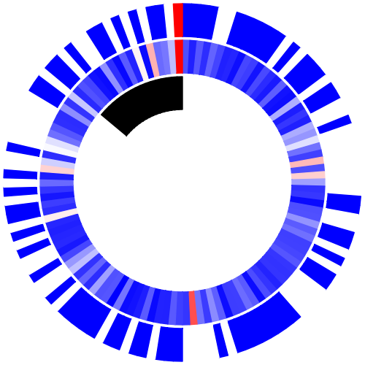
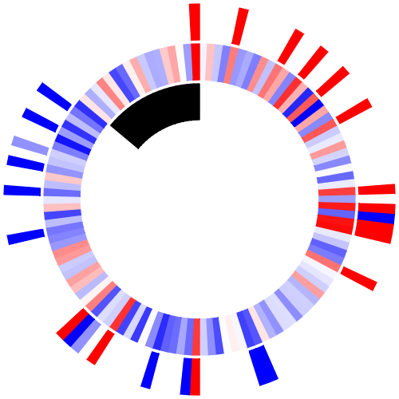
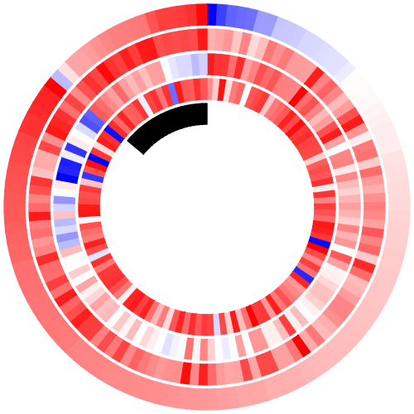
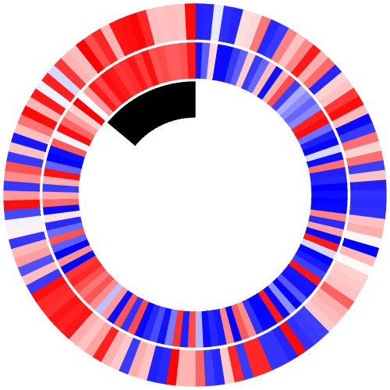
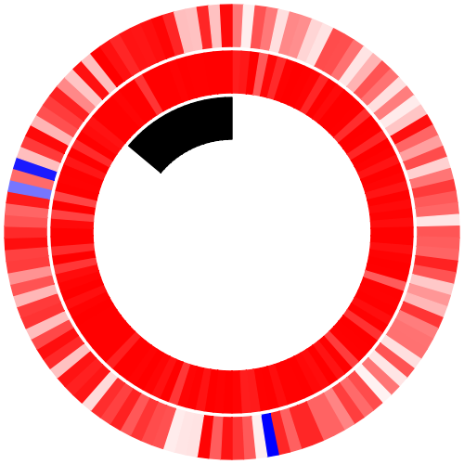
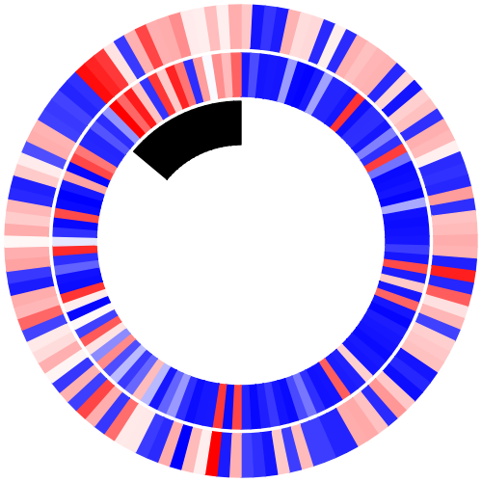
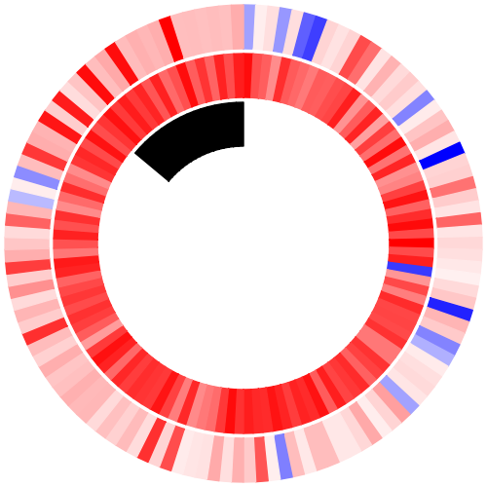
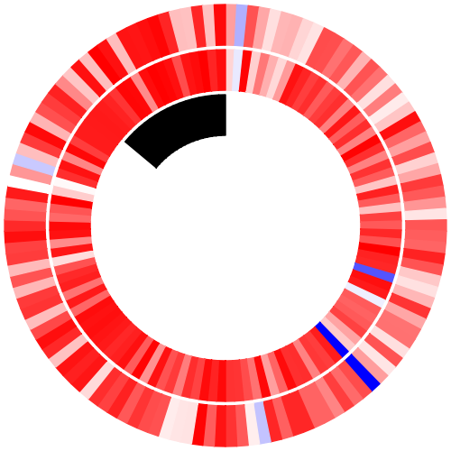
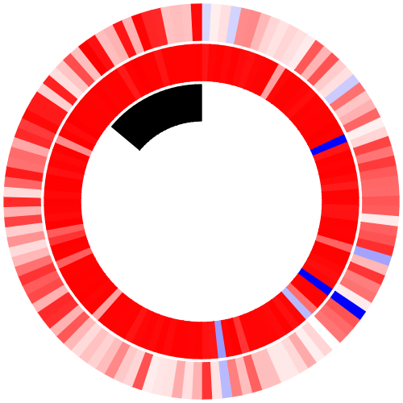
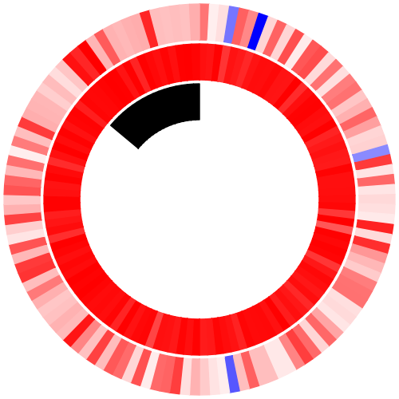
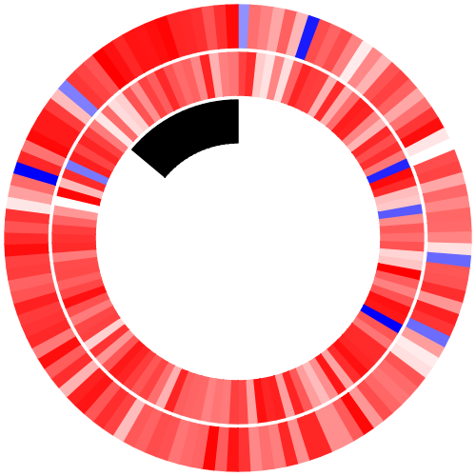
NFE2L2 Gain-of-Function (LUSC)
Upstream and Downstream Genes
PARADIGM
KEAP1
Expression
High Target
Activity
CUL3
EIF2AK3
Mutation Status of focus gene (NFE2L2)
NQO1
NFE2L2
GSTA2
GCLM
GPX3
GCLC
UGT1A6
GSTM3
POR

Slide 42
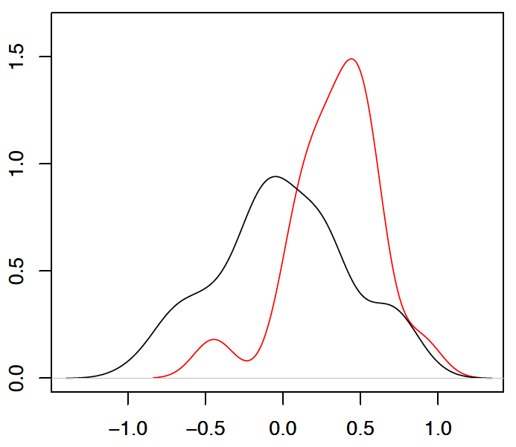
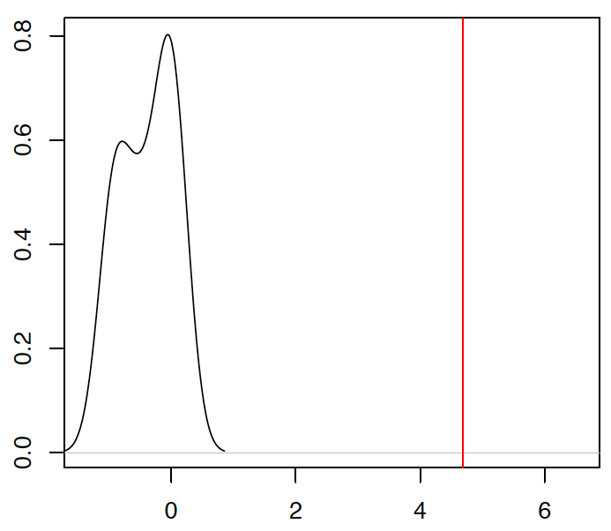
NFE2L2 Mutant Separation and Significance
M-separation (t-stat) = 4.69
Probability Density
Background
Observed
Shift Score
M-Separation

Slide 43
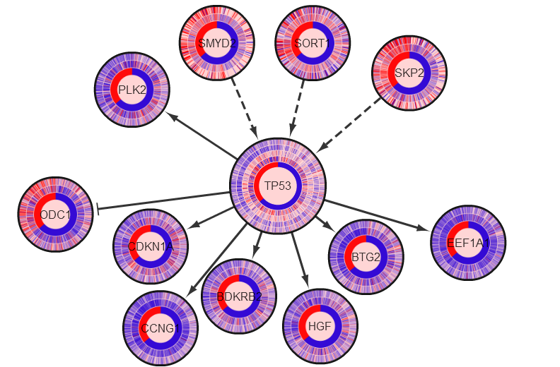
TP53 Network
Sam Ng

Slide 44
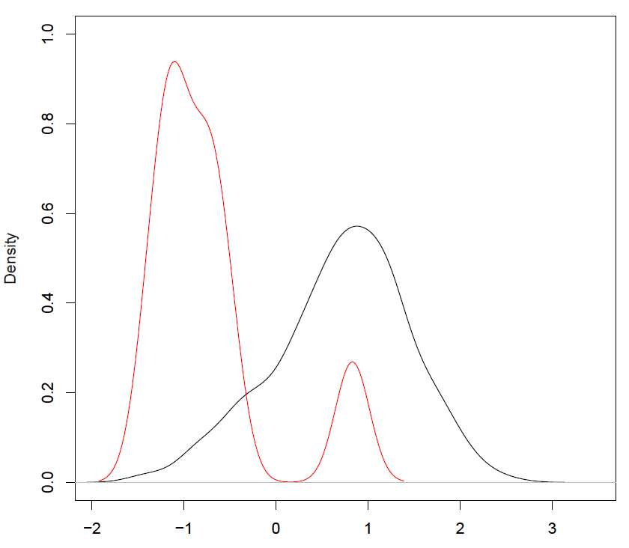
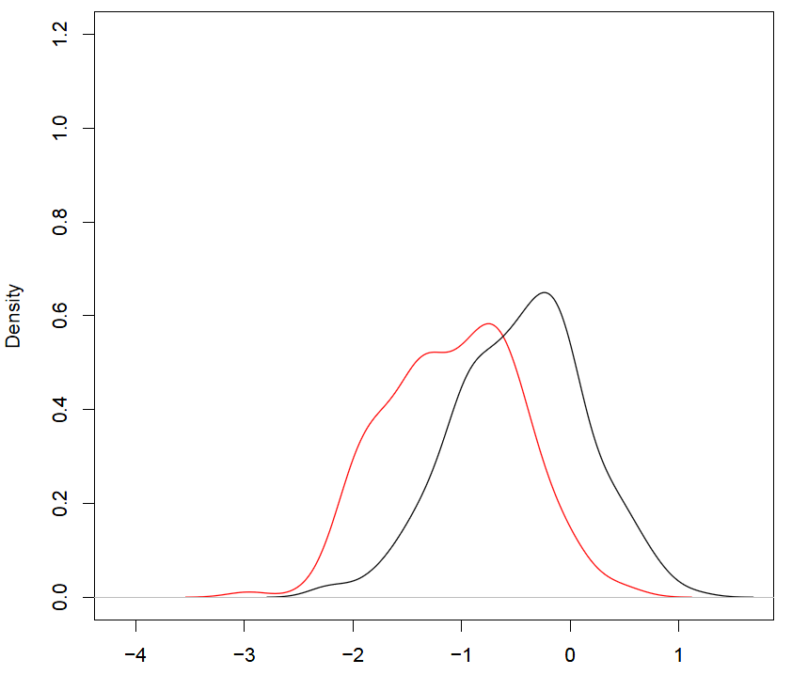
Discrepancy scores are sensitive
RB1
TP53
NFE2L2
Signal Score (t-statistic) = -5.78
Signal Score (t-statistic) = -10.94
Signal Score (t-statistic) = 4.985
Observed SS
Background SS
Sam Ng
Discrepancy Score
Discrepancy Score

Slide 45
Specificity on “passenger” mutations
Is the discrepancy specific?
Negative control: calculate scores for “passenger” mutations
Passengers:
insignificant by MutSig (p > 0.10)
well-represented in our pathways
Discrepancy of these “neutral” mutations should be close to what’s expected by chance (from permuted)
Sam Ng

Slide 46
Passenger Mutations not Shifted
Ran PARADIGM-SHIFT on COADREAD mutations with MutSig q-value > 0.5
Six genes had enough pathway annotations to perform the analysis and were not significant
Shift Score
Inferred Downstream
Inferred Upstream
Expression
PRKDC Mutation
PRKDC (q-value = 1.0)
Background
Observed
M-Separation
Notes:
In order to show specificity, I ran my discrepancy analysis on a set of potential passenger mutations found by MutSig. In this case, I ran on COADREAD mutations with p-value > 0.5 of which there were 4 genes with enough pathway annotations to perform the analysis. Shown here is PRKDC which does not show a significant discrepancy from mutant versus non-mutant.

Slide 47
Passenger Mutations not significantly Shifted
Sam Ng

Slide 48
PARADIGM-Shift gives orthogonal view of the importance of mutations (LUSC)
HIF3A (n=7)
TBC1D4 (n=9) (AKT signaling)
NFE2L2 (29)
MAP2K6 (n=5)
Pathway Discrepancy
LUSC
MET (n=7) (gefitinib resistance)
GLI2 (n=10) (SHH signaling)
CDKN2A (n=30)
AR (n=8)
EIF4G1 (n=20)
Enables probing into infrequent events
Can detect non-coding mutation impact (pseudo FPs)
Can detect presence of pathway compensation for those seemingly functional mutations (pseudo FPs)
Extend beyond mutations
Limited to genes w/ pathway representation
Sam Ng
Notes:
GBM results:
PDGFR predicted as GOF. Exon 8/9 deletion shown to be oncogenic.

Slide 49
Neighborhood Selection
Informative neighboring genes for classifying mutation status should also be informative for calling functional impact
Include neighboring genes upstream and downstream based on:
Unsupervised: variance
Supervised: Fischer’s, t-test, SVM weights

Slide 50
Neighboring Genes are Informative for Classifying Mutation Status
RB1 (GBM)
TP53 (GBM)
NFE2L2 (LUSC)
AUC
SVM-nbrs
SVM-nbrs
SVM-full
SVM-nbrs
SVM-full
SVM-full

Slide 51
Two Themes
1) Predict Drivers
2) Predict Essential

Slide 52
PATHMARK: Identify Pathway-based “markers” that underlie sub-types
Identify sub-pathways that distinguish patients sub-types (e.g. mutant vs. non-mutant, response to drug, etc)
Predict mutation impact on pathway “neighborhood”
Identify master control points for drug targeting.
Predict outcomes with quantitative simulations.
Insight from contrast
Sam Ng
Ted Goldstein

Slide 53
PathMark: Differential Subnetworks from a “SuperPathway”
Pathway Activities
Pathway Activities
Ted Goldstein
Sam Ng
Notes:
Pathway Inference in the Middle
Arrows pointing out to different uses:
differential marker ID for subtypes
cross-cancer analysis
assess mutations
simulate to infer drug targets

Slide 54
PathMark: Differential Subnetworks from a “SuperPathway”
SuperPathway Activities
SuperPathway Activities
Pathway
Signature
Ted Goldstein
Sam Ng
Notes:
Pathway Inference in the Middle
Arrows pointing out to different uses:
differential marker ID for subtypes
cross-cancer analysis
assess mutations
simulate to infer drug targets

Slide 55
Triple Negative Breast Pathway Markers Identified from 50 Cell Lines
One large highly-connected
component (size and connectivity
significant according to permutation
analysis)
980 pathway concepts
1048 interactions
Characterized by
several “hubs’
IL23/JAK2/TYK2
P53
tetramer
ER
HIF1A/ARNT
FOXA1
Myc/Max
Higher activity in ER-
Lower activity in ER-
Sam Ng, Ted Goldstein

Slide 56
Identify master controllers using SPIA (signaling pathway impact analysis)
Google PageRank for Networks
Determines affect of a given pathway on each node
Calculates perturbation factor for each node in the network
Takes into account regulatory logic of interactions.
Impact
factor:
Google’s PageRank-Like
Yulia Newton (NetBio SIG Poster)

Slide 57
Slight Trick: Run SPIA in reverse
Reverse edges in Super Pathway
High scoring genes now those at the “top” of the pathway
PageRank finds
highly referenced
Reverse to find
Highly referencing
Yulia Newton

Slide 58
Master Controller Analysis on Breast Cell Lines
Basal
Luminal
Yulia Newton

Slide 59
Master regulators predict response to drugs: PLK3 predicted as a target for basal breast
DNA damage network is upregulated in basal breast cancers
Basal breast cancers are sensitive to PLK inhibitors
GSK-PLKi
Claudin-low
Ng, Goldstein
Basal
Luminal
Up
Down
Heiser et al. 2011 PNAS

Slide 60
HDAC inhibitors predicted for luminal breast
HDAC Network is down-regulated in basal breast cancer cell lines
Basal/CL breast cancers are resistant to HDAC inhibitors
HDAC inhibitor
VORINOSTAT
Heiser et al. 2011 PNAS
Ng, Goldstein

Slide 61
Summary
Modeling information flow on known pathways gives view of gene activity.
Loss- and gain-of-function predicted from pathway neighbors for even rare mutations.
“Master regulators” can be found with methods like Google PageRank.
Interlinking genes connect genomic perturbations to observed transcriptional changes.
What ultimately are good targets?!
Other ideas to reveal essential genes in cancer?

Slide 62
UCSC Integrative Genomics Group
Marcos Woehrmann
Sam Ng
Dan Carlin
Evan Paull
Ted Golstein
James Durbin
Artem Sokolov
Yulia Newton
Chris Szeto
Chris Wong

Slide 63
Acknowledgments
David Haussler
Chris Benz,
Buck Institute for Aging
Christina Yau
Sean Mooney
Janita Thusberg
Collaborators
Joe Gray, LBL
Laura Heiser, LBL
Eric Collisson, UCSF
Nuria Lopez-Bigas, UPF
Abel Gonzalez, UPF
Funding Agencies
NCI/NIH
SU2C
NHGRI
AACR
UCSF Comprehensive Cancer Center
QB3
Jing Zhu
UCSC Cancer Genomics
Kyle Ellrott
Brian Craft
Chris Wilks
Amie Radenbaugh
Mia Grifford
Sofie Salama
Steve Benz
UCSC Genome Browser Staff
Mark Diekins
Melissa Cline
Jorge Garcia
Erich Weiler
Broad Institute
Gaddy Getz
Mike Noble
Daniel DeCara

Slide 64
UCSC Cancer Browser
genome-cancer.ucsc.edu
Jing Zhu

