Slide 1
QuestBrowser Making Quests Playable with Computer-Assisted Design
Anne Sullivan, Michael Mateas, Noah Wardrip-Fruin
anne@soe.ucsc.edu
http://users.soe.ucsc.edu/~anne/
13 December 2009

Slide 2
Scenario 1
Two bandits approach, murderous intent in their eyes.
Notes:
I’m playing an RPG, walking down the road minding my own business. When suddenly…

Slide 3
Scenario 1
Two bandits approach, murderous intent in their eyes.
Blizzard, World of Warcraft, 2004
Notes:
Let’s say I’m a spellcaster. The very elements are available to do my bidding. Perhaps I rain fire upon their heads, and laugh as they try to run from their certain demise.

Slide 4
Scenario 1
Two bandits approach, murderous intent in their eyes.
Blizzard, World of Warcraft, 2004
Notes:
Or perhaps I bind them in ice, and kill them one at a time, as they are unable to move against me.

Slide 5
Scenario 1
Two bandits approach, murderous intent in their eyes.
BioWare, Dragon Age: Origins, 2009
Notes:
This time, I’m a stealth class. I could vanish and garrote one silently while the other is still looking for me. Or perhaps I ignore them altogether and silently loot their hoard and go on my merry way.

Slide 6
Agency
The player actions available are supported by the dramatic probabilities of the situation.
- Wardrip-Fruin, et. al.
Notes:
RPG players have notions of what a spellcaster can do and what a stealth class can do. Base knowledge comes from literary sources (Tolkien, for example) or other RPGs the player may have encountered, and is strengthened or updated by the current game. The actions available to a player need to draw from and support the mental model the players have.
Now let’s look at a second scenario.

Slide 7
Scenario 2
The nightsaber population has grown too large.
Blizzard, World of Warcraft, 2004
Notes:
New scenario. I have been told that the nightsaber population has grown too large to be supported by the current food supplies, and am asked to deal with it.

Slide 8
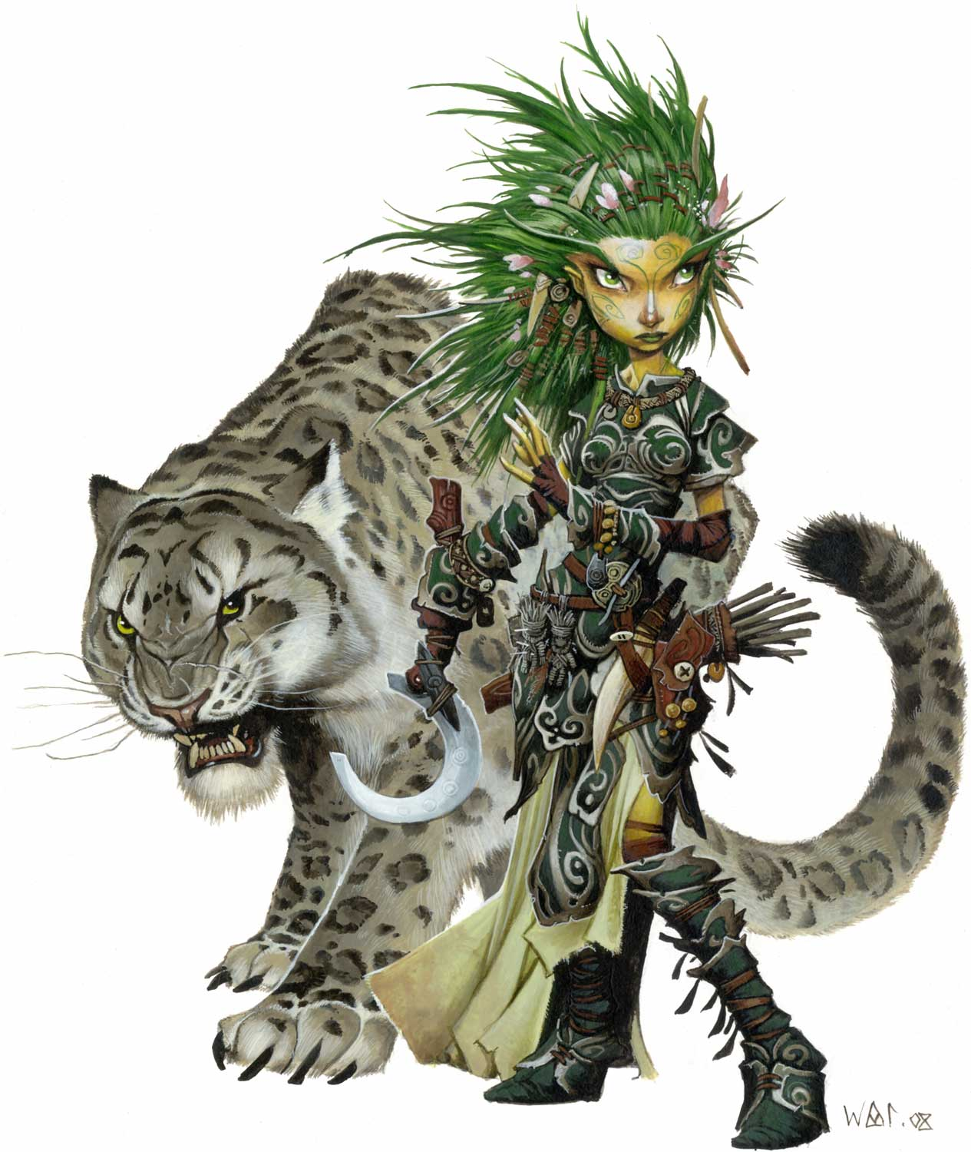
Scenario 2
The nightsaber population has grown too large.
Paizo Publishing, Pathfinder Roleplaying Game, 2008
Notes:
I’m playing a druid. I’m friends with animals, perhaps I can talk to the nightsaber elders and warn them that the food supplies are too small for their current group, and that some of them should move elsewhere.

Slide 9
Scenario 2
The nightsaber population has grown too large.
Paizo Publishing, Pathfinder Roleplaying Game, 2008
Notes:
Or I’m playing a priest. I have been given divine powers to heal. Maybe I can heal the land to produce more food, or call for divine intervention to keep the nightsabers from over producing in the future. (The fantasy version of a spay/neuter program)

Slide 10
Scenario 2
The nightsaber population has grown too large.
Blizzard, World of Warcraft, 2004.
Notes:
In actuality, I have one option. Kill seven nightsabers and return to the NPC when I am done to receive my next quest. If I’m a mage, a priest, a rogue, a warrior, a druid, it does not matter. This is my only option.

Slide 11
Quest Agency
Quests lack the player actions to match the dramatic probabilities of the situation.
Notes:
Lots of ideas of what I should be able to do based on my class/race, but these are not supported. Quests generally have one or two methods for completion, and quite frequently err on the side of combat, since this is where there is the most depth in the available player actions.

Slide 12
Computer Role-Playing Games
The main mechanic for choice is through combat.
Meanwhile, narrative is on a fixed trajectory.
Localized choices
Linear story
Localized choices
Linear story
Localized choices
Notes:
This is a common problem in most Computer Role-Playing Games (RPGs)
Narrative is confined to local, shallow effects to the game world.
Or in the case of multiple endings, one choice has too big of an impact (see: Dragon Age, as an elf, can’t stay in a relationship with Alistair if he becomes king. Not informed choice.)
To drive home the linear nature of the story, many times this linear story is presented in the form of a cut scene, no interactivity at all.

Slide 13
Quests
Players move through narrative in the form of quests.
Notes:
Quests are the mechanic used to guide (or in some cases, dictate) how players move through the story. It is the source of interaction between the player and the story.

Slide 14
Quests
A quest is “a goal-oriented
search for something of
value.”
-Jeff Howard
Edwin Austin Abbey, 1895. Sir Galahad finds the Holy Grail
Notes:
As seen in the picture, the quest for the holy grail.

Slide 15
Quests
A quest is a story-coated task
built around game mechanics.
Blizzard, World of Warcraft, 2004
Notes:
Marshal McBride tells you to kill 7 kobolds. There are no holy grails here!

Slide 16
Tasks vs. Goals
Task-based quests tell the player explicitly what to do.
Goal-based quests guide the player.
Blizzard, World of Warcraft, 2004
Notes:
This difference can be broken into two categories, task-based and goal-based quests.Task-based quests: Railroading within a quest. Player is being told what to do, it feels like a chore. Go clean the dishes. Go kill 5 orcs.
Goal-based quests: Room for creativity My research is focused on supporting goal-based quest structures.
The picture is of a quest that requires you to torture someone. A number of players were very upset by this.

Slide 17
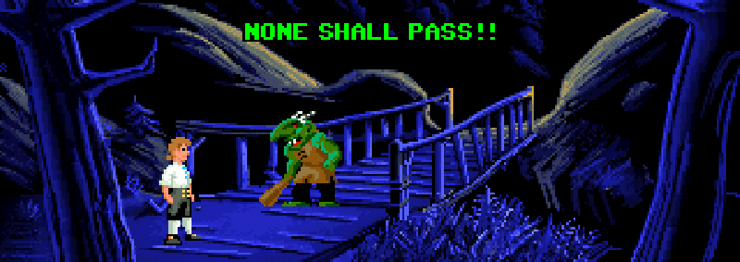
Goal-based quests
Finding the solution the designer had in mind should not be the mystery the player is solving.
- Jeffrey Kaplan
"I want something that will attract attention but have no real importance.“ Lucasfilm Games, Secret of Monkey Island, 1990.
Notes:
Some people may say that we have had goal-based quests in the past, and they did not do well. This was in the form of Adventure games. Jeffrey Kaplan, lead designer at World of Warcraft, pointed out one of the problems with early adventure games. Another way to look at this is that Early adventure games presented quests as goal-based interactions, but in fact were task-based mandates where they didn’t tell you the rules. This led to frustration.

Slide 18
Goal-based quests
Multiple solutions allows for player creativity and lack of frustration.
Player creativity offers the ability to shape their own narrative based on choice.
Notes:
Giving players choices allows for greater agency within the quest structure. By giving them options, they are no longer following a preset narrative. Instead it allows them to engage in the narrative in a similar way as is currently available in combat.

Slide 19
Quest choice
Quests have the ability to contain interesting and meaningful choices.
Notes:
This is a riff from Sid Meier’s quote, Games are a series of interesting choices. Goal-based quests allow for interesting and meaningful choices

Slide 20
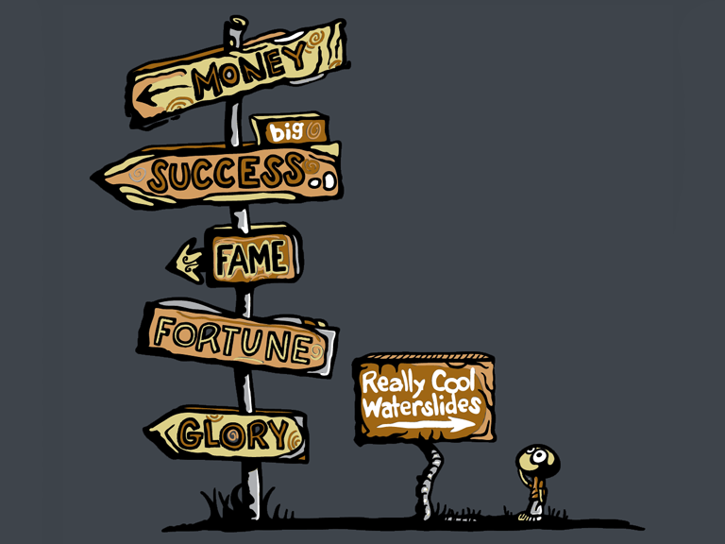
Interesting Choice
Interesting choice -
no clearly better option
options are not equally attractive
the player must be able to make an informed choice
- Rollings & Morris
shirt.woot.com. The Choice Was Not Hard, 2009
Notes:
Better option: mud vs chocolate
Attractive: white chocolate vs dark chocolate
Informed: brown thing or brown thing

Slide 21
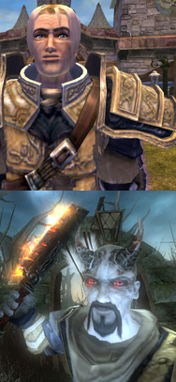
Meaningful Choice
Meaningful choice -
discernable, noticeable effect
integrated, significant impact
- Salen & Zimmerman
LionHead Studios, Fable II, 2008
Notes:
Fable II – choices changed the way you look, the way the world looks, and the way people interact with you. In order to have meaningful choices within quests means that the player should have an impact on the storyline.

Slide 22
Authorial burden
Creating quests with multiple solutions for multiple storylines requires an explosion of authoring.
Notes:
Left graph, similar to Dragon Age, where there are sometimes Interesting Choices, but no meaningful choices. (no effect further down the graph) Right graph shows meaningful and interesting choices. Author explosion.

Slide 23
The Grail Framework
The Grail Framework is a large project created to address this explosion.

Slide 24
QuestBrowser
QuestBrowser focuses on the top level of this issue.
Notes:
For the rest of this talk I will only be focusing on one part of the grail framework, the QuestBrowser brainstorming tool. It was created to help designers with the top level explosion of creating multiple ways to solve each quest.

Slide 25
QuestBrowser
Multiple solutions of non-standard quest types can be difficult for designers to invent.
Notes:
Not everyone attacks a challenge the same way. What might be obvious to me, may not be obvious to you.

Slide 26
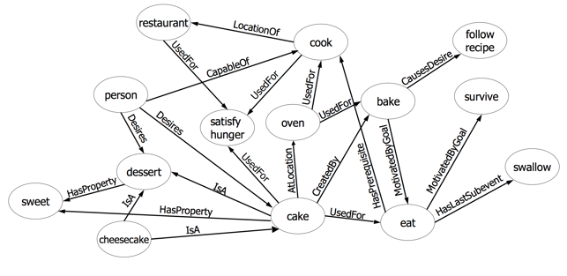
QuestBrowser
ConceptNet is a common-sense knowledgebase represented as a semantic network
crowdsourced corpus
Notes:
Using a common sense knowledgebase allows the designer to access a large network of ideas to create solutions to quests.
Highly pruned tree
For instance, oven has many more things associated with it, such as racks, heating elements, heat, and different foods.

Slide 27
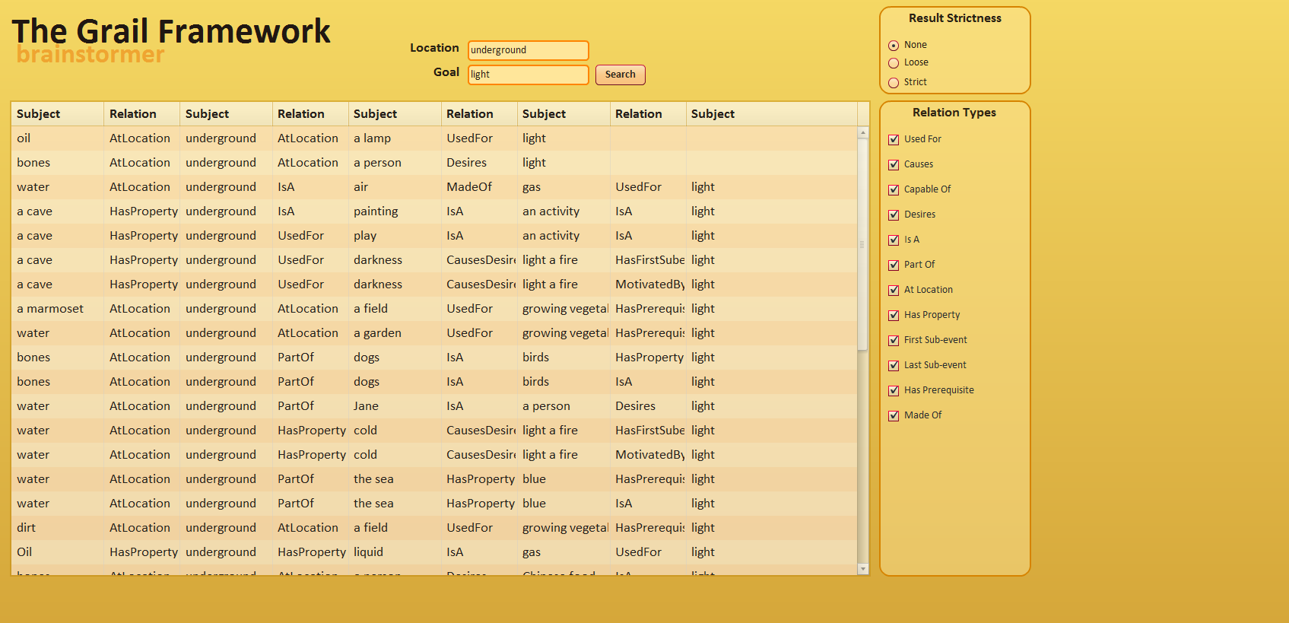
QuestBrowser
QuestBrowser brainstorming tool
Notes:
Harness ConceptNet to aid in coming up with ideas that might be “common sense” but don’t come immediately to mind. Give designers ways to prune the data to their needs.
Able to put in two concepts and find the paths between them, or put in one concept and see all concepts related to it down one step. I’ll show you an example of this next.

Slide 28
Example
Town: Forest Song
Problem:
Reason:
Solutions:
Notes:
Let’s go through an example. In our fantasy setting, there is a wooded town named “Forest Song.” At this point, the designer wishes to create a set of quests involving the town. To begin this process, the author would need to identify a problem within the town that needs solving. Entering Forest and Song into the QuestBrowser system

Slide 29
QuestBrowser
forest
bird
tree
squirrel
brook
fire
music
mammal
Lays eggs
water
noise
burn
wood
heat
voice
happiness
church
song
Notes:
Pruned for space.

Slide 30
QuestBrowser
forest
bird
tree
squirrel
brook
fire
music
mammal
Lays eggs
water
noise
burn
wood
heat
voice
happiness
church
song

Slide 31
QuestBrowser
forest
bird
tree
squirrel
brook
fire
music
mammal
Lays eggs
water
noise
burn
wood
heat
voice
happiness
church
song
Notes:
This result helps spark an idea for the designer, who then decides that the town of Forest Song was named for the sound of the birds in the forest, but the birds have now ceased singing. This is used as the initial background issue within Forest Song for the player to solve. Therefore, the quest within Forest Song is to find out why the birds have quit singing, and to find a way to make the birds sing again.

Slide 32
Example
Town: Forest Song
Problem: Birds aren’t singing
Reason:
Solutions:
Notes:
The next step for the designer is to identify possible solutions for the player. The first step is to find a solution to “Why are the birds not singing?” For this step, the designer may choose to only have one reason. Using the QuestBrowser system, the designer asks for the list of results for the input “Bird”. Looking through the results, the designer notices:

Slide 33
QuestBrowser
bird
fly
feathers
fear cats
flu
forest

Slide 34
QuestBrowser
bird
fly
feathers
fear cats
flu
forest

Slide 35
Example
Town: Forest Song
Problem: Birds aren’t singing
Reason: Wild cats are terrorizing the birds
Solutions:
Notes:
What are some types of quests to take care of the cats?

Slide 36
QuestBrowser
cat
milk
not be wet
catnip
curious
out of the bag

Slide 37
Example
Town: Forest Song
Problem: Birds aren’t singing
Reason: Wild cats are terrorizing the birds
Solutions: Kill the cats
Notes:
The first solution is to allow the player to simply kill the wild cats to rebalance the population. This is an appropriate solution for a fighting style of character that prefers combat. As stated above, this is the type of quest that would be most common in current RPGs.

Slide 38
QuestBrowser
cat
milk
not be wet
catnip
curious
out of the bag

Slide 39
Example
Town: Forest Song
Problem: Birds aren’t singing
Reason: Wild cats are terrorizing the birds
Solutions: Kill the cats
(Stealth) Create moats around nesting trees
Notes:
For characters that are stealth-based, a second solution uses the idea that cats do not like to be wet. The player is able to stealth past the cats to the area that the birds are nesting. Once there, the player can create moats around the nesting trees such that the cats will not cross. This allows the birds to return to their nesting grounds and the forest to be filled with bird song once again.

Slide 40
QuestBrowser
cat
milk
not be wet
catnip
curious
out of the bag

Slide 41
Example
Town: Forest Song
Problem: Birds aren’t singing
Reason: Wild cats are terrorizing the birds
Solutions: Kill the cats
(Stealth) Create moats around nesting trees
(Potion) Create catnip poultice to befriend cats
Notes:
Spell-casting characters are able to solve the quest using the knowledge that cats desire catnip. They can create a poultice using catnip which allows the villagers to befriend the cats. Once befriended, the town villagers can take care of their new feline friends, which will no longer hunt the birds as they will be properly fed.

Slide 42
QuestBrowser
cat
milk
not be wet
catnip
curious
out of the bag

Slide 43
Example
Town: Forest Song
Problem: Birds aren’t singing
Reason: Wild cats are terrorizing the birds
Solutions: Kill the cats
(Stealth) Create moats around nesting trees
(Potion) Create catnip poultice to befriend cats
Tempt cats in bags with milk - relocate
Notes:
Finally, the last solution is a bit tongue-in-cheek and uses the concept of “letting the cat out of the bag.” The player can use milk and cats‟ natural curiosity to tempt the cats into bags. Once bagged, the cats can be moved to a new location with plenty of mice for the cats to eat. This solution is one that any style of player can complete.

Slide 44
QuestBrowser
Designer is still a key part of the design process.
QuestBrowser is not domain specific.
Notes:
In this example, it is important to note that the designer is still a key part of the design process. QuestBrowser is a tool to help the designer think of possibilities that use common sense, but the designer is necessary in putting it all together. Additionally, QuestBrowser is not domain specific, so it is up to the designer to decide if or when quests should be class or player specific.
using this system allows the designer to see past their own quest preferences and routines, finding new and innovative solutions for each quest

Slide 45
Conclusion
Making quests playable requires giving the player interesting and meaningful choices that support the dramatic probabilities.
Notes:
Adding options keeps the player engaged as they are offered interesting choices at each quest, instead of the same single solution that is common in many modern-day CRPGs.
Important to make sure that options aren’t added blindly but instead are added to increase agency.

Slide 46
Conclusion
Making quests playable requires giving the player interesting and meaningful choices that support the dramatic probabilities.
QuestBrowser was created to aid the author in designing for these choices.
Notes:
To deal with the increase of authorial burden, we created QuestBrowsser, a brainstorming tool to help reduce this burden.

Slide 47
Thank You
Questions?
Anne Sullivan
anne@soe.ucsc.edu
http://soe.ucsc.edu/~anne/
Blizzard, World of Warcraft, 2004

